Slide 1
MetLife Social Selling Calendar
November - December 2023

Slide 2
Post 1 - My Life as an Agent
Caption:
One of the perks of being an insurance agent is witnessing the relief in the clients' eyes when they realize they're financially protected. Ready to explore your protection needs? Let’s discuss securing your future and your loved ones.
#MetLife #MetLifeLebanon #NavigatingLifeTogether #MyLifeAsAnAgent #FinancialGuidance
Facebook, LinkedIn.

Slide 3
Post 2 - Movember -
Caption:
November is known as 'Movember’, highlighting the significance of men's health through early testing, screenings, and regular check-ups, as an important measure to protect men from potential health issues, including testicular cancer, prostate cancer, depression, and physical inactivity.
Remember to prioritize both your well-being and that of the men in your life. Early detection saves lives.
#Movember #MensHealth #MentalHealth #Cancer #ProstateCancer #TesticularCancer
Facebook, LinkedIn.

Slide 4
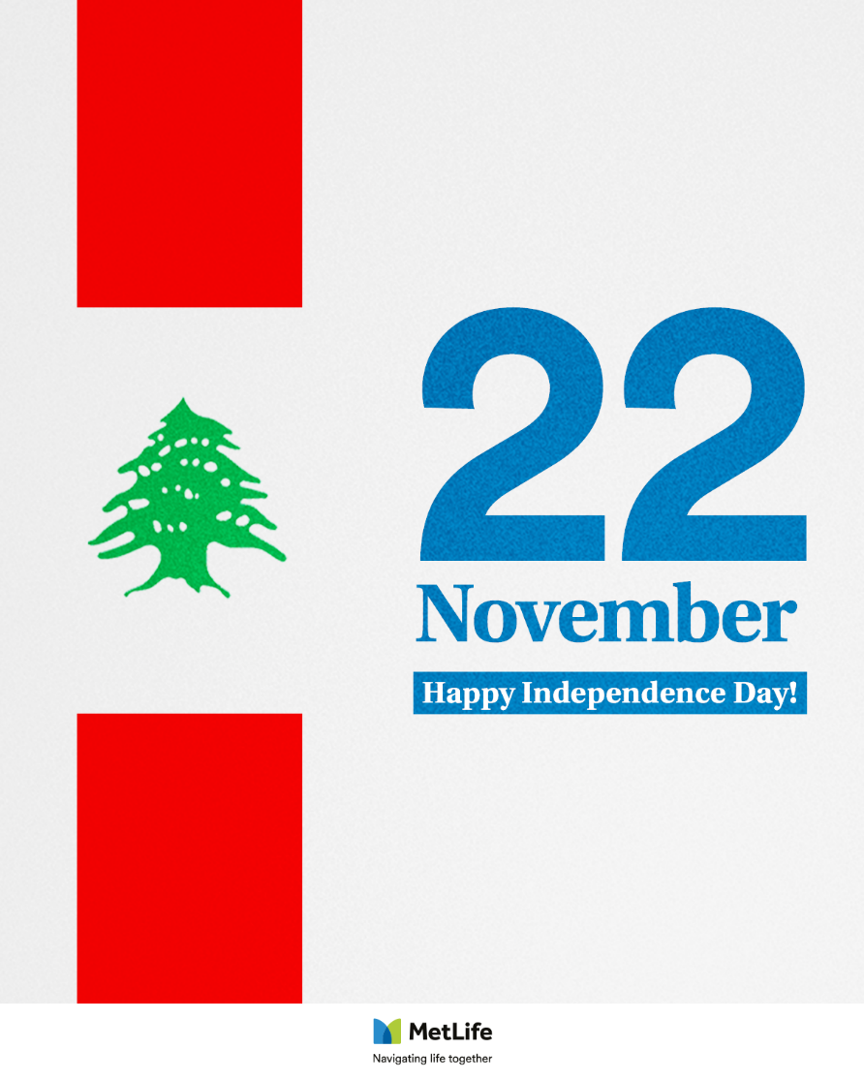
Post 3 - Independence Day
Caption:
Sending warm wishes on this Independence Day! May this day bring peace and tranquility to our beloved Lebanon.
#MetLife #MetLifeLebanon #NavigatingLifeTogether #IndependenceDay
Facebook, LinkedIn.

Slide 5
Post 4 - Life Insurance
Caption:
The more you understand the basics of life insurance, the better equipped you will be to choose the coverage that is right for you and your loved ones. If your family relies on your income, it is essential to learn how life insurance can protect them if anything happens to you.
Direct Message me and I’d be happy to provide you with more information about how it works, and which solution is right for you.
#LifeOnYourOwnTerms #MetLife #MetLifeLebanon #NavigatingLifeTogether
Facebook, LinkedIn.

Slide 6
Post 5 - Financial Planning -
Caption:
As we approach the end of the year, it is a good time to review your financial situation to see how well you have met your financial goals and to make any necessary adjustments for the new year.
Here are 7 steps you can take to assess your financial plan and prepare for 2024.
#MetLife #MetLifeLebanon #NavigatingLifeTogether #FinancialPlanning
Facebook, LinkedIn.

Slide 7
Post 6 - Christmas
Caption:
Wishing you a Merry Christmas filled with joy, love, and laughter!
#MerryChristmas #Christmas #MetLife #MetLifeLebanon #NavigatingLifeTogether
Facebook, LinkedIn.

Slide 8
Post 7 - Happy New Year
Caption:
May the coming year be a time of growth, love, and joy. Happy New Year!
#MetLife #MetLifeLebanon #NavigatingLifeTogether #HappyNewYear #NewYear2024
Facebook, LinkedIn.

Slide 9
Thank You

