Slide 1
MetLife Social Matters Content Calendar

Slide 2
May 2023​ FACEBOOK – Social Selling
Monday | Tuesday | Wednesday | Thursday | Friday | Saturday | Sunday
1 Labor Day | 2 World Asthma Day | 3 | 4 | 5 | 6 | 7
8 | 9 | 10 Your life as an agent pillar | 11 | 12 | 13 | 14
15 | 16 | 17 | 18 Small acts make a big difference | 19 | 20 | 21
22 | 23 | 24 Family Planning | 25 | 26 | 27 | 28
29 | 30 Financial wellbeing - EB | 31

Slide 3
Facebook post 1
Contextual | Labor Day – 1 May
Caption:
I want to wish all of you a happy Labor Day! Have a restful, safe, and enjoyable day! Go out for a picnic, soak up some vitamin D under the sun, relax and just enjoy the day in your own way. Because you deserve it. ☀️
How do you plan to celebrate #LaborDay?

Slide 4
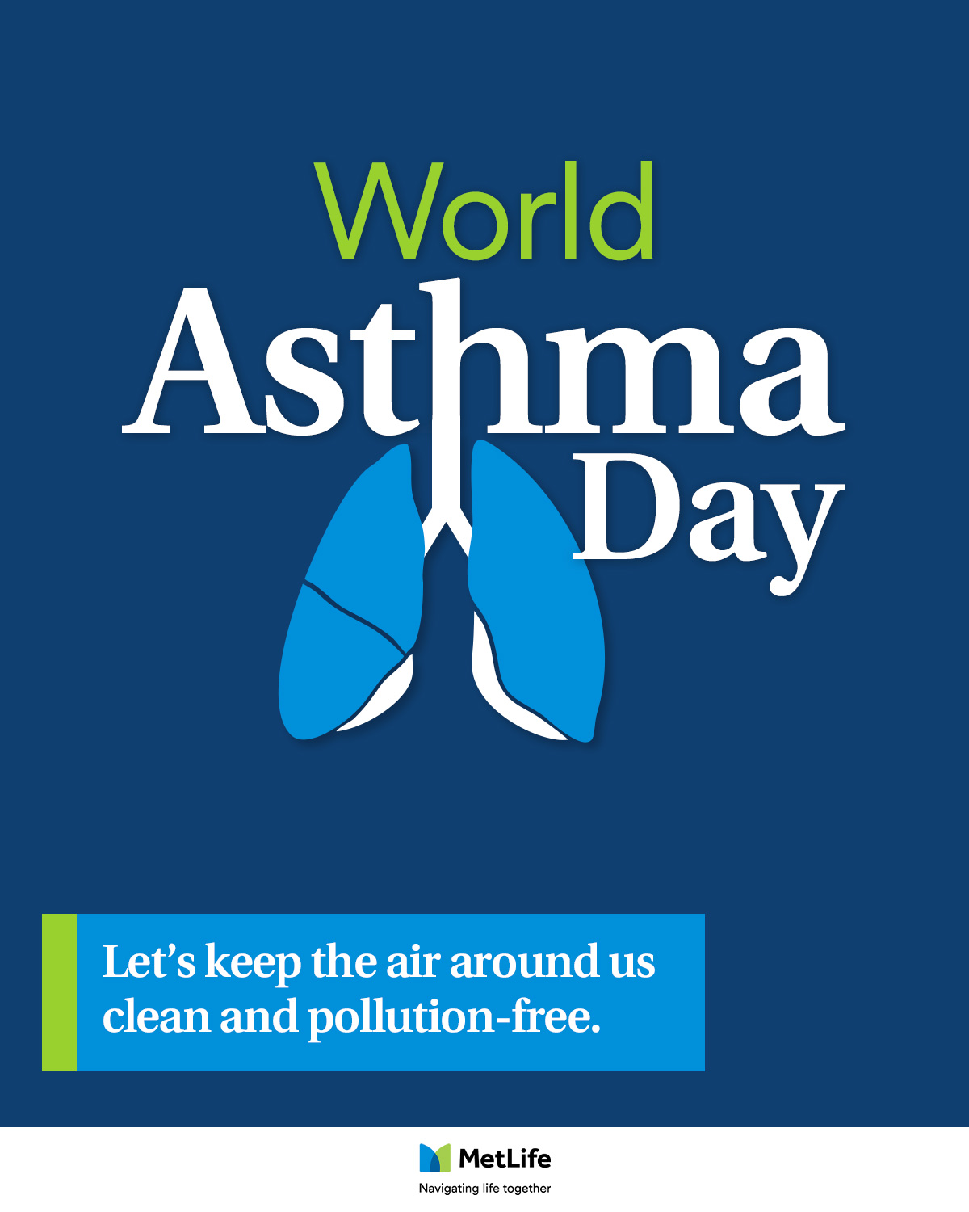
Facebook post 2
Contextual | World Asthma Day | 2 May
Caption:
Did you know that more than 339 million people worldwide are living with asthma? It isn't easy being wheezy! So, this #WorldAsthmaDay, let’s all push for the clean air policies that can make the lives of those with Asthma easier, improve health for all of us, and contribute to tackling climate change.
#LoveYourLungs #NavigatingLifeTogether

Slide 5
Facebook post 3
Your life as an agent pillar | Photo Post
Caption:
As an insurance agent, I invest most of my time in getting to know you; your concerns, interests and family ambitions. Then, I search to find better, more affordable solutions in a way that makes sense for you.
What I’m doing for you is what I’d do for my own family and closest friends.
#LifeOfAnInsuranceAgent

Slide 6
​​
Facebook post 4
Campaign post: Small acts make a big difference
Caption:
I truly believe that small acts can make a big difference, and that's why together with my colleagues we're committed to making our industry, and the world, a better place for all. 🤲🌍
Through multiple initiatives and MetLife EMEA programs that promote sustainability and well-being across our business and beyond, we're always striving to do our part and create a brighter future for everyone. 💚💙
#MetLife #SmallActs #BigDifference #Sustainability

Slide 7
Facebook post 5
Family Planning
Caption:
In today’s competitive market, our child’s education has never been more important to ensure they thrive in their future. We want to give our children every opportunity we can, but without planning, this could come as a cost to our personal savings, lifestyles and retirement plans.
Do you have a saving scheme for your children’s education?
#Educationplans #Savings #Insurance #NavigatingLifeTogether

Slide 8
Facebook post 7
Financial wellbeing - EB
Caption:
Talking about personal finances can be difficult. To help employees prepare for a more secure financial future, this taboo needs to be challenged with clear and open communication.
In the end, having a financially stable workforce is your ticket to a more productive and profitable future.
Do you agree?
#Financialwellbeing #EmployeeBenefits #NavigatingLifeTogether #HR

Slide 9
May 2023​ LinkedIn – Social Selling
Monday | Tuesday | Wednesday | Thursday | Friday | Saturday | Sunday
1 Labor Day | 2 | 3 | 4 | 5 | 6 | 7
8 | 9 Small acts make a big difference | 10 | 11 | 12 | 13 | 14
15 | 16 | 17 | 18 Your life as an agent pillar | 19 | 20 | 21
22 | 23 Company Reputation – EB - VIDEO | 24 | 25 | 26 | 27 | 28
29 | 30 | 31 Financial wellbeing - EB

Slide 10
LinkedIn post 1
Contextual | Labor Day– 1 May
Caption:
I want to wish all of you a happy Labor Day! Have a restful, safe, and enjoyable day! Go out for a picnic, soak up some vitamin D under the sun, relax and just enjoy the day in your own way. Because you deserve it. ☀️
How do you plan to celebrate #LaborDay?

Slide 11
​​
LinkedIn post 2
Campaign post: Small acts make a big difference
Caption:
I truly believe that small acts can make a big difference, and that's why together with my colleagues we're committed to making our industry, and the world, a better place for all. 🤲🌍
Through multiple initiatives and MetLife EMEA programs that promote sustainability and well-being across our business and beyond, we're always striving to do our part and create a brighter future for everyone. 💚💙
#MetLife #SmallActs #BigDifference #Sustainability

Slide 12
LinkedIn post 3
Your life as an agent pillar | Photo Post
Caption:
As an insurance agent, I invest most of my time in getting to know you; your concerns, interests and family ambitions. Then, I search to find better, more affordable solutions in a way that makes sense for you.
What I’m doing for you is what I’d do for my own family and closest friends.
#LifeOfAnInsuranceAgent

Slide 13
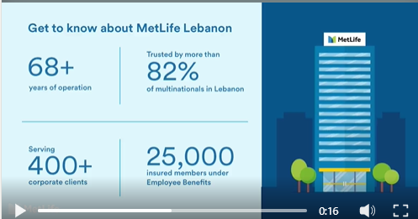
LinkedIn post 4
Company Reputation – EB - VIDEO
Caption:
At MetLife, our clients come first, which means that we always strive to deliver on our promises several decades into the future. Our investments, accordingly, help us keep the financial promises we’ve made to our customers all over the world and fulfil our purpose of building a confident future for everyone.
Being in business for 70 years is a huge milestone for MetLife Lebanon, one that wouldn’t be possible without the support of tens of thousands of our loyal customers. I want to personally thank you as we move forward into more exciting growths.
#MetLife #MetlifeLebanon #NavigatingWorkTogether

Slide 14
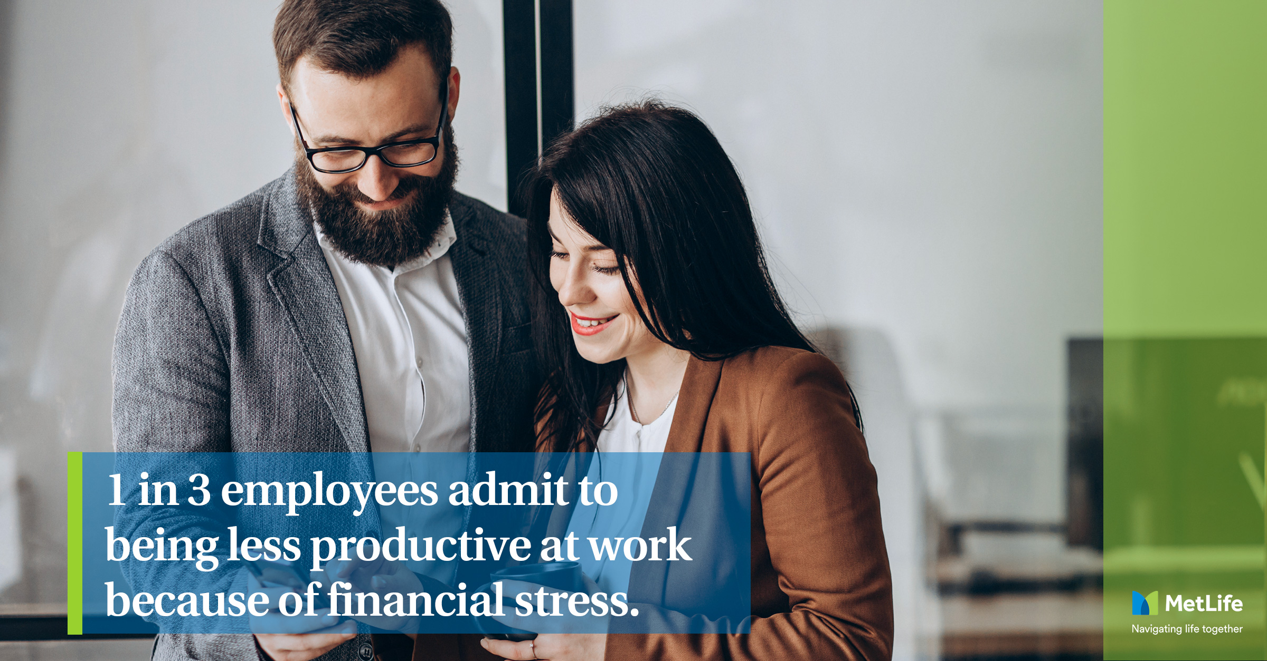
LinkedIn post 4
Financial wellbeing - EB
Caption:
Talking about personal finances can be difficult. To help employees prepare for a more secure financial future, this taboo needs to be challenged with clear and open communication.
In the end, having a financially stable workforce is your ticket to a more productive and profitable future.
Do you agree?
#Financialwellbeing #EmployeeBenefits #NavigatingLifeTogether #HR

Slide 15
Thank you!

