Slide 1
MetLife Social Selling January 2023

Slide 2
Facebook

Slide 3
Start the year off right by expressing gratitude. If you ask me, I am grateful for my profession. I really enjoy helping people and working in the insurance field gives me the opportunity to do that in many ways. Helping people in some of the most challenging times in their lives is the most rewarding part of my job. ❤️
What are you grateful for?
#LifeOfAnInsuranceAgent #MetLife
Facebook post 1 – Tue, 3 Jan
My life as an agent
Caption:
Start the year off right by expressing your gratitude. If you ask me, I am grateful for my profession. I really enjoy helping people and working in the insurance field gives me the opportunity to do that in many ways. Helping people in some of the most challenging times in their lives is the most rewarding part of my career. ❤️
What are you grateful for?
#LifeOfAnInsuranceAgent #MetLife
Helping people protect their way of life is extremely rewarding
Copy on image:
Helping people protect their way of life is extremely rewarding

Slide 4
Start the year off right by expressing gratitude. If you ask me, I am grateful for my profession. I really enjoy helping people and working in the insurance field gives me the opportunity to do that in many ways. Helping people in some of the most challenging times in their lives is the most rewarding part of my career. ❤️
What are you grateful for?
#LifeOfAnInsuranceAgent #MetLife
Facebook post 1 – Tue, 3 Jan
My life as an agent
Caption:
Start the year off right by expressing your gratitude. If you ask me, I am grateful for my profession. I really enjoy helping people and working in the insurance field gives me the opportunity to do that in many ways. Helping people in some of the most challenging times in their lives is the most rewarding part of my career. ❤️
What are you grateful for?
#LifeOfAnInsuranceAgent #MetLife
Copy on image:
Helping people protect their way of life is extremely rewarding

Slide 5
Want to feel more confident about your finances in 2023? Financial stability starts with reviewing your current financial resources. 💡 This is important because your financial resources affect not only your ability to reach your goals, but your ability to protect those goals from potential financial crises.
I'm here to provide you with customized solutions, according to your needs, to protect your finances, family and future.
#FinancialStability #MetLife
Facebook post 2 – Tue, 10 Jan
Financial stability
Caption:
Want to feel more confident about your finances in 2023? Financial stability starts with reviewing your current financial resources. 💡 This is important because your financial resources affect not only your ability to reach your goals, but your ability to protect those goals from potential financial crises.
I'm here to provide you with customized solutions, according to your needs, to protect your finances, family and future.
#FinancialStability #MetLife
Planning for a future of financial stability
Copy on image:
Planning for a future of financial stability

Slide 6
Sometimes we don’t think about our life insurance needs until it’s too late. Changing circumstances, rises or falls in income and whether or not the kids are still at home - all affect the amount of cover we need.
Let's have a chat about why you should consider adapting life insurance cover for all life stages. 🤝
#LifeInsurance #MetLife
Facebook post 3 - Thu, 12 Jan
Insurance solutions
Caption:
Sometimes we don’t think about our life insurance needs until it’s too late. Changing circumstances, rises or falls in income and whether or not the kids are still at home - all affect the amount of cover we need.
Let's have a chat about why you should consider adapting life insurance cover for all life stages. 🤝 ​
#LifeInsurance #MetLife
Copy on image:
For a future that grows as beautifully as your present
For a future that grows as beautifully as your present

Slide 7
At MetLife, we are driven by winning together through collaboration and aligned goals and objectives. Guided by empathy to treat one another with respect and care, we work to make positive differences in the lives of our customers and communities, all underpinned by embracing change to grow our business in the right way. 🙌
#MetLife #Diversity #Inclusion
Facebook post 4 – Tue, 17 Jan
MetLife company reputation
Caption:
At MetLife, we are driven by winning together through collaboration and aligned goals and objectives. Guided by empathy to treat one another with respect and care, we work to make positive differences in the lives of our customers and communities, all underpinned by embracing change to grow our business in the right way. 🙌
#MetLife #Diversity #Inclusion
Text on image:
Everyone of us participates in shaping our inclusive culture
EVERYONE OF US PARTICIPATES IN SHAPING OUR INCLUSIVE CULTURE

Slide 8
Did you know that accident & health insurance coverage can help supplement costs that are not covered under your existing medical plan? Take steps to safeguard your financial well-being with the care, comfort and confidence of protection for all life’s ups and downs. ✨ Let me help you in this journey.
#Accident&HealthInsurance #MetLife
Facebook post 5 – Thu, 19 Jan
Insurance solutions
Caption:
Did you know that accident & health insurance coverage can help supplement costs that are not covered under your existing medical plan? Take steps to safeguard your financial well-being with the care, comfort and confidence of protection for all life’s ups and downs. ✨ Let me help you in this journey.
#Accident&HealthInsurance #MetLife
Copy on image:
Protect your financial well-being

Slide 9
Knowledge is not only power, but when it is applied, it has the power to change our lives and the world. 🎓🌍 On #InternationalDayOfEducation, let’s reflect on our responsibility to protect and promote education. How can we inspire young minds to give their all to education?
From my side, I can help with a better understanding of financial education.
Facebook post 6 – Tue, 24 Jan
International Day Of Education (24 Jan)
Caption:
Knowledge is not only power, but when it is applied, it has the power to change our lives and the world. 🎓🌍 On #InternationalDayOfEducation, let’s reflect on our responsibility to protect and promote education. How can we inspire young minds to give their all to education?
From my side, I can help with a better understanding of financial education.
Let’s nurture the talents of our next generation
Copy on image:
Let’s nurture the talents of our next generation

Slide 10
As an insurance agent, my daily work centers around communication. 😊 Whether internal or external, effective communication is essential for me to offer the right financial protection. I ask questions in order to understand my clients' needs and then I offer them the most suitable solutions. What's important to you in your profession?
#LifeOfAnInsuranceAgent #MetLife
Facebook post 7 – Thu, 26 Jan
My life as an agent
Caption:
As an insurance agent, my daily work centers around communication. 😊 Whether internal or external, effective communication is essential for me to offer the right financial protection. I ask questions in order to understand my clients' needs and then I offer them the most suitable solutions.
What's important to you in your profession?
#LifeOfAnInsuranceAgent #MetLife
Effective communication builds trust
Copy on image:
Effective communication builds trust

Slide 11
As an insurance agent, my daily work centers around communication. 😊 Whether internal or external, effective communication is essential for me to offer the right financial protection. I ask questions in order to understand my clients' needs and then I offer them the most suitable solutions. What's important to you in your profession?
#LifeOfAnInsuranceAgent #MetLife
Facebook post 7 – Thu, 26 Jan
My life as an agent
Caption:
As an insurance agent, my daily work centers around communication. 😊 Whether internal or external, effective communication is essential for me to offer the right financial protection. I ask questions in order to understand my clients' needs and then I offer them the most suitable solutions.
What's important to you in your profession?
#LifeOfAnInsuranceAgent #MetLife
Effective communication builds trust
Copy on image:
Effective communication builds trust

Slide 12
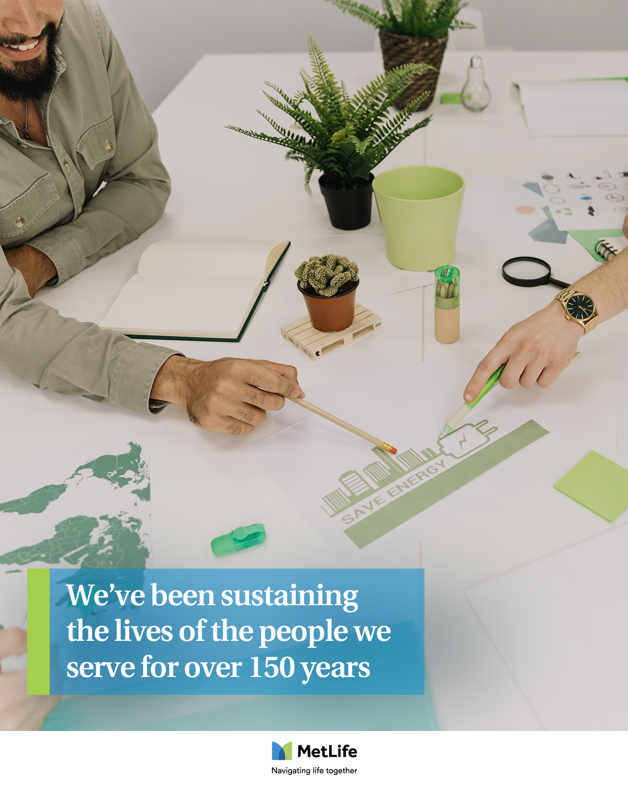
What does sustainability mean to you? Sustainability at MetLife is as diverse as the people we serve, the communities we operate in and the challenges we face as a society.
From strengthening communities and improving health and well-being, to addressing climate change and gender and racial inequity, sustainability is woven into the fabric of who we are. 💚💙
#MetLife #Sustainability #NavigatingLifeTogether
Facebook post 8 - Tue, 31 Jan
MetLife company reputation
Caption:
What does sustainability mean to you? Sustainability at MetLife is as diverse as the people we serve, the communities we operate in and the challenges we face as a society.
From strengthening communities and improving health and well-being, to addressing climate change and gender and racial inequity, sustainability is woven into the fabric of who we are. 💚💙
#MetLife #Sustainability #NavigatingLifeTogether
Text on image:
We’ve been sustaining the lives of the people we serve for over 150 years
We’ve been sustaining the lives of the people we serve for over 150 years

Slide 13
LinkedIn

Slide 14
LinkedIn post 1 – Tue, 3 Jan
My life as an agent
As we begin a new year, let's show gratitude for what we have. For me, it is my profession. I really enjoy helping people and working in the insurance field gives me the opportunity to do that in many ways. 🤲 Offering my clients the best insurance plans to keep them safe is rewarding - knowing that I am helping them to live safer and healthier lives. What are you grateful for?
#LifeOfAnInsuranceAgent #MetLife
Caption:
As we begin a new year, let's show gratitude for what we have. For me, it is my profession. I really enjoy helping people and working in the insurance field gives me the opportunity to do that in many ways. 🤲 Offering my clients the best insurance plans to keep them safe is rewarding - knowing that I am helping them to live safer and healthier lives. What are you grateful for? #LifeOfAnInsuranceAgent #MetLife
Copy on image:
Helping people protect their way of life is extremely rewarding

Slide 15
LinkedIn post 1 – Tue, 3 Jan
My life as an agent
As we begin a new year, let's show gratitude for what we have. For me, it is my profession. I really enjoy helping people and working in the insurance field gives me the opportunity to do that in many ways. 🤲 Offering my clients the best insurance plans to keep them safe is rewarding - knowing that I am helping them to live safer and healthier lives. What are you grateful for?
#LifeOfAnInsuranceAgent #MetLife
Caption:
As we begin a new year, let's show gratitude for what we have. For me, it is my profession. I really enjoy helping people and working in the insurance field gives me the opportunity to do that in many ways. 🤲 Offering my clients the best insurance plans to keep them safe is rewarding - knowing that I am helping them to live safer and healthier lives. What are you grateful for? #LifeOfAnInsuranceAgent #MetLife
Copy on image:
Helping people protect their way of life is extremely rewarding

Slide 16
LinkedIn post 2 – Mon, 16 Jan
Insurance solutions
No one's path through life is linear. And you don't need to have your life mapped out at 20 to optimize life insurance. You just have to make it a part of your plan. Work with it. Evolve alongside it. And use it at every stage to ensure the best for you and your loved ones.
🗣 Tell me, in comments, why you think you should consider adapting life insurance cover for all life stages. ​ #LifeInsurance #MetLife
Caption:
No one's path through life is linear. And you don't need to have your life mapped out at 20 to optimize life insurance. You just have to make it a part of your plan. Work with it. Evolve alongside it. And use it at every stage to ensure the best for you and your loved ones.
🗣 Tell me, in the comments, why you think you should consider adapting life insurance cover for all life stages. ​
#LifeInsurance #MetLife
Copy on image:
For a future that grows as beautifully as your present

Slide 17
LinkedIn post 3 – Thu, 19 Jan
MetLife company reputation
Trust and open dialogue allow us to create a world where all is possible when we work together. 👐
At MetLife, we are driven by winning together through collaboration and aligned goals and objectives. Guided by empathy to treat one another with respect and care, we work to make positive differences in the lives of our customers and communities, all underpinned by embracing change to grow our business in the right way
Caption:
Trust and open dialogue allow us to create a world where all is possible when we work together. 👐
At MetLife, we are driven by winning together through collaboration and aligned goals and objectives. Guided by empathy to treat one another with respect and care, we work to make positive differences in the lives of our customers and communities, all underpinned by embracing change to grow our business in the right way
#MetLife #Diversity #Inclusion
Copy on image:
All is possible when we work together

Slide 18
LinkedIn post 4 – Sat , 21 Jan
MetLife company reputation
Sustainability at MetLife means living our purpose: Always with you, building a more confident future - for the long term. We’re deploying the full strength of our people, products, services, and investments to be a greater force for good in the world. It’s what inspired us in the past, fuels our strategy today and will set us apart in the future.
What does sustainability mean to you? #MetLife #Sustainability #NavigatingLifeTogether
Caption:
Sustainability at MetLife means living our purpose: Always with you, building a more confident future - for the long term. 🌱🌏 We’re deploying the full strength of our people, products, services, and investments to be a greater force for good in the world. It’s what inspired us in the past, fuels our strategy today and will set us apart in the future.
What does sustainability mean to you?
#MetLife #Sustainability #NavigatingLifeTogether
Copy on image:
With our purpose at our core, we’ve been sustaining the lives of the people we serve for over 150 years

Slide 19
​
LinkedIn post 5 – Mon, 23 Jan
My life as an agent
As an insurance agent, my daily work centers around communication. 😊 Whether internal or external, effective communication is essential for me to offer the right financial protection. I ask questions in order to understand my clients' needs and then I offer them the most suitable solutions.
What's important to you in your job? #LifeOfAnInsuranceAgent #MetLife
Caption:
As an insurance agent, my daily work centers around communication. 😊 Whether internal or external, effective communication is essential for me to offer the right financial protection. I ask questions in order to understand my clients' needs and then I offer them the most suitable solutions.
What's important to you in your profession?
#LifeOfAnInsuranceAgent #MetLife
Copy on image:
Effective communication builds trust

Slide 20
​
LinkedIn post 5 – Mon, 23 Jan
My life as an agent
As an insurance agent, my daily work centers around communication. 😊 Whether internal or external, effective communication is essential for me to offer the right financial protection. I ask questions in order to understand my clients' needs and then I offer them the most suitable solutions.
What's important to you in your profession?
#LifeOfAnInsuranceAgent #MetLife
Caption:
As an insurance agent, my daily work centers around communication. 😊 Whether internal or external, effective communication is essential for me to offer the right financial protection. I ask questions in order to understand my clients' needs and then I offer them the most suitable solutions.
What's important to you in your profession?
#LifeOfAnInsuranceAgent #MetLife
Copy on image:
Effective communication builds trust

Slide 21
LinkedIn post 6 – Tue, 31 Jan
Insurance solutions
Did you know that accident & health insurance coverage can help supplement costs that are not covered under your existing medical plan? While you can’t plan for the unexpected, you can be better prepared financially with MetLife Accident & Health Insurance. Let me help you in this journey. 🤝
#HealthInsurance #MetLife #AccidentInsurance
Caption:
Did you know that accident & health insurance coverage can help supplement costs that are not covered under your existing medical plan? While you can’t plan for the unexpected, you can be better prepared financially with MetLife Accident & Health Insurance. Let me help you in this journey. 🤝
#HealthInsurance #MetLife #AccidentInsurance
Copy on image:
Protect yourself and your family from the financial impact of unexpected events

Slide 22
Thank you!

