Slide 1
MetLife Social Matters Content Calendar Month 1 – December 2022

Slide 2
Intro
MetLife is a company that aims at building bridges inside and outside the organization.
This is why, the purpose of the monthly calendar is not only to provide ready-made content, but also to provide a tailored brand-readiness platform, that takes in consideration all regional needs, whilst adapting the information by bringing a local flavor.
The following calendar was built for the MetLife Social Matters Pilot and addresses topics that tackle different content pillars, through topics related to health & financial concerns.

Slide 3
About this calendar
This funnel helps you visualise the main stages you have to go through in order to obtain & convert a prospect.
As shown, from each stage you should expect specific outcomes. Unless you’re really lucky, conversion won’t happen in an instant.
The following calendar approaches the Engage & Nurture funnel stages, with content pieces prepared to tackle the acquisition of new social connections and leads, and the nurturing of already existing leads by socializing and being helpful.

Slide 4
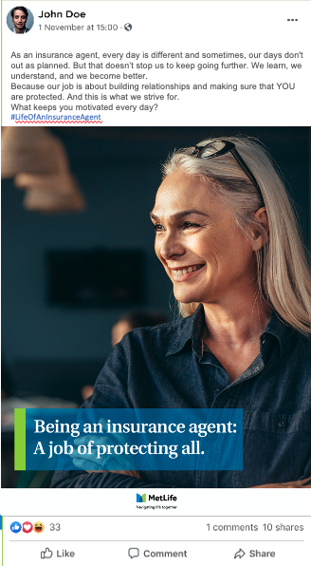
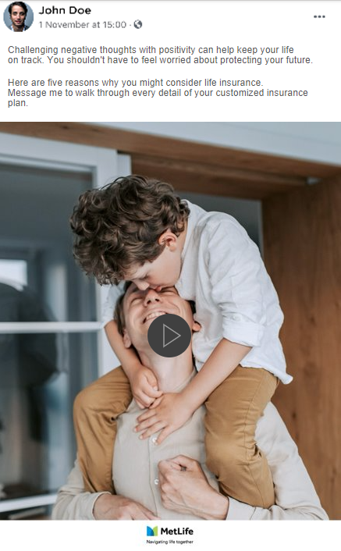
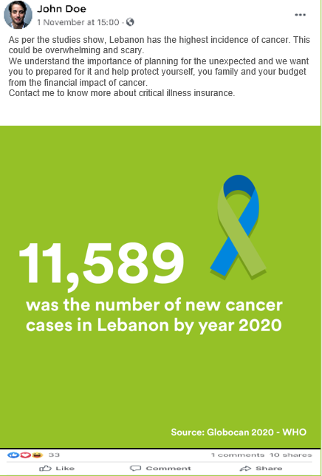
Engage
Content funnel approach
The following materials in the content calendar have been tailored in a manner that aims at engaging the audience, with an outcome that aims at the aquisition of new social connections and leads
Nurture
The following materials in the content calendar have been tailored in a manner that aims at socializing with the audience, while being helpful. By approaching this type of content, we aim at nurturing the existing contacts, while providing the means of meeting people.

Slide 5
What makes a good calendar
This calendar has ready posts, but in order to get you going with your social selling, understanding a few outlines of what makes a good calendar is of great importance.
Is the content aligned to co-branding principles?
The following calendar is built by following the MetLife brand guidelines. By approaching content within these guides, we make sure that our image and voice is consistent, no matter where we make them heard.
Before committing to creating your own social posts, make sure that the tactic and/or asset is compliant to the respective MetLife guidelines.
Does your content have a clear CTA?
We always need to make sure that every touchpoint and asset builds up on the same main objective and that any Call to action used around communication is clearly formulated, straightforward and visible.
By doing this, we once again ensure that our brand’s message gets carried to the right audience, in a correct manner. Simplicity is key. Less is more.

Slide 6
Does the content look like MetLife?
Prior to creating any content, we need to make sure that all creatives belong to the MetLife Universe from the following point of view: branding, tone of voice, color, use of imagery, characters, etc. If you want to learn more about our guides, please refer to Hiba Beckdash
In the shoes of your audience
Is the message simple and efficient? Would your audience understand what they are supposed to do from the second they see the post?
Make sure that any extra content you create answer the needs of your audience, and ask them to do simple actions, in a simple way.

Slide 7
How to post on Facebook
There are two ways to create posts on your Facebook page. Let’s dive in!
Posting on mobile
Posting on Desktop
1. Open Facebook App
If you’re logged in, Facebook will open to your News Feed.
If you aren’t logged in, enter your email address and password and tap Log In.
2. Tap the post box – at the top of the News Feed
There will generally be a phrase like "Write something" or "What's on your mind?" in the box
3. Upload a photo or a video
Tap Photo/Video near the middle of the post screen, then select a photo or video to upload and tap Done. Doing so adds the photo or video to your post.
4. Add text to your post
Tap the text field, then type in the text for your post. Don’t be afraid to play with the texts by adding your own personal flavor to them.
5. Tap Add to your post
Select Photo/Video to add more photos or videos to your posting.
Tap Post – on the top right corner of the screen.
Congratulations, your post is uploaded and is visible to the public.
1. Open Facebook in a web browser – go to https://www.facebook.com/
If you’re logged in, Facebook will open to your News Feed.
If you aren’t logged in, enter your email address and password and tap Log In.
2. Click the post box– at the top of the News Feed
There will generally be a phrase like "Write something" or "What's on your mind?" in the box
3. Add text to your post
Type your content into the post box. Don’t be afraid to play with the texts by adding your own personal flavor to them.
4. Add a Photo/Video to your post
Click on the Photo/Video option, located below the post box
Select a photo or a video from your computer to upload to the post
Click Post - It's the blue button in the bottom the window
Congratulations, your post is uploaded and is visible to the public.

Slide 8
How to post on LinkedIn
There are two ways to publish LinkedIn posts. Let’s dive in!
Posting on mobile
Posting on Desktop
1. Open LinkedIn App
If you’re not already signed in to your LinkedIn account, enter your username and password into the blanks at the top of the screen, then click Sign in.
2. Tap the New Post icon – at the top of the News Feed
It’s the blue circle with a sheet of paper and pencil at the bottom-right corner of the screen.
3. Type the contents of your post into the box
If you copied text or a link from another app, tap and hold the typing area, then tap Paste. Don’t be afraid to play with the texts by adding your own personal flavor to them.
4. Add a photo or video to the post
Tap the camera icon
Tap Select photos from the gallery to open your gallery and select a photo to upload.
5. Tap @ to tag someone (optional)
It’s at the bottom of the new post. Start typing the name of someone you want to tag, then select them from the search results. You can tag more than one person if you wish.
6. Tap Post
Congratulations, your LinkedIn post now appears in the feed.
1. Open LinkedIn in a web browser – go to https://www.linkedin.com
If you’re not already signed in to your LinkedIn account, enter your username and password into the blanks at the top of the screen, then click Sign in.
2. Click the Share an article, photo, video, or idea box
It’s near the top-center part of the page. This expands the box to display additional post options.
3. Type what you want to share
You can also paste text you’ve copied from another location by right-clicking the typing area and selecting Paste. Don’t be afraid to play with the texts by adding your own personal flavor to them.
If you include a URL, it will be clickable on LinkedIn.
4. Click Images or Video to add a photo/video
This brings up the file browser on your computer, allowing you to select the image/ video you want to include and click Open.
5. Click Post button
Congratulations, Your LinkedIn post now appears in the feed.

Slide 9
Facebook posts part I

Slide 10
At MetLife, every day we uncover new ways to put people at the heart of everything we do. We want to understand their needs and to have a transparent relationship regarding insurances. I am very proud to work in a company that helps customers meet their goals and navigate life's twists and turns.
For this reason, I’m super excited to announce I have prepared a series of useful and interesting posts that will make our relationship stronger. Because #YouMatter and I am #HereForYou.
Facebook post 1 – Dec 1
Teasing post
Caption:
At MetLife, every day we uncover new ways to put people at the heart of everything we do. We want to understand their needs and to have a transparent relationship regarding insurances. I am very proud to work in a company that helps customers meet their goals and navigate life's twists and turns.
For this reason, I’m super excited to announce I have prepared a series of useful and interesting posts that will make our relationship stronger. Because #YouMatter and I am #HereForYou.
Copy on image:
V1 Getting ready to deliver great content to great people.
COMING SOON

Slide 11
With over 153 years of experience, the MetLife companies are a leading innovator and a recognized leader in protection planning and retirement and savings solutions around the world. MetLife, Inc. and its subsidiaries have one of the highest financial strength ratings from various rating agencies that any company can have.
We are committed to always be with you building a more confident future.
Facebook post 2 – Dec 5
About MetLife - One of the highest financial strength ratings
-> video
Caption:
With over 153 years of experience, the MetLife companies are a leading innovator and a recognized leader in protection planning and retirement and savings solutions around the world. MetLife, Inc. and its subsidiaries have one of the highest financial strength ratings from various rating agencies that any company can have.
We are committed to always be with you building a more confident future.
Copy on image:
V1 figures about MetLife

Slide 12
Challenging negative thoughts with positivity can help keep your life on track. You shouldn't have to feel worried about protecting your future.
Here are five reasons why you might consider life insurance. Message me to walk through every detail of your customized insurance plan.
Facebook post 3 – dec8
Benefits of Life insurance -> video
Caption:
Challenging negative thoughts with positivity can help keep your life on track. You shouldn't have to feel worried about protecting your future.
Here are five reasons why you might consider life insurance. Message me to walk through every detail of your customized insurance plan.
Copy on image:
1. Protect your family and loved ones
2. Add more financial security
3. Leave an inheritance
4. Bring peace of mind
5. Pay off debts and other expenses

Slide 13
Facebook post 4 – Dec12
As an insurance agent, every day is different and sometimes, our days don't out as planned. But that doesn’t stop us to keep going further. We learn, we understand, and we become better.
Because our job is about building relationships and making sure that YOU are protected. And this is what we strive for.
What keeps you motivated every day?
#LifeOfAnInsuranceAgent
Your life as an agent pillar | photo post
Caption:
As an insurance agent, every day is different and sometimes, our days don’t go out as planned. But that doesn’t stop us to keep going further. We learn, we understand, and we become better.
Because our job is about building relationships and making sure that YOU are protected. And this is what we strive for.
What keeps you motivated every day?
#LifeOfAnInsuranceAgent
Copy on image:
Being an insurance agent:
A job of protecting all.

Slide 14
Sometimes, life can feel like it goes on and on forever. Other times, life feels like it passes by in the blink of an eye. To live it to the fullest you need to understand its milestones and appreciate them.
And December is all about welcoming the new season, wrapping up the past year, and being with loved ones as often as possible. Before the year is over, now is the right time to decide when you need to reevaluate your life insurance coverage.
Want to know when it’s recommended to adjust your coverage? Let’s discover together. ☺
Facebook post 5 – Dec 15
Insurance products pillas / Reviewing insurance policies – photo post
Caption:
Sometimes, life can feel like it goes on and on forever. Other times, life feels like it passes by in the blink of an eye. To live it to the fullest you need to understand its milestones and appreciate them.
And December is all about welcoming the new season, wrapping up the past year, and being with loved ones as often as possible. Before the year is over, now is the right time to decide when you need to reevaluate your life insurance coverage.
Want to know when it’s recommended to adjust your coverage? Let’s discover together. ☺
Copy on image:
Time to reevaluate life insurance coverage:
✓ Your Family Has Grown
✓ Your Career and Income Have Changed
✓ You Have New Financial Obligations Resource:
https://www.metlife.com/financial-wellness-content-hub/financial-wellness/what-is-life-insurance-an-introduction/

Slide 15
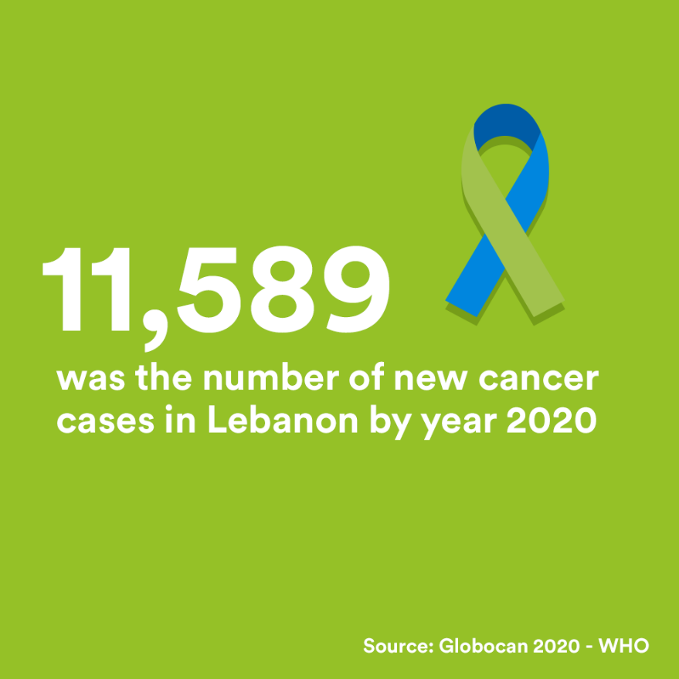
As per the studies show, Lebanon has the highest incidence of cancer. This could be overwhelming and scary.
We understand the importance of planning for the unexpected and we want you to prepared for it and help protect yourself, you family and your budget from the financial impact of cancer.
Contact me to know more about critical illness insurance.
Facebook post 6 – dec19
Insurance products / Critical Illness insurance | photo post
Caption:
As per the studies show, Lebanon has the highest incidence of cancer. This could be overwhelming and scary.
We understand the importance of planning for the unexpected and we want you to prepared for it and help protect yourself, you family and your budget from the financial impact of cancer.
Contact me to know more about critical illness insurance.
Copy on image:
11,589 was the number of new cancer cases in Lebanon by year 2020
Resource:
Globocon 2020-who

Slide 16
Holidays season is a time when giving and receiving has a special meaning– and providing protection is considered one of the most important gifts you can give to your loved ones.
Whether you are saving for your kids’ education or planning for a comfortable and enjoyable retirement, I’m committed to helping you make the right choices so that you can navigate through life; working closely with our customers, we take on their goals as our own and bring our knowledge to the table to help them anticipate change and navigate the road ahead with confidence.
I’m here to help you decide on your special gift.
This is the #LifeOfAnInsuranceAgent. Happy Holidays everyone!
Facebook post 7 – Dec 22
Your life as an agent pillar | Happy Holidays | Photo Post
Caption:
Holidays season is a time when giving and receiving has a special meaning– and providing protection is considered one of the most important gifts you can give to your loved ones.
Whether you are saving for your kids’ education or planning for a comfortable and enjoyable retirement, I’m committed to helping you make the right choices so that you can navigate through life; working closely with our customers, we take on their goals as our own and bring our knowledge to the table to help them anticipate change and navigate the road ahead with confidence.
I’m here to help you decide on your special gift.
This is the #LifeOfAnInsuranceAgent. Happy Holidays everyone!
Copy on image:
I may not be a Superhero,
but I am an Insurance Agent

Slide 17
Facebook post 8 – Dec26
The typical day for a health and life insurance agent, centers around communication. Whether internal or external, communication is essential for us to do our job properly.
We ask questions in order to understand our clients’ needs. We are open and we do care. So, what’s on your mind today?
#LifeOfAnInsuranceAgent
Your life as an agent pillar | Photo Post
Caption:
The typical day for a life insurance agent, centers around communication. Whether internal or external, communication is essential for us to do our job properly.
We ask questions in order to understand our clients’ needs. We are open and we do care.
So, what’s on your mind today?
#LifeOfAnInsuranceAgent
Copy on image:
Talking about what matters most.

Slide 18
The very words “bucket list” can stir up some pretty heave-duty. Defined as a list of things to do before a specific time; it can be a reminder that our time is limited and can guide us to achieve what is most important to us before it is too late.
Whether you want to see the world, change your career or watch your children graduate with a doctorate degree, with our wide range of savings plans, it’s just a matter of when.
May this year bring new happiness, new goals, and new achievements! Happy New Year!
I’m always here to help you achieve your goals.
Facebook post 9 - Dec 29
MetLife solutions | Happy New Year!
Caption:
The very words “bucket list” can stir up some pretty heave-duty. Defined as a list of things to do before a specific time; it can be a reminder that our time is limited and can guide us to achieve what is most important to us before it is too late.
Whether you want to see the world, change your career or watch your children graduate with a doctorate degree, with our wide range of savings plans, it’s just a matter of when.
May this year bring new happiness, new goals, and new achievements! Happy New Year!
I’m always here to help you achieve your goals.
Copy on image:
What's on your bucket list?

Slide 19
LinkedIn posts part I

Slide 20
LinkedIn post 1
Teasing post
At MetLife, every day we uncover new ways to put people at the heart of everything we do. We want to understand their needs and to have a transparent relationship regarding insurances. I am very proud to work in a company that helps customers meet their goals and navigate life's twists and turns.
For this reason, I’m super excited to announce I have prepared a series of useful and interesting posts that will make our relationship stronger. Because #YouMatter and I am #HereForYou.
Caption:
At MetLife, every day we uncover new ways to put people at the heart of everything we do. We want to understand their needs and to have a transparent relationship regarding insurances. I am very proud to work in a company that helps customers meet their goals and navigate life's twists and turns.
For this reason, I’m super excited to announce I have prepared a series of useful and interesting posts that will make our relationship stronger. Because #YouMatter and I am #HereForYou.
Copy on image:
V1 Getting ready to deliver great content to great people.
COMING SOON

Slide 21
LinkedIn post 2 – Dec 5
About MetLife - One of the highest financial strength ratings
-> video
With over 153 years of experience, the MetLife companies are a leading innovator and a recognized leader in protection planning and retirement and savings solutions around the world. MetLife, Inc. and its subsidiaries have one of the highest financial strength ratings from various rating agencies that any company can have.
We are committed to always be with you building a more confident future.
Caption:
With over 153 years of experience, the MetLife companies are a leading innovator and a recognized leader in protection planning and retirement and savings solutions around the world. MetLife, Inc. and its subsidiaries have one of the highest financial strength ratings from various rating agencies that any company can have.
We are committed to always be with you building a more confident future.
Copy on image:
V1 figures about MetLife

Slide 22
LinkedIn post 3
Benefits of Life insurance -> video
Challenging negative thoughts with positivity can help keep your life on track. You shouldn't have to feel worried about protecting your future.
Here are five reasons why you might consider life insurance. Message me to walk through every detail of your customized insurance plan.
Caption:
Challenging negative thoughts with positivity can help keep your life on track. You shouldn't have to feel worried about protecting your future.
Here are five reasons why you might consider life insurance. Message me to walk through every detail of your customized insurance plan.
Copy on video:
1. Protect your family and loved ones
2. Add more financial security
3. Leave an inheritance
4. Bring peace of mind
5. Pay off debts and other expenses

Slide 23
LinkedIn post 4 – Dec12
Your life as an agent pillar | photo post
As an insurance agent, every day is different and sometimes, our days don’t go out as planned. But that doesn’t stop us to keep going further. We learn, we understand, and we become better.
Because our job is about building relationships and making sure that YOU are protected. And this is what we strive for.
What keeps you motivated every day?
#LifeOfAnInsuranceAgent
Caption:
As an insurance agent, every day is different and sometimes, our days don’t go out as planned. But that doesn’t stop us to keep going further. We learn, we understand, and we become better.
Because our job is about building relationships and making sure that YOU are protected. And this is what we strive for.
What keeps you motivated every day?
#LifeOfAnInsuranceAgent
Copy on image:
Being an insurance agent:
A job of protecting all.

Slide 24
LinkedIn post 5 – Dec 15
Insurance products pillas / Reviewing insurance policies – photo post
Sometimes, life can feel like it goes on and on forever. Other times, life feels like it passes by in the blink of an eye. To live it to the fullest you need to understand its milestones and appreciate them.
And December is all about welcoming the new season, wrapping up the past year, and being with loved ones as often as possible. Before the year is over, now is the right time to decide when you need to reevaluate your life insurance coverage.
Want to know when it’s recommended to adjust your coverage? Let’s discover together. ☺
Caption:
Sometimes, life can feel like it goes on and on forever. Other times, life feels like it passes by in the blink of an eye. To live it to the fullest you need to understand its milestones and appreciate them.
And December is all about welcoming the new season, wrapping up the past year, and being with loved ones as often as possible. Before the year is over, now is the right time to decide when you need to reevaluate your life insurance coverage.
Want to know when it’s recommended to adjust your coverage? Let’s discover together. ☺
Copy on image:
Time to reevaluate life insurance coverage:
✓ Your Family Has Grown
✓ Your Career and Income Have Changed
✓ You Have New Financial Obligations Resource:
https://www.metlife.com/financial-wellness-content-hub/financial-wellness/what-is-life-insurance-an-introduction/

Slide 25
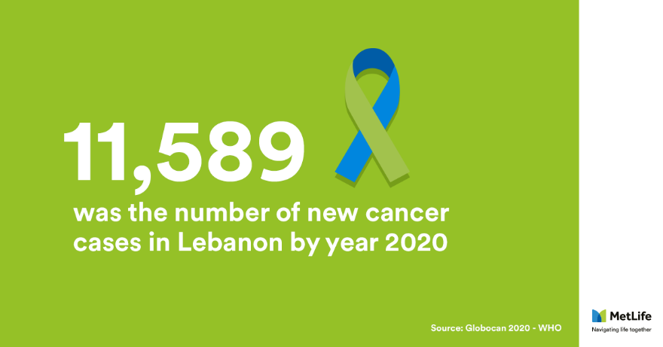
LinkedIn post 6 – dec19
Insurance products / Critical Illness insurance | photo post
As per the studies show, Lebanon has the highest incidence of cancer. This could be overwhelming and scary.
We understand the importance of planning for the unexpected and we want you to prepared for it and help protect yourself, you family and your budget from the financial impact of cancer.
Contact me to know more about critical illness insurance.
Caption:
As per the studies show, Lebanon has the highest incidence of cancer. This could be overwhelming and scary.
We understand the importance of planning for the unexpected and we want you to prepared for it and help protect yourself, you family and your budget from the financial impact of cancer.
Contact me to know more about critical illness insurance.
Copy on image:
11,589 was the number of new cancer cases in Lebanon by year 2020
Resource:
Globocon 2020-who

Slide 26
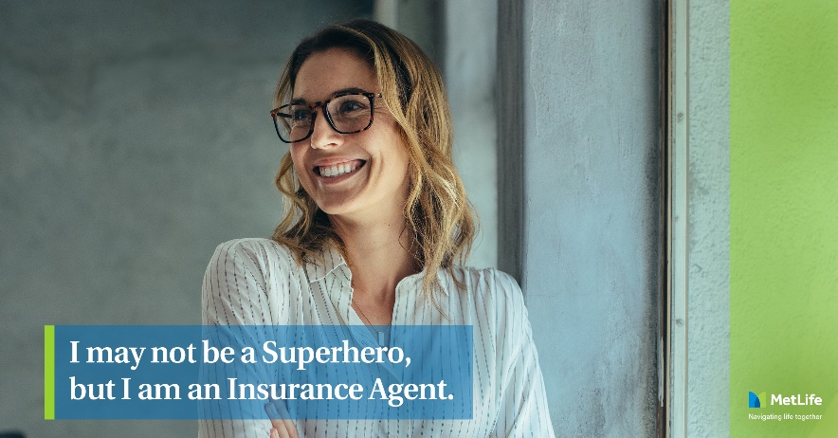
LinkedIn post 7 – Dec 22
Your life as an agent pillar | Photo Post
Holidays season is a time when giving and receiving has a special meaning– and providing protection is considered one of the most important gifts you can give to your loved ones.
Whether you are saving for your kids’ education or planning for a comfortable and enjoyable retirement, I’m committed to helping you make the right choices so that you can navigate through life; working closely with our customers, we take on their goals as our own and bring our knowledge to the table to help them anticipate change and navigate the road ahead with confidence.
I’m here to help you decide on your special gift.
This is the #LifeOfAnInsuranceAgent. Happy Holidays everyone!
Caption:
Holidays season is a time when giving and receiving has a special meaning– and providing protection is considered one of the most important gifts you can give to your loved ones.
Whether you are saving for your kids’ education or planning for a comfortable and enjoyable retirement, I’m committed to helping you make the right choices so that you can navigate through life; working closely with our customers, we take on their goals as our own and bring our knowledge to the table to help them anticipate change and navigate the road ahead with confidence.
I’m here to help you decide on your special gift.
This is the #LifeOfAnInsuranceAgent. Happy Holidays everyone!
Copy on image:
I may not be a Superhero,
but I am an Insurance Agent

Slide 27
LinkedIn post 8 – De26
Your life as an agent pillar | Photo Post
The typical day for a life insurance agent, centers around communication. Whether internal or external, communication is essential for us to do our job properly.
We ask questions in order to understand our clients’ needs. We are open and we do care.
So, what’s on your mind today?
#LifeOfAnInsuranceAgent
Caption:
The typical day for a life insurance agent, centers around communication. Whether internal or external, communication is essential for us to do our job properly.
We ask questions in order to understand our clients’ needs. We are open and we do care.
So, what’s on your mind today?
#LifeOfAnInsuranceAgent
Copy on image:
Talking about what matters most.

Slide 28
LinkedIn post 9 - Dec 29
MetLife solutions | Happy New Year!
The very words “bucket list” can stir up some pretty heave-duty. Defined as a list of things to do before a specific time; it can be a reminder that our time is limited and can guide us to achieve what is most important to us before it is too late.
Whether you want to see the world, change your career or watch your children graduate with a doctorate degree, with our wide range of savings plans, it’s just a matter of when.
May this year bring new happiness, new goals, and new achievements! Happy New Year!
I’m always here to help you achieve your goals.
Caption:
The very words “bucket list” can stir up some pretty heave-duty. Defined as a list of things to do before a specific time; it can be a reminder that our time is limited and can guide us to achieve what is most important to us before it is too late.
Whether you want to see the world, change your career or watch your children graduate with a doctorate degree, with our wide range of savings plans, it’s just a matter of when.
May this year bring new happiness, new goals, and new achievements! Happy New Year!
I’m always here to help you achieve your goals.
Copy on image:
What's on your bucket list?

Slide 29
Thank you!

