Slide 1
Third Calendar MetLife AL/UM

Slide 2
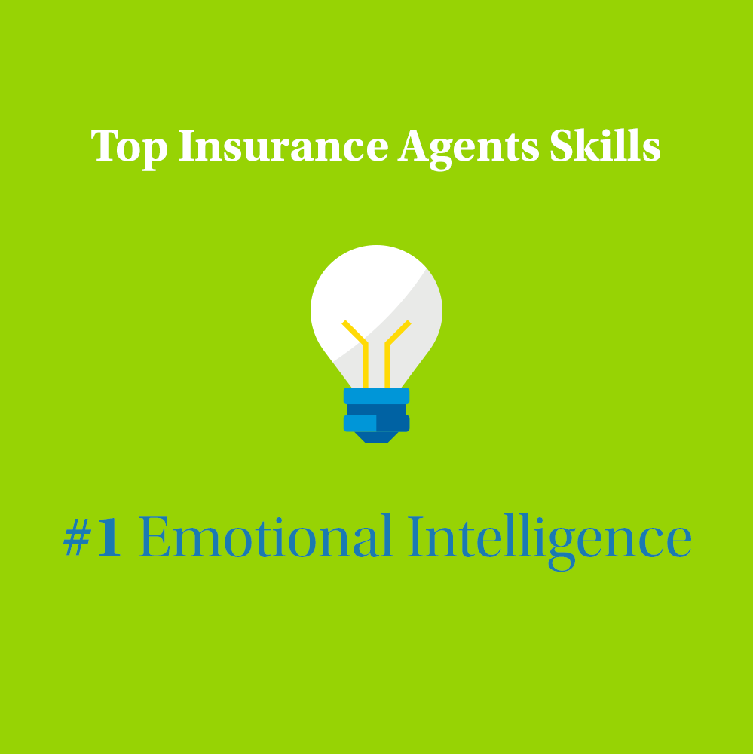
Post 1
Text on Visual:
Top Insurance Agents Skills
Emotional Intelligence
Caption:
To be successful in the insurance industry, new agents should know the skills that are common among top producers. You should be willing and able to listen and empathize with clients on a deeper level in order to understand what are their needs and help them to tailor a protection plan that is adapted to their needs.
If you have good people skills, let’s connect!
Facebook, LinkedIn.

Slide 3
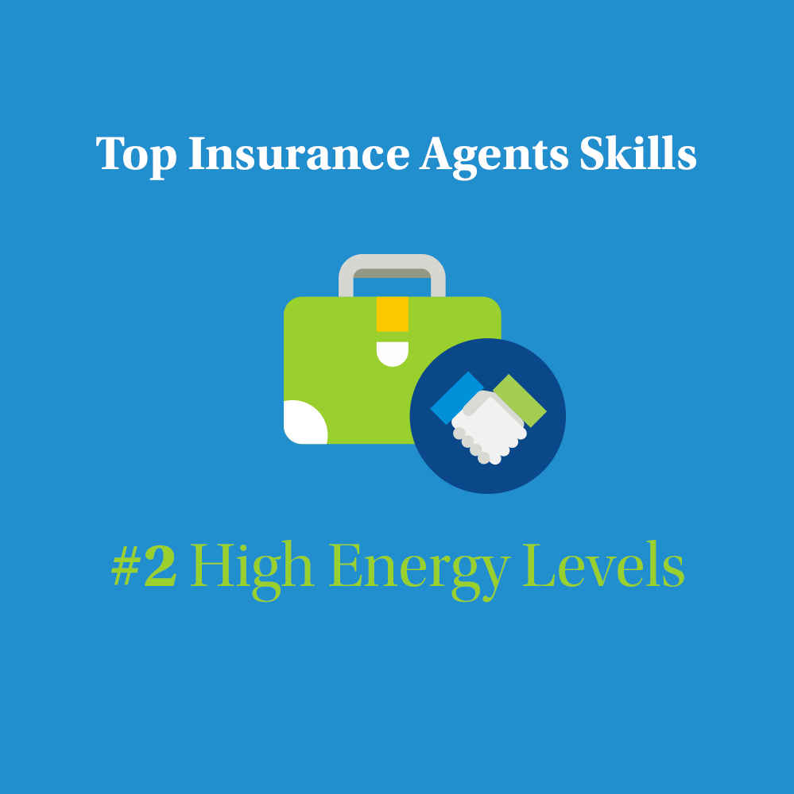
Post 2
Text on Visual:
Top Insurance Agents Skills High Energy Levels
Caption:
Persistence is a golden quality to have as an insurance agent. The best agents appear to be always excited and eager. A lack of energy and purpose could affect your relationship with your potential clients and discourage them from partnering up with you.
Do you think you fit the role? Send me a message to discuss it further.
Facebook, LinkedIn.

Slide 4
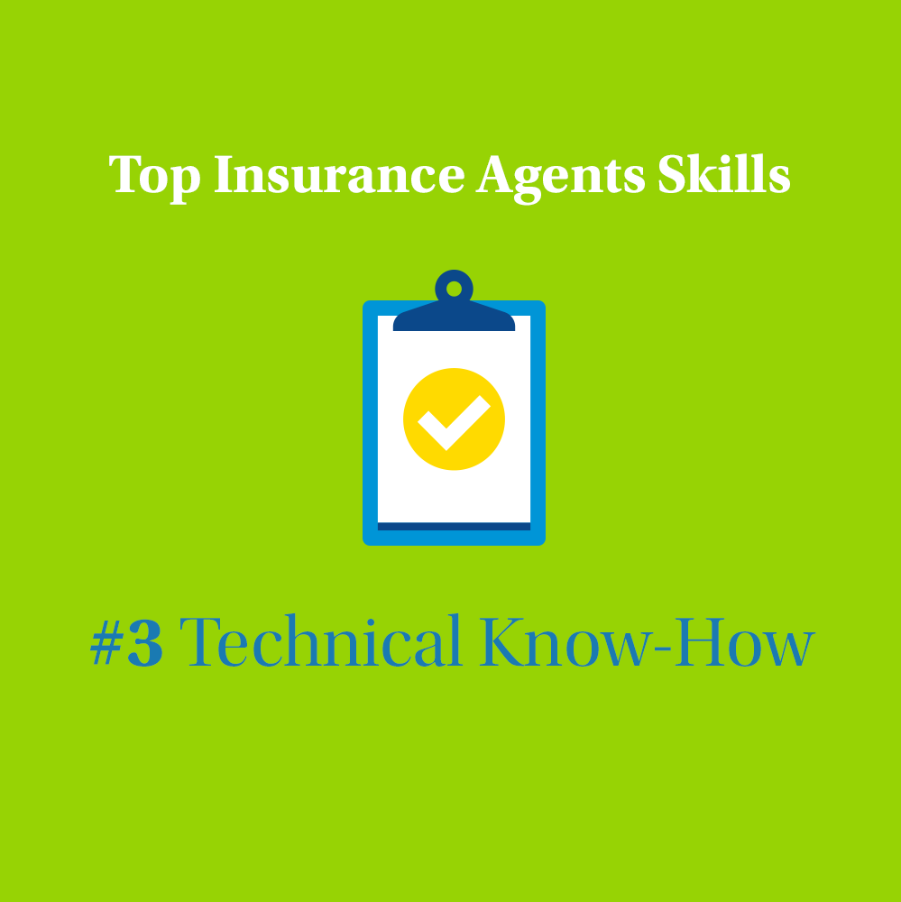
Post 3
Text on Visual:
Top Insurance Agents Skills Technical Know-How
Caption:
Clients are attracted to products that fit their needs along with a great service. If insurance agents understand the knowledge of the insurance products they’re selling and how they fit their client's financial situation, they will be able to gain their trust on the long term.
Don’t worry! Right after the internal trainings and learning the available tools - You can start working in my team almost immediately
If you’re someone who always goes the extra mile and willing to learn, we can walk a long journey together, let’s connect.
Facebook, LinkedIn.

Slide 5
Post 4
Text on Visual:
Big Challenges & Bigger Rewards
Caption:
The life insurance industry is without a doubt very challenging, yet it’s immensely rewarding for those who are willing to learn and grow the needed skills to build strong portfolios.
If you’re focused on changing your life and serious about putting the work for it, let’s talk.
Facebook, LinkedIn.

Slide 6
Post 5
Text on Visual:
No ceiling on your income potential
Caption:
While it may take time for you to build up your clients, with the first years being the toughest, there is potential to earn an abundant income with time. With unlimited earning potential, the insurance industry offers you unlimited career advancement and success.
If you’re looking for a career that rewards your adequately for your efforts, let’s connect.
Facebook, LinkedIn.

Slide 7
Post 6 –
Text on Visual:
Insurance is a growing industry
Caption:
Although recent times were challenging, the insurance industry remains a solid bet for any new joiner to the job market. If you’re looking for a steady and fast track career, insurance sales might just be the thing you’re looking for.
Let’s discuss it if you’re contemplating the idea of a career as an Insurance Agent.
Facebook, LinkedIn.

Slide 8
Post 7
Text on Visual:
Why choose to work with MetLife?
Caption:
Why do potential candidates choose to pursue the insurance agents' career to work with MetLife?
Here are some simple reasons:
Enhanced Earning Potential,
simple sales tools,
mentoring at every stage,
bonus & rewards system,
Accelerated Career Growth
better Work-Life Balance
Is this what you are looking for? DM me to discuss the details.
Facebook, LinkedIn

Slide 9
Post 8
Text on Visual:
Selling Insurance is a career not a job
Caption:
The real difference between a successful insurance agent and an unproductive one lies in attitude. If you’re looking for a career, you will have long-term goals and a plan to achieve them. If you’re looking for a job, you will be in it to earn money to pay your bills and support your lifestyle. If you’re willing to approach Insurance agent as a long-term career, I can tell you that you will see a great outcome. If you’re in it for the long haul, let’s connect.
Facebook, LinkedIn

Slide 10
Post 9
Text on Visual:
How driven for success are you?
Caption:
Here’s a question, I would ask any applicant: How driven for success are you? Insurance Agents need to have a strong internal drive to succeed. Everything you get out of this career will be the result of what you put into it.
Let’s discuss it further if you’re interested.
Facebook, LinkedIn

Slide 11
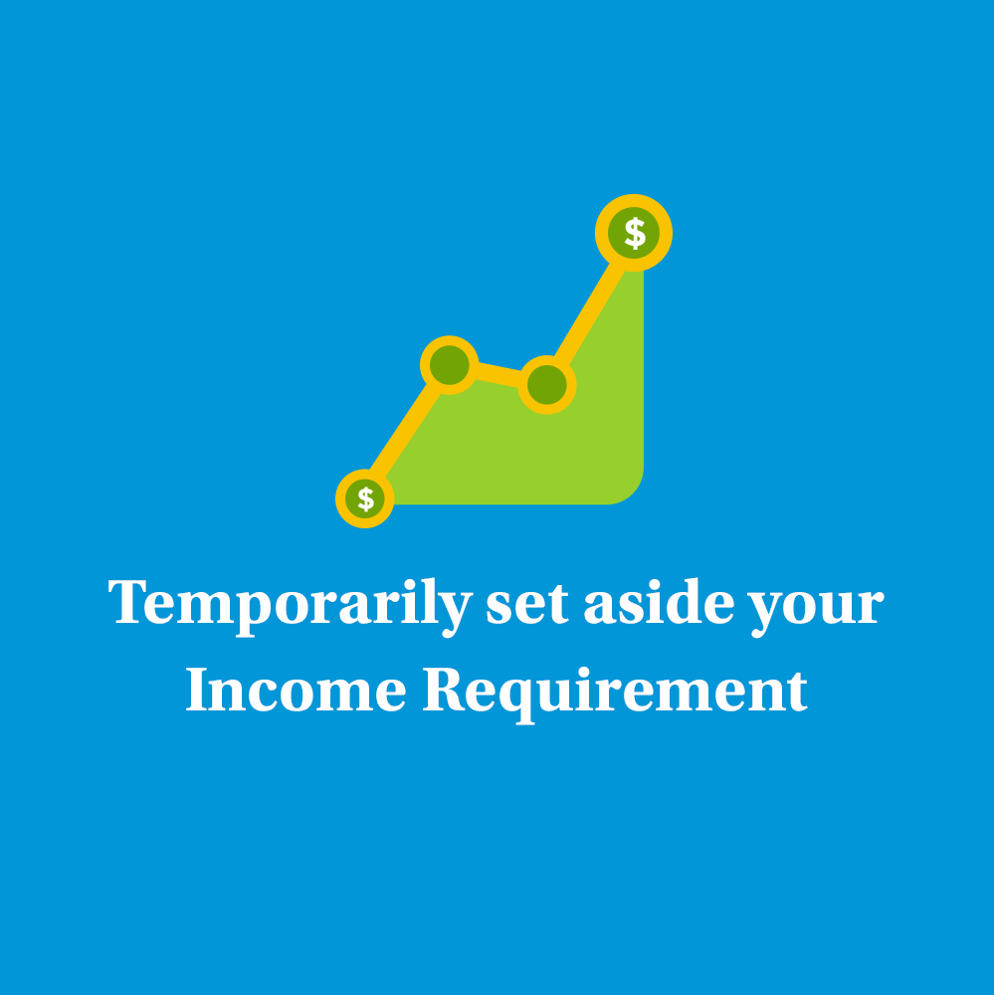
Post 10
Text on Visual:
Temporarily set aside your Income Requirement
Caption:
It’s common for an insurance agent’s first years to be the leanest of their career. Top producers are very hard working individuals who put the time and effort to reach high income levels. If you’re willing to put in the needed work, you will reap the benefits. Just give it time it to happen during the first years of your career. Be patient, that’s my advice. Let’s connect to discuss it further!
Facebook, LinkedIn.

Slide 12
Post 11
Caption:
We’re now looking for Life Insurance Agents to join our dynamic team at [Agency Name] with MetLife, who will be responsible for:
Introducing MetLife through visits and demonstrating the protection solution and services it can provide
Providing intermediary services between the insurance company and clients and good customer service to maintain and retain clients
Meeting prospective clients to gather information about them and analyzing the client’s current portfolios and make recommendations based on their needs
Submitting a weekly activity report to the Unit Manager, along with the strategy plan for the coming weeks
Stay in touch with your customers to ensure a steady stream of repeat business
Having persistency, ambition, determination & positivity to achieve the personal SMART goals
Requirements:
Education Level: Bachelor Degree
Excellent communication skills
Display good analytical skills
Provide excellent customer service
Possess excellent interpersonal skills
We offer attractive remuneration packages and commission with career growth, learning and development for successful candidates.
Interested ? Apply by sending an email to XXX or message me on LinkedIn
Closing date for accepting applications is XXX
LinkedIn

Slide 13
Thank You

