Slide 1
MetLife Calendar AL/UM
September 2022
© Born Interactive, Proprietary and Confidential

Slide 2
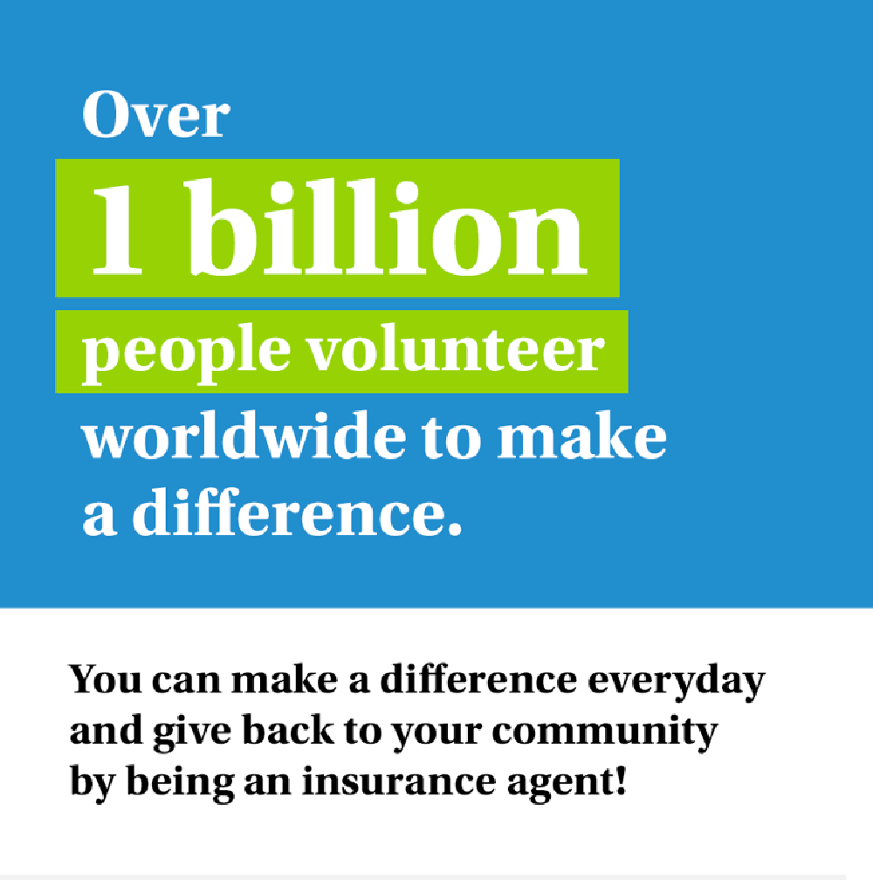
Post 1
Caption:
Today's job seekers are searching for positions that offer more than simply a salary. People are becoming more and more interested in careers that allow them to give back.
An insurance career can help satisfy this desire for meaningful work and community involvement. The insurance sector was founded on the idea of protecting community members.
Would you like to take part in that? Send me a message so we can discuss

Slide 3
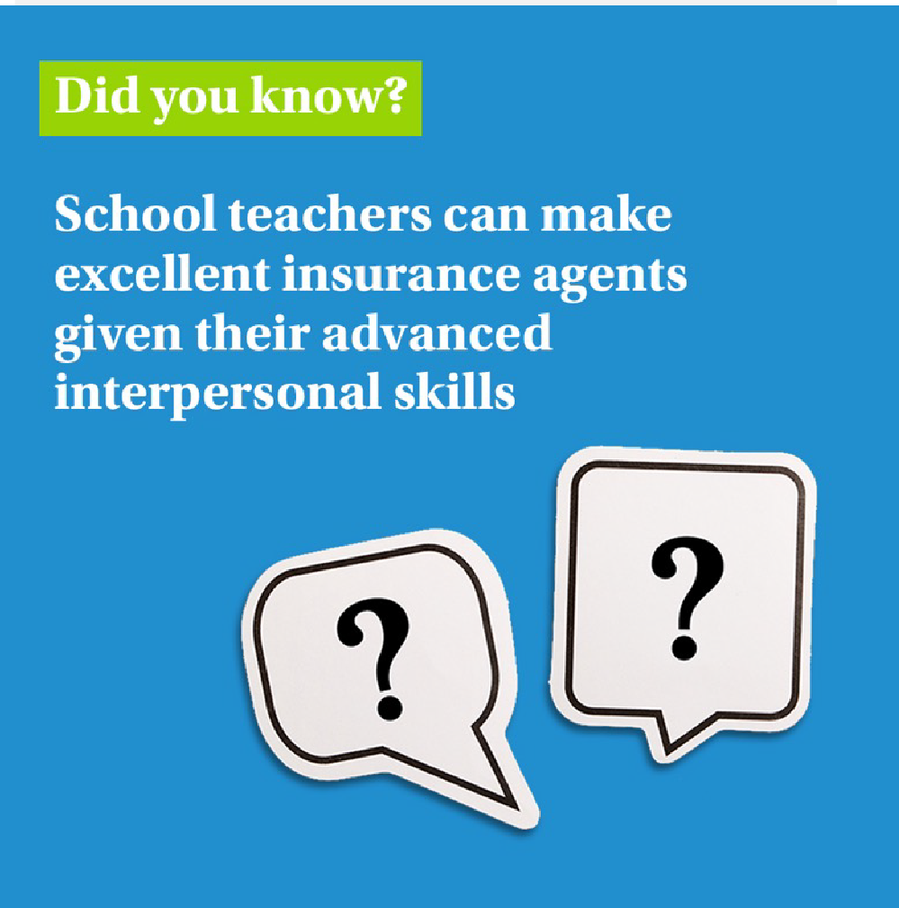
Post 2
Caption:
If you are a teacher, you can certainly translate perfectly, choose the language of the recipient, you are patient and you approach everyone individually. With MetLife, we value these people!
Tag a teacher who needs to hear this!

Slide 4
Post 3 –To recruit PALs
Caption:
We’re now looking for Sales Team Leader to join our dynamic team at [Agency Name] with MetLife.
Key responsibilities:
Keep Informed of New Products and
Services
Recruit, Train, and Coach the Sales Team
Set Sales Targets and Motivate Sales Team
Prepare Sales Reports
Text on Visual:
Requirements:
28-40 years old
University Graduates with Official Lebanese Baccalaureate
Minimum 5 years of experience in Sales
Minimum 2 years managerial experience
Highly motivated and Goal oriented
E-mail your CV to: XXXXX@metlifeagency.net to be considered for the selection process or message me on LinkedIn
Closing date for accepting applications is XXX

Slide 5
Post 4
Text on Visual:
You don’t need work insurance experience to start a career as an insurance agent!
Caption:
No experience? No problem. Even if you have no previous professional experience as an insurance agent, you might be surprised to learn that your set of skills can translate to a successful future in insurance.
Join the MetLife team of agents and receive ongoing trainings throughout your journey, from product training to leadership programs.
Constantly learning and growing to uncover your
true potential.
DM so we can discuss further on how to be part of our team.

Slide 6
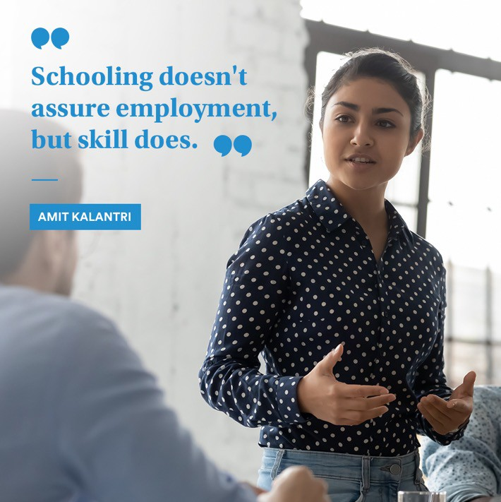
Post 5
Caption:
Text on Visual:
“Schooling doesn't assure employment, but skill does.” ― Amit Kalantri
A "regular day" does not exist in the insurance industry. As an insurance agent, each day will present you with fresh challenges and opportunities for learning, as you expand and refine your skills.
Can you handle it? Let's connect and discuss it.

Slide 7
Post 6 –To recruit PALs
Caption:
We are recruiting Sales Team Leaders For those interested to join, have an entrepreneurial mindset and fit the below criteria, please send us your resume to XXXX@metlifeagency.conet
- 28-40 years old
Text on Visual:
University Graduates with Official Lebanese Baccalaureate
Minimum 5 years of experience in Sales
Minimum 2 years managerial experience
Highly motivated and Goal oriented
Ability to direct and be a mentor on the sales ground by actively working to attain everyday sales objectives

Slide 8
Thank You
© Born Interactive, Proprietary and Confidential

