Slide 1
Second Calendar MetLife AL/UM

Slide 2
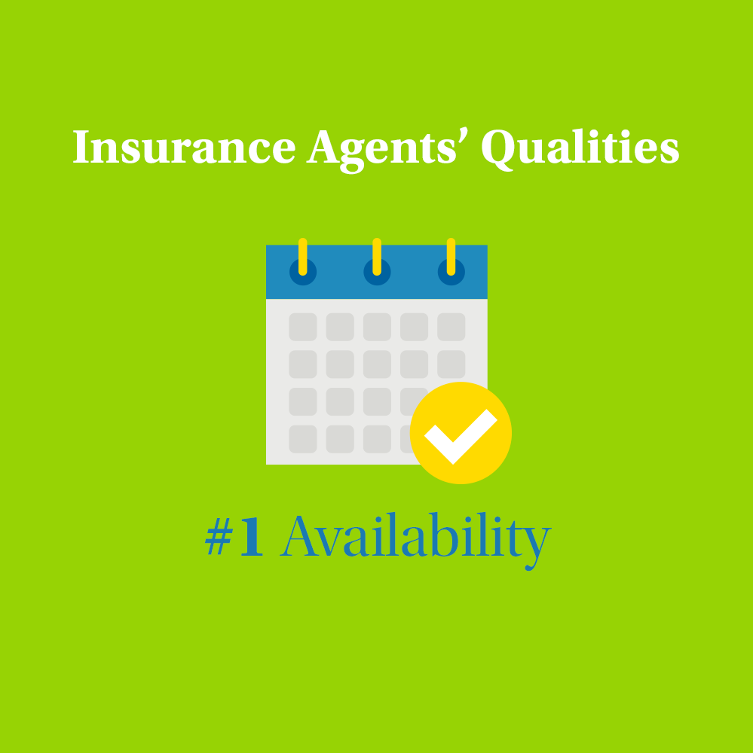
Post 1
Text on Visual:
Insurance Agents’ Qualities #1 Availability
Caption:
One of the most important habits to adopt as an insurance agent is to be always available, not only when it’s most convenient for you. Being available could mean allowing text message communication or chatting with prospects and clients via different channels. The point is, always make time to return an email or a phone call, it gives an opportunity to add value and your personal touch with your clients ;)
If you’re looking for a career in Insurance, let’s connect!
Facebook, Instagram, LinkedIn.

Slide 3
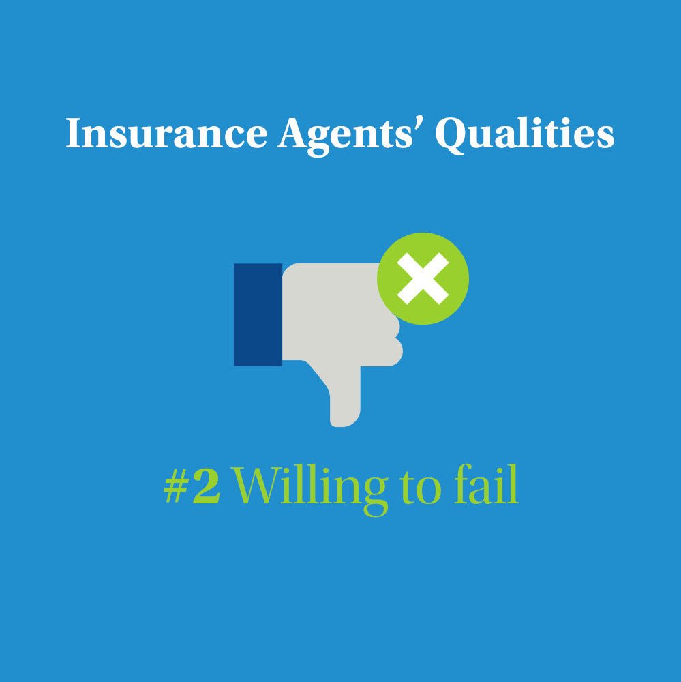
Post 2
Caption:
As Albert Einstein once said, “ Failure is success in progress”. Let’s face it, many of us avoid the feeling of failure. In fact, we’re so focused on not failing, that we don’t aim for success, but instead settle for a life of mediocrity. We’re taught to be risk averse, but that shouldn’t stop us from taking calculated risks in our own businesses. Sometimes things may not go as planned, but that doesn’t mean your strategy isn’t correct. Do you want to learn more about the work of an Insurance Agent? Let’s get in touch!
Facebook, Instagram, LinkedIn.

Slide 4
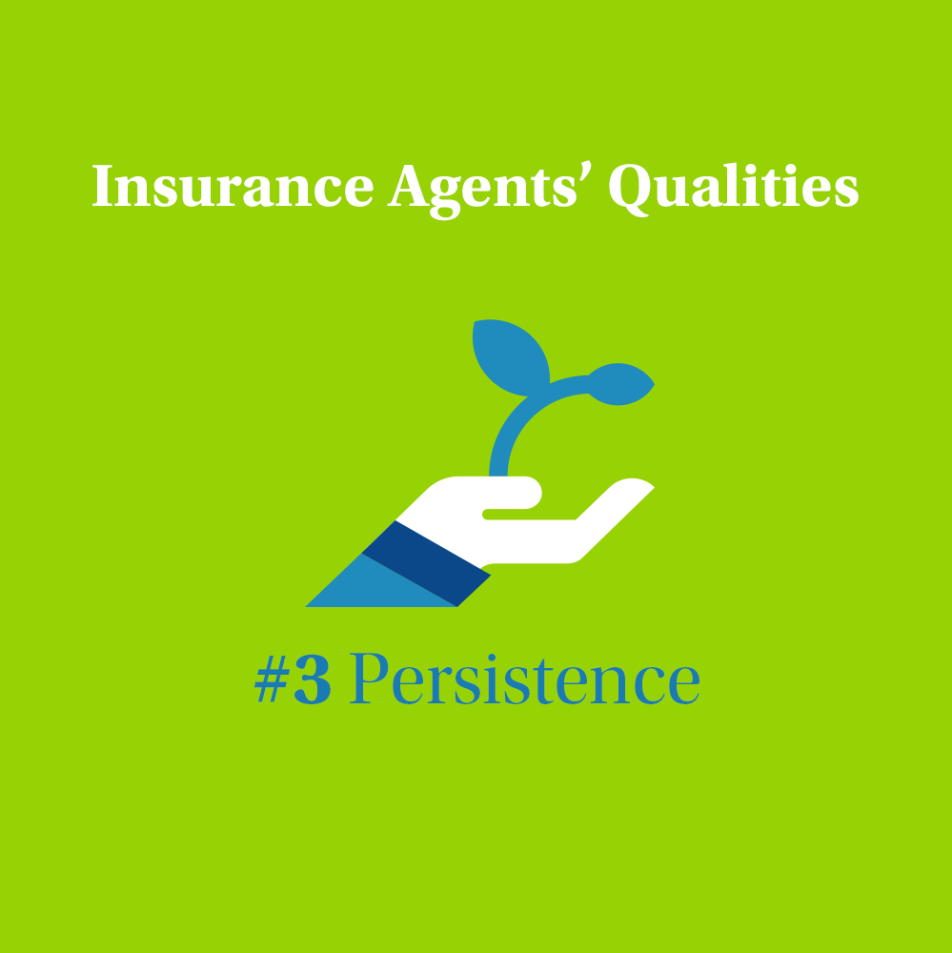
Post 3
Caption:
Sorry to burst your bubble, but building a successful insurance career isn’t always easy.
Sometimes, you’ll lose a customer for many reasons, and it can get depressing.
But, rather than giving up, find a way to win because you can’t get lucky without hard work. A key ingredient is persistence.
Do you want to learn more about the work of an Insurance Agent? Let’s get in touch!
Facebook, Instagram, LinkedIn.

Slide 5
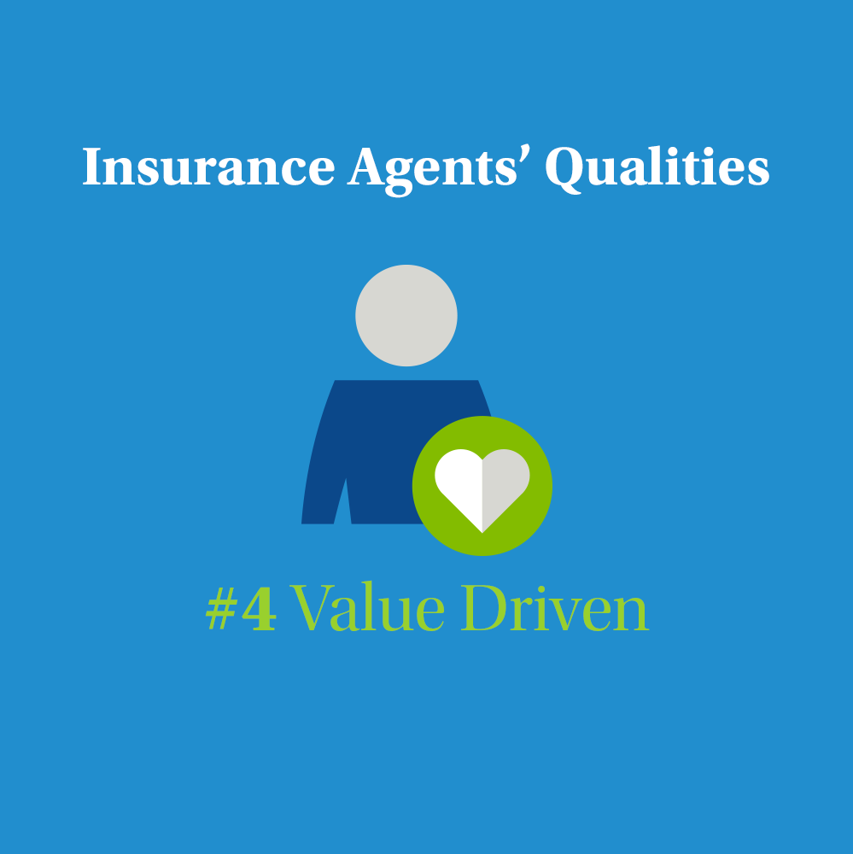
Post 4
Caption:
The work of an insurance agent is associated with the opportunity to meet new people and their stories. A good consultant should be able to listen and then adjust the protection solutions to the current needs of the client. The interpersonal skills and not only the knowledge of insurance, turn out to be one of the most important in this career.
That is why I value experienced people in my work so much and I give people of all ages a chance for development with MetLife.
If you want to change after many years and you like working with people - write to me and I will tell you how to start working in my team.
Facebook, Instagram, LinkedIn

Slide 6
Post 5 – Only if it applies to you as per the caption
Caption:
When I was an insurance agent, I ran into challenges that made me question my career path. Now that I overcame these challenges and started my own agency with MetLife, I would like to share with you my recipe for a successful insurance agent career:
- Learn how to find and customize unique solutions for each customer - Research and educate yourself. Plan your time. - Don’t take it personal whenever dealing with difficult clients If you want the same help that I gave myself a few years ago, book a consultation call with me to discuss your future career.
Facebook, Instagram, LinkedIn

Slide 7
Post 6
Text on Visual:
Are you looking for a new job?
Caption:
Openness to new things, empathy, satisfaction from working with people, negotiation skills - these are the features that a good insurance agent cannot do without. Do you own most of them and are you looking for a new job? Test yourself with MetLife!
You can start working in my team almost immediately - right after the internal trainings and learning the available tools. A flexible schedule and the possibility of remote work will certainly allow you to reconcile your new duties with the existing ones.
Would you like to know more about working at MetLife’s agency? Write to me!
Facebook, Instagram, LinkedIn

Slide 8
Post 7
Caption:
Our agents work flexibly! They choose the time and place of work themselves – driven by their objective and their mission to protect. Working at MetLife’s agencies is for you if:
you value independence,
you know people
you like to listen and advise others.
Do you feel that you will prove yourself in this role? Write to me and I will be happy to give you more details.
Facebook, LinkedIn

Slide 9
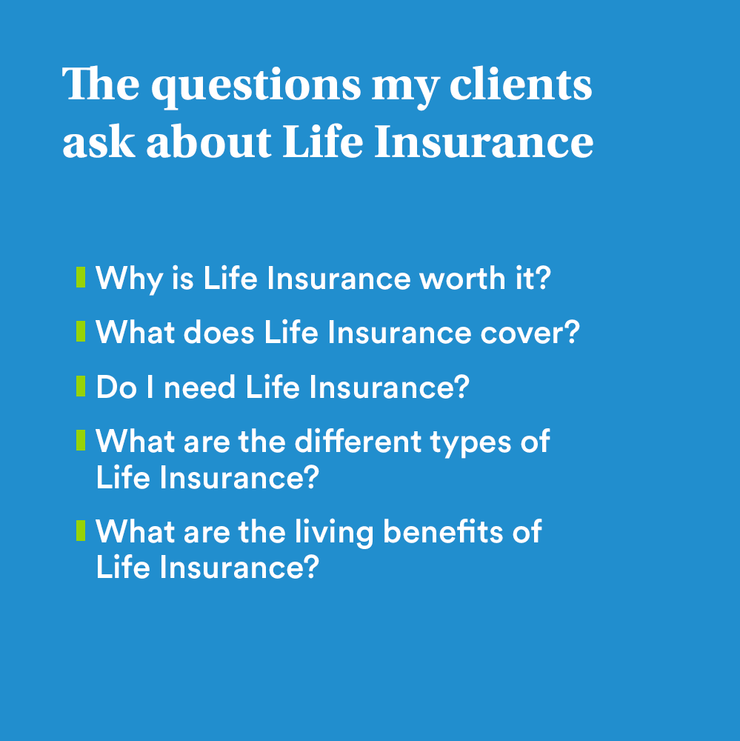
Post 8
Text on Visual:
The questions my clients ask about Life Insurance 1- Why is Life Insurance worth it? 2- What does Life Insurance cover? 3- Do I need Life Insurance? 4- What are the different types of Life Insurance? 5- What are the living benefits of Life Insurance?
Caption:
I have the answers to common questions about Life Insurance so that you can make informed decisions about protecting your loved ones. Today is a great place to start and an easy step you can take simply by contacting me. Book a consultation today and let’s discuss your questions!
Facebook, Instagram, LinkedIn

Slide 10
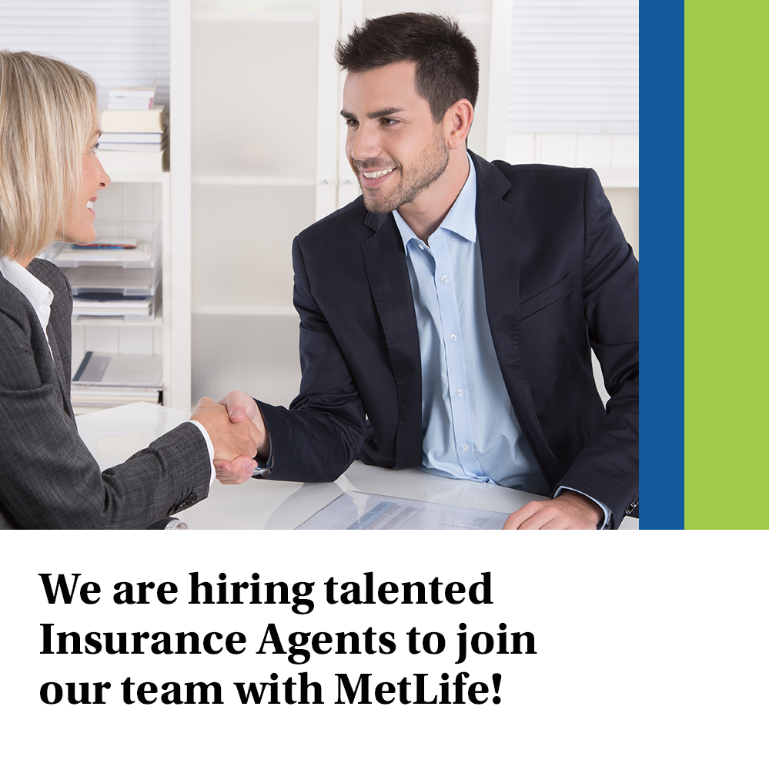
Post 9
Text on Visual:
We are hiring talented Insurance Agents to join our team
Caption:
We’re now looking for Life Insurance Agents to join our dynamic team at [Agency Name] with MetLife, who will be responsible for:
Introducing MetLife through visits and demonstrating the services it can provide
Providing intermediary services between the insurance company and clients and good customer service to maintain and retain clients
Meeting prospective clients to gather data about them and analyzing the client’s current portfolios and make recommendations based on their needs
Submitting a weekly activity report to the Unit Manager, along with the strategy plan for the coming weeks
Stay in touch with your customers to ensure a steady stream of repeat business
Having persistency, ambition, determination & positivity to achieve the personal SMART goals
Requirements:
Education Level: Bachelor Degree
Excellent communication skills
Display good analytical skills
Provide excellent customer service
Possess excellent interpersonal skills
We offer attractive remuneration packages and commission with career growth, learning and development for successful candidates.
Interested ? Apply by sending an email to XXX or message me on LinkedIn
Closing date for accepting applications is XXX
Facebook, LinkedIn

Slide 11
Post 10
Text on Visual:
Do not postpone good decisions for later
Caption:
Accidents happen to people ... Instead of believing in your own resistance to bad luck and accusing yourself for not thinking about something earlier - take out Accident & Health insurance with MetLife.
In addition to financial support, MetLife Accident & Health also offers assistance services, such as coverage of rehabilitation costs.
Write to me if you want to know more
#MetLifeInsuranceConsultant #MetLifeAgent
Facebook, Instagram, LinkedIn

Slide 12
Post 11
Text on visual:
Start your first career steps with MetLife
Caption:
At MetLife, you can count on product and sales training, conducted by Learning & Development specialists with many years of experience, right from the start. Thanks to this preparation at MetLife, you will feel confident taking your first steps in the profession of an insurance agent.
I am looking for people who want to help others and feel good at working with people. Do you feel that you will prove yourself in this role? Let's talk!
Facebook, Instagram, LinkedIn

Slide 13
Post 12
ANIMATION VIDEO.
Caption:
MetLife insurance agents can count on many benefits. What kind? Watch the animation and decide for yourself if it's worth it - I'm waiting for your application. 😉
Facebook, Instagram, LinkedIn

Slide 14
Thank You

