Slide 1
MetLife Social Recruitment Calendar
October 2023

Slide 2
Post 1 -
.
Caption:
Become a MetLife Insurance agent and embrace work-life balance with flexible schedules, cutting-edge technology, and a supportive network. Achieve professional success while enjoying quality time with loved ones. Let us connect and talk about it.
#MetLifeLebanon #MetLife #WorkLifeBalance #MetLifeAgent
LinkedIn

Slide 3
Post 2
Caption:
October is Breast Cancer Awareness Month, and it's a reminder that regular screenings, early detection, and support are the keys to saving lives in the fight against breast cancer. Together, let's make a difference.
#BreastCancerAwareness #EarlyDetectionSavesLives
#MetLife #MetLifeLebanon #NavigatingLifeTogether
LinkedIn

Slide 4
Post 3
Caption:
I am looking for people with different experience and age range. People who want to remain professionally active. If you have worked in a different profession so far, and you want to start a new phase in your life, I will gladly welcome you to our ranks. For me, the most valuable thing is your approach and motivation.
You do not need to have experience in insurance – our Leanings and Development scheme will teach you everything, you will also get easy-to-use tools that will help you fulfill your professional duties. In addition, a flexible schedule will certainly make your career as an insurance consultant with MetLife easier - you decide what is best for you.
Would you like to join my team? Apply now: XXXX
#MetLifeLebanon #WeAreHiring #MetLifeAgent #insurance #Career #jobseekers
LinkedIn

Slide 5
Post 4 – animated Video -
Caption:
MetLife insurance agents can count on many benefits. What kind? Watch the video and decide for yourself if it's worth it - I'm waiting for your application. Apply now [linkXXXX ]😉
#MetLifeLebanon #WeAreHiring #MetLifeAgent #insurance #Career #jobseekers #consultants
LinkedIn

Slide 6
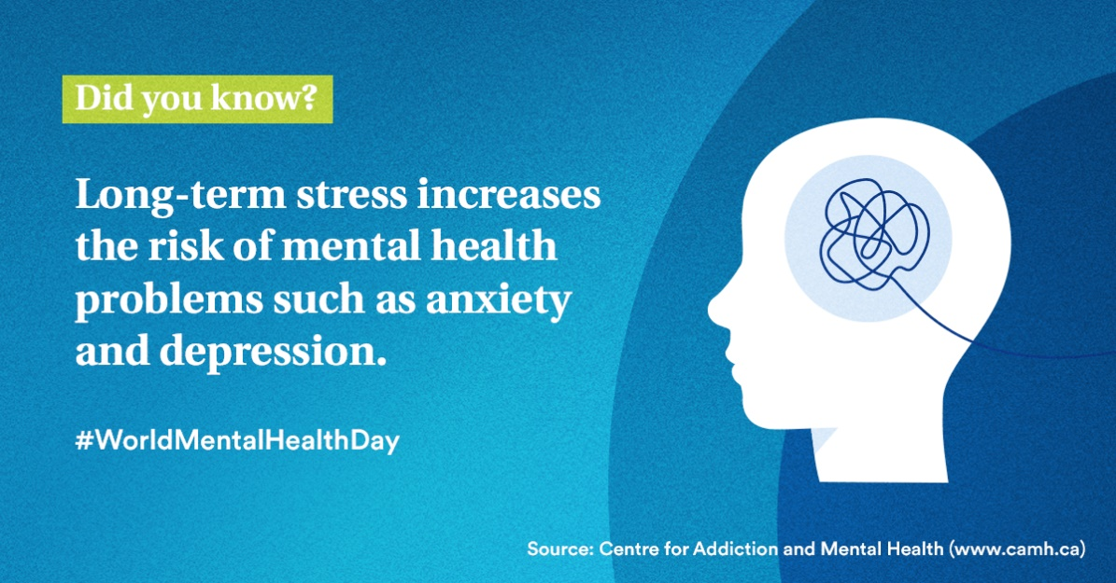
Post 5 - World Mental Health Day - October 10th
Caption:
On World Mental Health Day, let's remember: Long-term stress isn't just a tough phase; it can pave the way for anxiety and depression. Prioritize your mental well-being today and every day.
#MentalHealthMatters #WorldMentalHealthDay #MetLife #MetLifeLebanon #NavigatingLifeTogether
LinkedIn

Slide 7
Post 6 – sales team leader
Caption:
If you're enthusiastic about sales and thrive in leadership roles, we have an exciting opportunity for you to join our team at [Agency Name] with MetLife.
Key responsibilities:
Keep informed of new products and services
Recruit, train, and coach the sales team
Set sales targets and motivate sales team
Prepare sales reports
Requirements:
28-40 years old
University Graduates with Official Lebanese Baccalaureate
Minimum 5 years of experience in Sales
Minimum 2 years managerial experience
Highly motivated and Goal oriented
Apply now :[link XXX ] to be considered for the selection process.
#MetLifeLebanon #WeAreHiring #MetLifeAgent #teamleader #insurance
LinkedIn

Slide 8
Post 7
Caption:
Believing in yourself is the first step to achieving your dreams. If you've ever considered a career as a MetLife insurance agent, ask yourself: 'Am I ready for a new and fulfilling career?’
The answer might just be the beginning of an incredible journey. Let's chat about the possibilities.
#MetLifeLebanon #MetLife #MetLifeAgent #InsuranceCareer
LinkedIn

Slide 9
Post 8 –
Caption:
Most people sometimes worry about the future. For example, getting ill or suffer from complications, losing their ability to work - for a shorter or longer period of time, etc... As an insurance agent, making sure their future remains secure becomes your number-one priority. They all need guidance in choosing how to protect their future and the future of their loved ones.
Would you like to take part in that? Apply now: XXXX
#MetLifeLebanon #MetLife #MetLifeAgent #InsuranceCareer
LinkedIn

Slide 10
Thank You

