Slide 1
MetLife Calendar AL/UM
October 2022

Slide 2
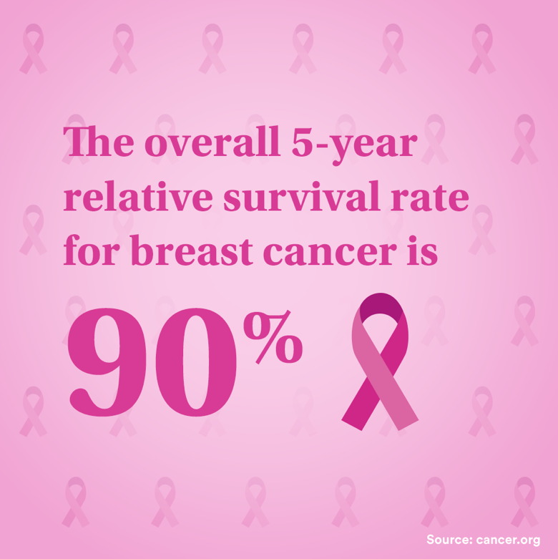
Post 1
Text on Visual:
The overall 5-year relative survival rate for breast cancer is 90%
Cancer.org
Caption:
90 out of 100 women diagnosed with breast cancer are alive after 5 years.
Women all over the world are fighting the good fight, winning their battles and standing tall as survivors, and they want everyone to know that there really is hope for the future.
#BreastCancer #BreastCancerAwarenessMonth #Pinktober
Facebook, LinkedIn.

Slide 3
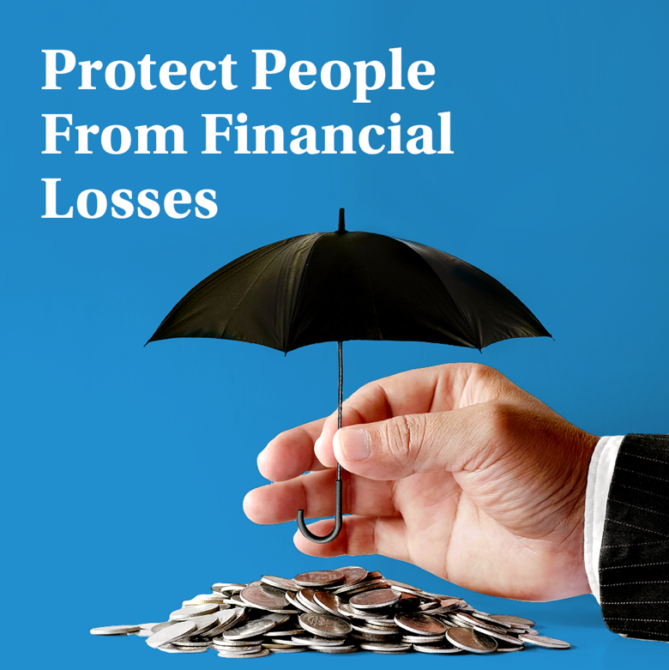
Post 2
Text on Visual:
Protect People From Financial Losses
Caption:
As an insurance agent, you get to advise your clients on which insurance policies will best meet their needs. The research you conduct and the recommendations you make have a genuine impact on a client's financial well-being in the long run.
Do you have what it takes? Let’s connect and talk about it.
Facebook, LinkedIn.

Slide 4
Post 3
Text on Visual:
We Are Looking For Sales Team Leaders!
Caption:
We are recruiting Sales Team Leaders
For those interested to join, have an entrepreneurial mindset and fit the below criteria, please send us your resume to XXXX@metlifeagency.conet
28-40 years old
University Graduates with Official Lebanese Baccalaureate
Minimum 5 years of experience in Sales
Minimum 2 years managerial experience
Highly motivated and Goal oriented
Ability to direct and be a mentor on the sales ground by actively working to attain everyday sales objectives
Facebook, LinkedIn.

Slide 5
Post 4
Text on Visual:
Evaluate Your Life Day
October 19, 2022
It is time to check in with ourselves and assess if we're still on the right track
Caption:
Evaluate Your Life Day is all about self-evaluation and self-assessment, which includes examining yourself in terms of what goals you've achieved. This assessment is done out with the goal of improving rather than self-judgment or criticism.
What goal did you achieve this year? Mention in the comment section.
Facebook, LinkedIn.

Slide 6
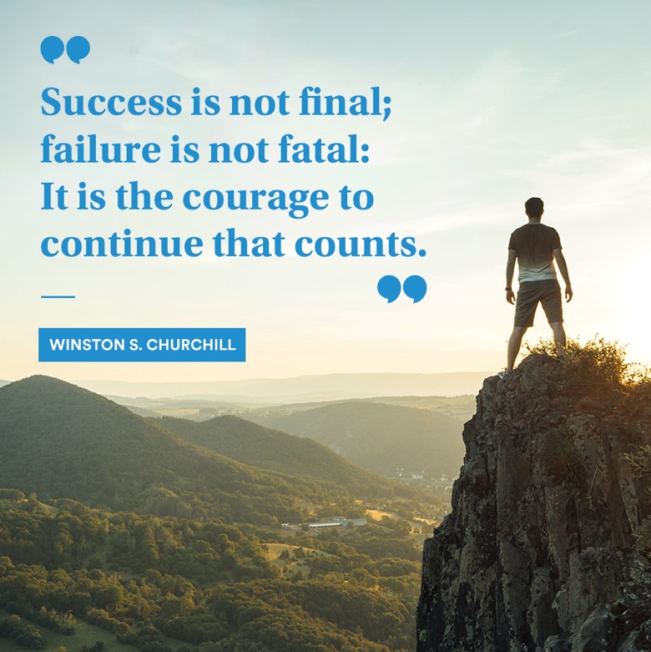
Post 5
Caption:
It is essential to remember that it is all about you and push yourself to the end, even if you encounter failures in the future. You also should try as much as possible to love the process, stay positive, and enjoy the ride.
Text on Visual:
"Success is not final; failure is not fatal: It is the courage to continue that counts." — Winston S. Churchill
Facebook, LinkedIn.

Slide 7
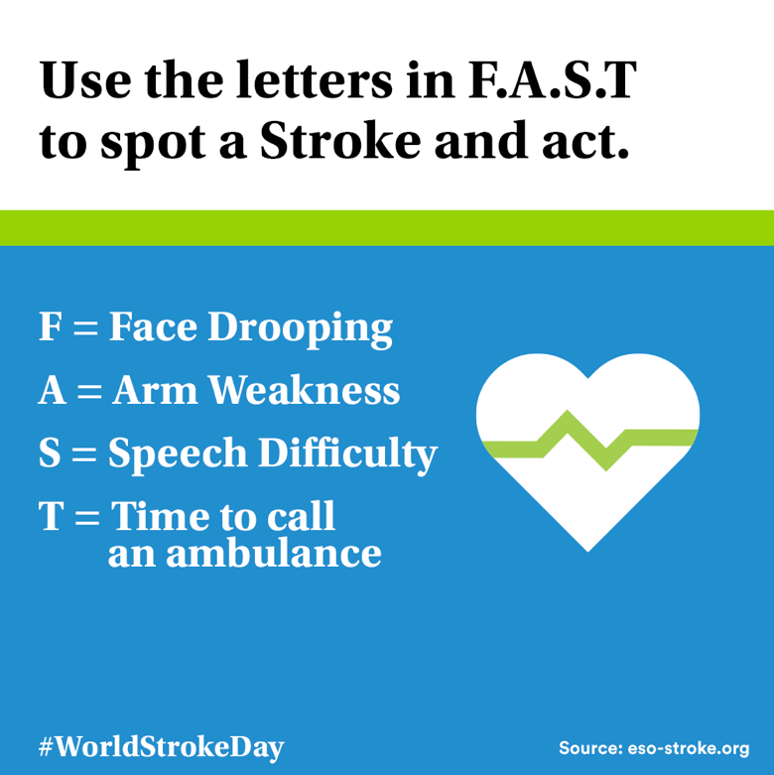
Post 6
Text on Visual:
Use the letters in F.A.S.T to spot a Stroke and act.
F = Face Drooping
A = Arm Weakness
S = Speech Difficulty
T = Time to call an ambulance
#WorldStrokeDay
Source: eso-stroke.org
Caption:
World Stroke Day takes place on Oct 29th every year and is established to increase awareness and drive action on stroke around the world.
Fast access to treatment saves lives and improves recovery. If you spot the signs of stroke, call an ambulance immediately.
Facebook, LinkedIn.

Slide 8
Thank You

