Slide 1
MetLife Calendar AL/UM
November 2022

Slide 2
Post 1
Text on Visual:
It’s Movember, Let’s talk about Men’s Health
Caption:
Many countries around the world refer to November as Movember, a term that correlates the importance of men's health to early tests, screenings, and annual physical examinations as a major step toward protecting men from potential health problems such as testicular cancer, prostate cancer, depression, and physical inactivity.
Take care of your own health as well as the health of the men in your life.
#Movember #MensHealth #MentalHealth #Cancer #ProstateCancer #TesticularCancer
Facebook, LinkedIn.

Slide 3
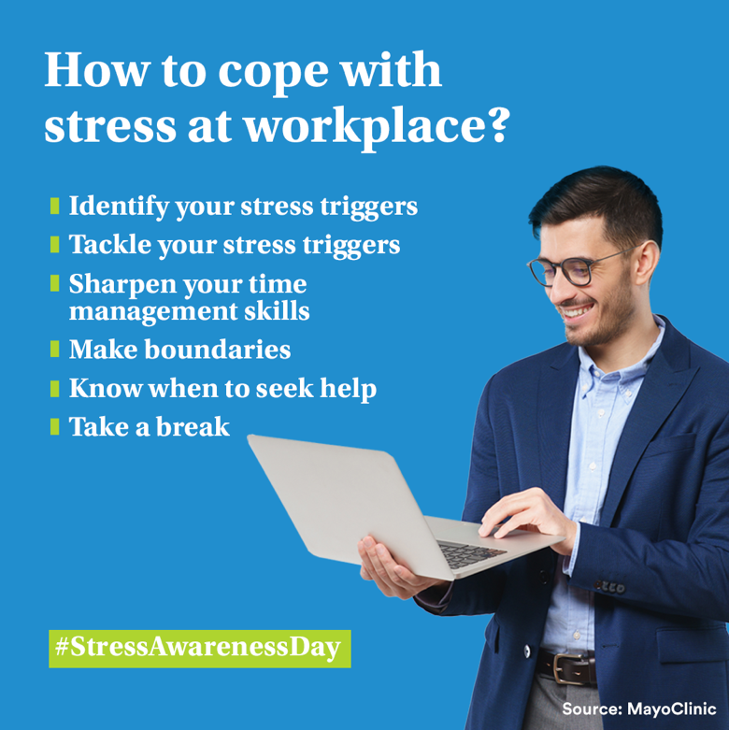
Post 2 (To be posted on November 2nd)
Text on Visual:
How to cope with stress at workplace?
Identify your stress triggers
Tackle your stress triggers
Sharpen your time management skills
Take a break
Make boundaries
Know when to seek help
#StressAwarenessDay
Source: MayoClinic
Caption:
Your job is a potential cause of stress, but you are not powerless to combat the impacts of workplace stress. Coping with job stress effectively can help both your career and personal lives. Here are 6 ways to cope with stress at workplace.
#StressAwarenessDay #Stress #Health #ManageStress
Facebook, LinkedIn.

Slide 4
Post 3
Text on Visual:
We’re Hiring!
Sales Team Leaders
Caption:
We are recruiting Sales Team Leaders
For those interested to join, have an entrepreneurial mindset and fit the below criteria, please send us your resume to XXXX@metlifeagency.conet
28-40 years old
University Graduates with Official Lebanese Baccalaureate
Minimum 5 years of experience in Sales
Minimum 2 years managerial experience
Highly motivated and Goal oriented
Ability to direct and be a mentor on the sales ground by actively working to attain everyday sales objectives
Facebook, LinkedIn.

Slide 5
Post 4 – (To be posted on 22nd November )
Text on Visual:
Happy Independence Day!
22nd of November 2022
Caption:
Happy independence day! May this country shine bright with its peace and tranquility in the upcoming years.
#IndependenceDay #LebaneseIndependence #Lebanon
Facebook, LinkedIn.

Slide 6
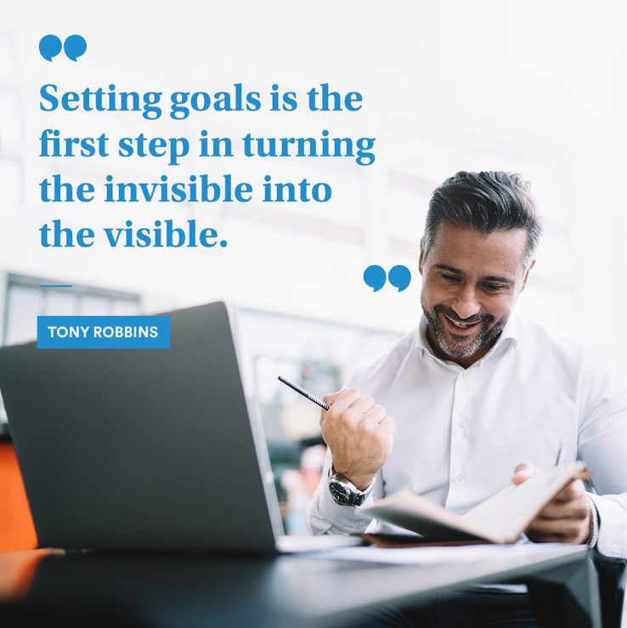
Post 5
Caption:
By being an Insurance Agent at MetLife, your income increases in accordance with work and effort and accumulates and grows over time. Don't miss the opportunity to invest in yourself.
Join us, make a difference in your life!
Message me to know what it’s like to be an Insurance Agent partnering with MetLife.
Text on Visual:
“Setting goals is the first step in turning the invisible into the visible.” — Tony Robbins
Facebook, LinkedIn.

Slide 7
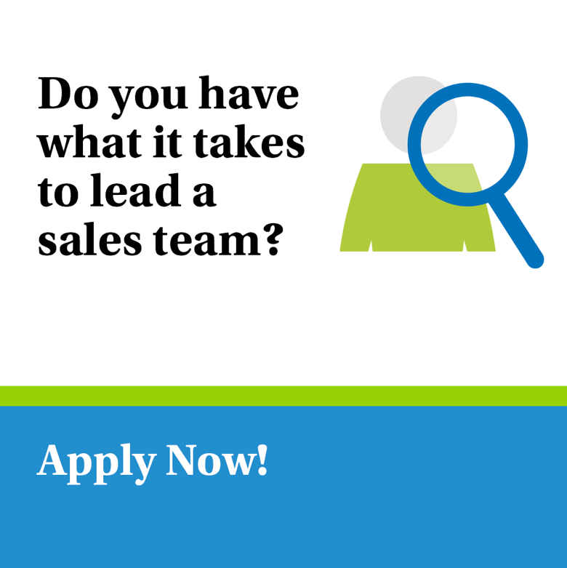
Post 6
Text on Visual:
Do you have what it takes to lead a sales team?
Apply now!
Caption:
We’re now looking for Sales Team Leader to join our dynamic team at [Agency Name] with MetLife.
Key responsibilities:
Keep Informed of New Products and Services
Recruit, Train, and Coach the Sales Team
Set Sales Targets and Motivate Sales Team
Prepare Sales Reports
Requirements:
28-40 years old
University Graduates with Official Lebanese Baccalaureate
Minimum 5 years of experience in Sales
Minimum 2 years managerial experience
Highly motivated and Goal oriented
E-mail your CV to: XXXXX@metlifeagency.net to be considered for the selection process or message me on LinkedIn
Closing date for accepting applications is XXX
Facebook, LinkedIn.

Slide 8
Thank You

