Slide 1
MetLife Calendar AL/UM
May – June 2023
© Born Interactive, Proprietary and Confidential

Slide 2
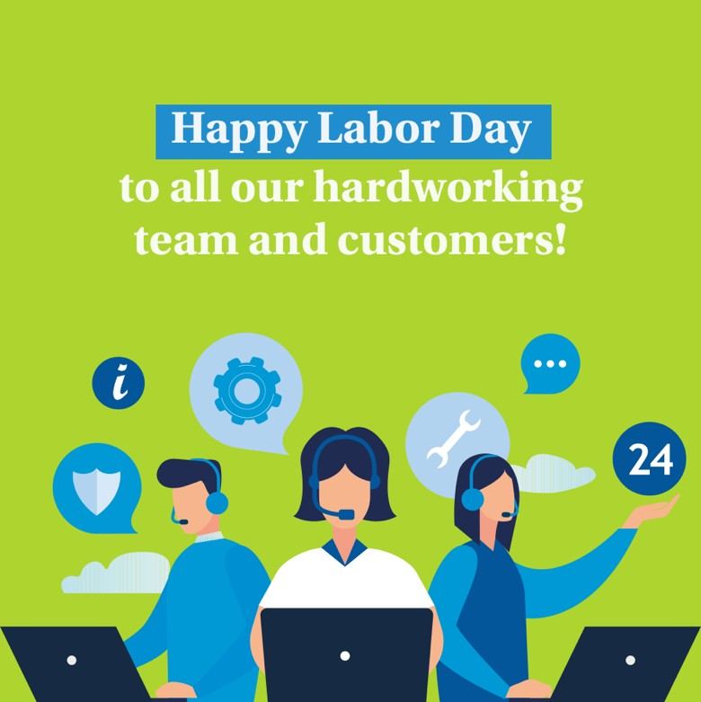
Post 1
Text on Visual:
Happy Labor Day to all our hardworking clients team and customers!
Caption:
We're grateful for the hardworking individuals who make our communities thrive. Happy Labor Day to all our team and customers!
#LaborDay #Workers #Labor #WorkHard

Slide 3
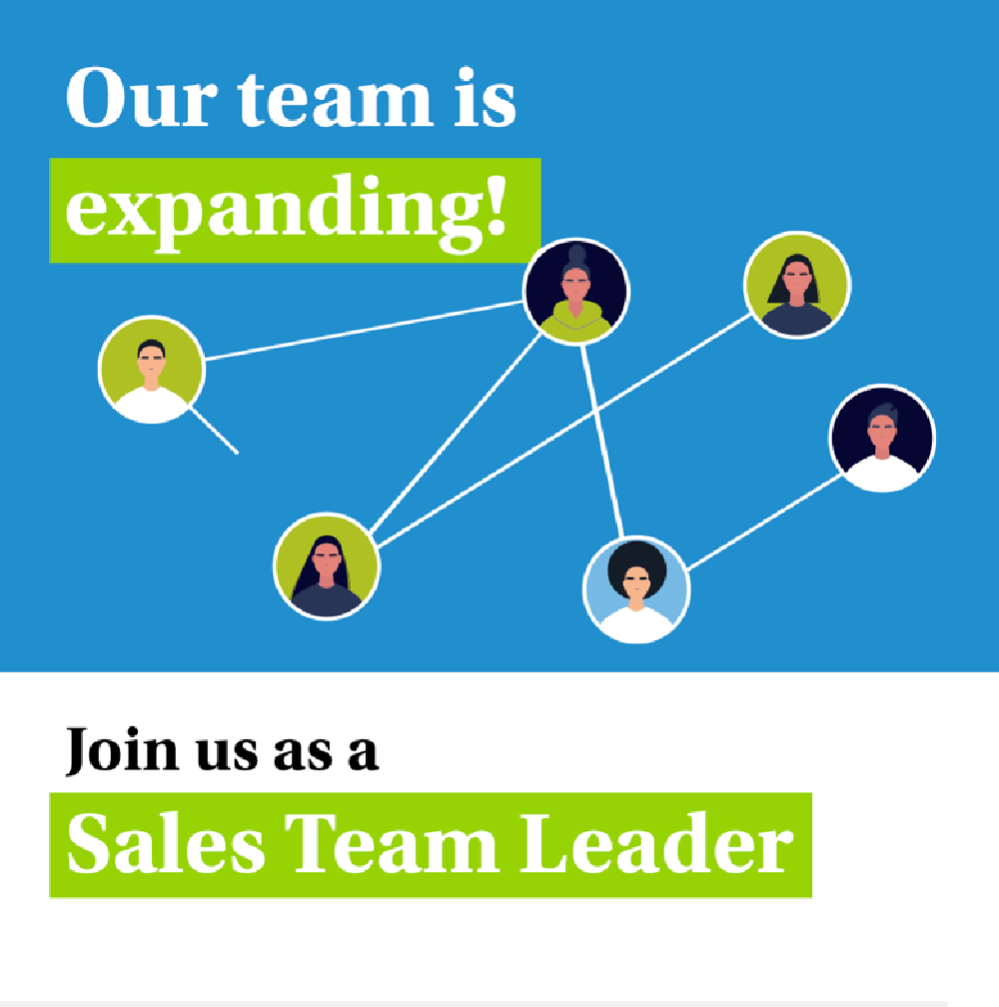
Post 2 -
(PAL)
Caption:
We are recruiting Sales Team Leaders. For those interested to join, have an entrepreneurial mindset and fit the below criteria, please send us your resume to 123456789@metlifeagency.net
30-45 years old
University Graduates with Official Lebanese Baccalaureate
Minimum 5 years of experience in Sales
Minimum 2 years managerial experience
Highly motivated and Goal oriented

Slide 4
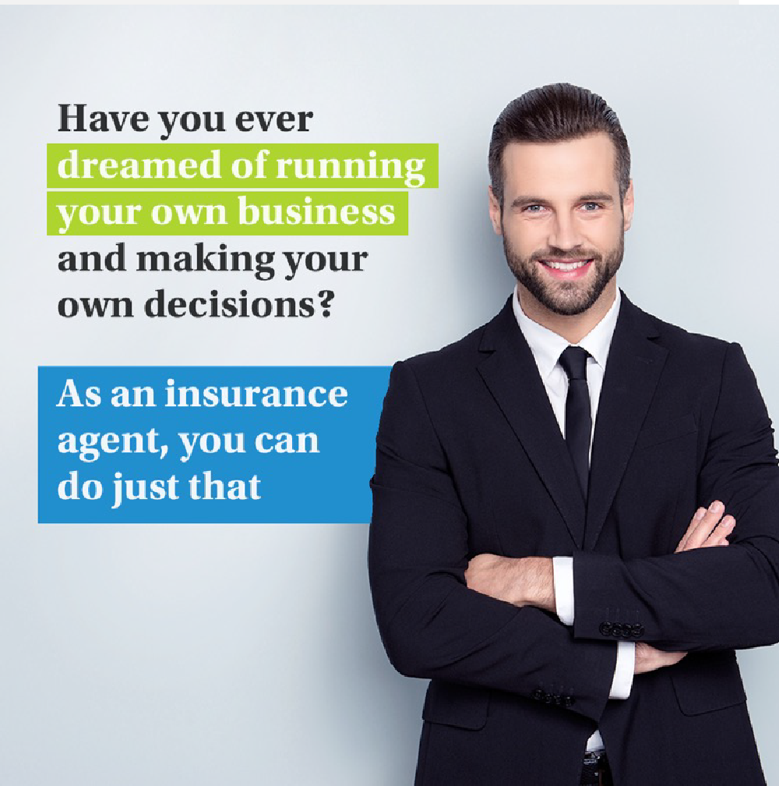
Post 3
Caption:
As an agent, you have the freedom and flexibility to make your own decisions and build your business according to your vision. Is it something that excites you?
Text on Visual:
Send a message to learn more about the opportunities available and how we can support you in building a successful career in the insurance industry.

Slide 5
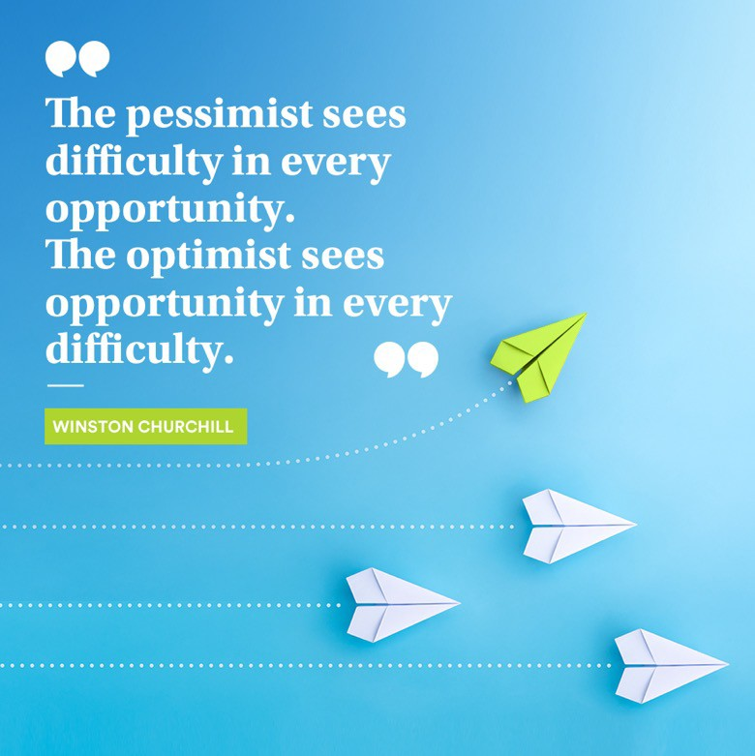
Post 4 – June
Caption:
Obstacles can either be seen as roadblocks or opportunities. Choose optimism and take on new challenges with confidence.
Become an insurance agent with us and turn obstacles into opportunities for growth.

Slide 6
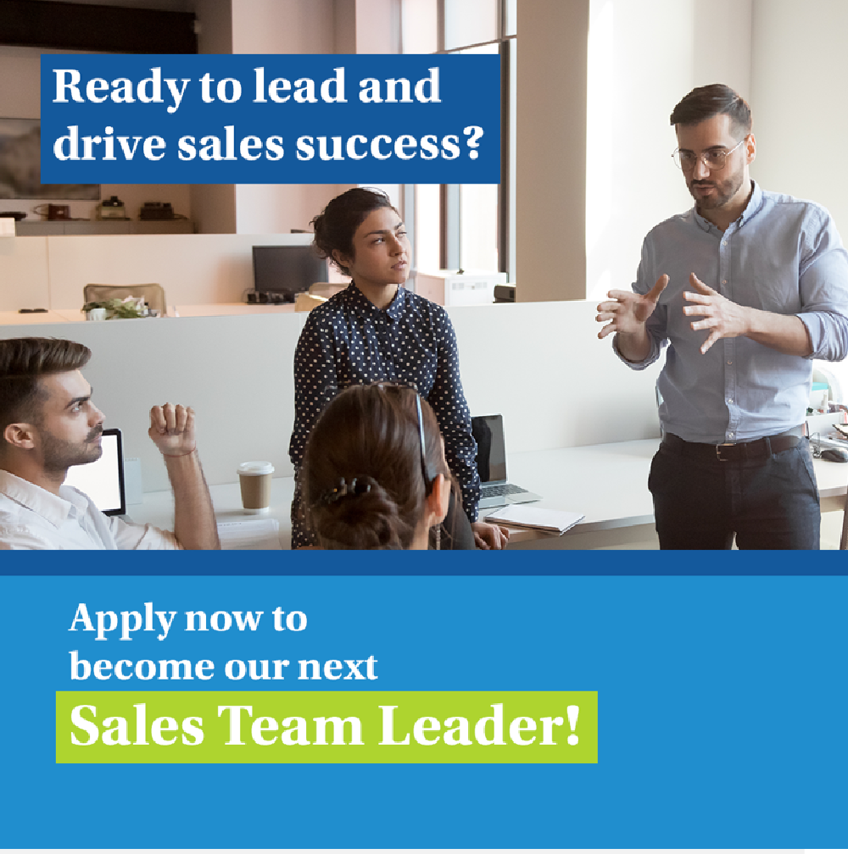
Post 5 (PAL) –
Caption:
If you have a passion for sales and leadership and are excited about the opportunity to work in a dynamic and rewarding environment join our team at [Agency Name] with MetLife.
Key responsibilities:
Keep Informed of New Products and Services
Text on Visual:
Recruit, Train, and Coach the Sales Team
Set Sales Targets and Motivate Sales Team
Prepare Sales Reports
Requirements:
28-40 years old
University Graduates with Official Lebanese Baccalaureate
Minimum 5 years of experience in Sales
Minimum 2 years managerial experience
Highly motivated and Goal oriented
E-mail your CV to: XXXXX@metlifeagency.net to be considered for the selection process or message me

Slide 7
Post 6 – Insurance Awareness Day June 28
Caption:
Happy Insurance Awareness Day! Today is a reminder of just how important insurance is in protecting your future and the future of your loved ones. Don't wait until it's too late to get the protection you need.
#InsuranceAwarenessDay #InsuranceAwareness #ProtectYourFuture #FamilyProtection

Slide 8
Post 7
Caption:
If you're looking for a career that combines meaningful work with professional growth and financial stability, consider becoming an insurance agent. As an experienced agency, we can provide you with the support, training, and resources you need to succeed.
DM so we can discuss further on how to be part of our industry.

Slide 9
Thank You
© Born Interactive, Proprietary and Confidential

