Slide 1
MetLife Calendar AL/UM
May, 2022

Slide 2
Post 1
Text on Visual:
Happy Labor Day!
It is time to reflect on your career plan
Caption:
Today is a great day to reflect on your career plan.
Are you passionate about helping people? Are you a good listener? Are you ready to learn new skills? Do you enjoy coming up with creative solutions to problems?
You’ll get out of your career whatever you put into it. Insurance is really no different. If you are passionate about insurance and have similar traits to those outlined above, you have a great shot at having a long and successful insurance career.
Message me with your questions!
Facebook, LinkedIn.

Slide 3
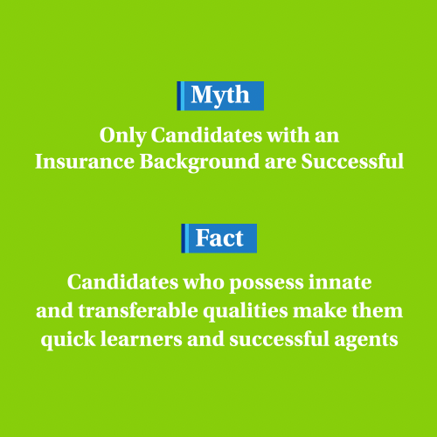
Post 2
Text on Visual:
Myth: Only Candidates with an Insurance Background are Successful
Fact: Candidates who possess innate and transferable qualities make them quick learners and successful agents
Caption:
You don’t necessarily need to have an insurance background to become a successful agent. Having personality traits, such as an entrepreneurial spirit, self-motivation and the ability to communicate effectively, can lay the right foundation for success in becoming an insurance agent.
Message me and let’s make a difference together!
Facebook, LinkedIn.

Slide 4
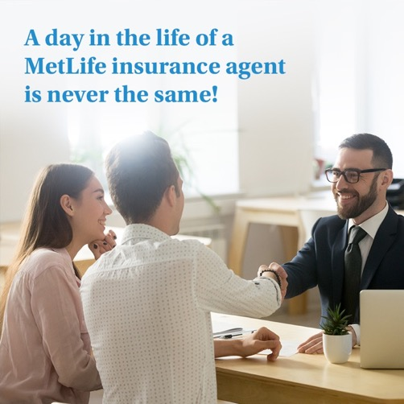
Post 3
Text on Visual:
A day in the life of a MetLife insurance agent is never the same!
Caption:
It’s true that a job in insurance sales isn’t your typical “9 to 5” job. We are expected to be there for our client/members when they need us, and in the event of an emergency, that can be day or night. However, we enjoy the freedom that comes with owning our own business and the flexibility it allows in creating our own schedules and doing business on our own ways.
Message me and let’s discuss the opportunity I may have for you.
Facebook, LinkedIn.

Slide 5
Post 4
Text on Visual:
You protect their everything from their family to their professional dreams!
Caption:
Most people think of insurance in terms of life and car insurance, but there are a number of other important products to consider. We offer a full suite of insurance products and we are able to help people from all walks of life!
Do you want to take part in that? Message me with your questions.
Facebook, LinkedIn.

Slide 6
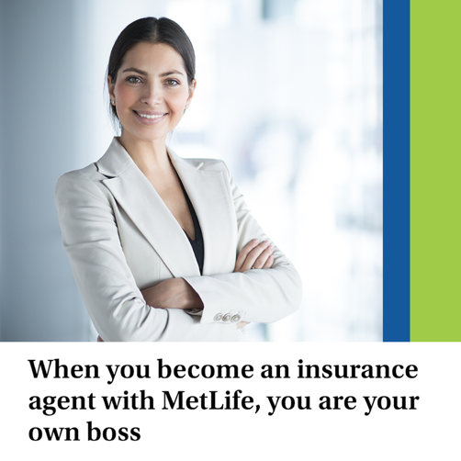
Post 5
Caption:
Although you’ll get plenty of support from MetLife, you should take full advantage of the opportunities that running your own business brings. When you become an insurance agent, you are your own boss. It is your responsibility to get to know the individuals within your community, learn about what’s important to them and use that information to determine their insurance needs.
Are you ready to become your own boss? we’d love to talk to you.
Text on Visual:
When you become an insurance agent with MetLife, you are your own boss
Facebook, LinkedIn.

Slide 7
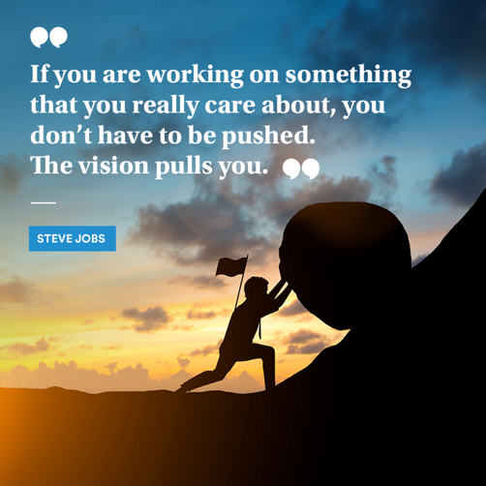
Post 6
Text on Visual:
“If you are working on something that you really care about, you don’t have to be pushed. The vision pulls you.” — Steve Jobs
Caption:
If your vision is to become someone who helps others and protect them from life’s twists and turns, then becoming an agent with MetLife is the right job for you.
Contact me to know more. 📩
Facebook, LinkedIn.

Slide 8
Thank You

