Slide 1
MetLife Calendar AL/UM
March – April 2023
© Born Interactive, Proprietary and Confidential

Slide 2
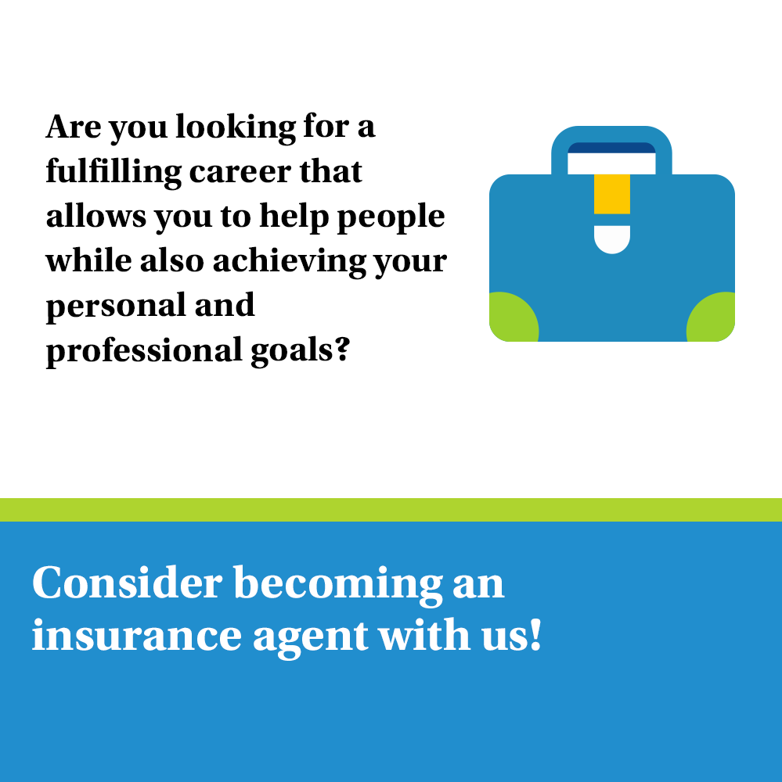
Post 1
Caption:
As an insurance agent, you'll have the opportunity to make a real difference in people's lives by helping them protect themselves and their families from unforeseen events. You'll work with clients to understand their unique needs and provide tailored solutions that offer peace of mind.
Let us connect so you get to know more about the world of MetLife insurance agents.

Slide 3
Post 2 -
(PAL)
Caption:
We are recruiting Sales Team Leaders. For those interested to join, have an entrepreneurial mindset and fit the below criteria, please send us your resume to 123456789@metlifeagency.net
30-45 years old
University Graduates with Official Lebanese Baccalaureate
Minimum 5 years of experience in Sales
Minimum 2 years managerial experience
Highly motivated and Goal oriented

Slide 4
Post 3 - Video
Caption:
Happy Mother's Day to all the amazing moms out there! We know that being a mom is one of the toughest jobs in the world, but you make it look easy. We hope this Mother's Day brings you joy, relaxation, and lots of love. You deserve it!
#HappyMothersDay #Mothers #FamilyLove

Slide 5
Post 4
(PAL)
Caption:
We’re now looking for Sales Team Leader to join our dynamic team at [Agency Name] with MetLife.
Key responsibilities:
Keep Informed of New Products and Services
Recruit, Train, and Coach the Sales Team
Set Sales Targets and Motivate Sales Team
Prepare Sales Reports
Requirements:
28-40 years old
University Graduates with Official Lebanese Baccalaureate
Minimum 5 years of experience in Sales
Minimum 2 years managerial experience
Highly motivated and Goal oriented
E-mail your CV to: XXXXX@metlifeagency.net to be considered for the selection process or message me

Slide 6
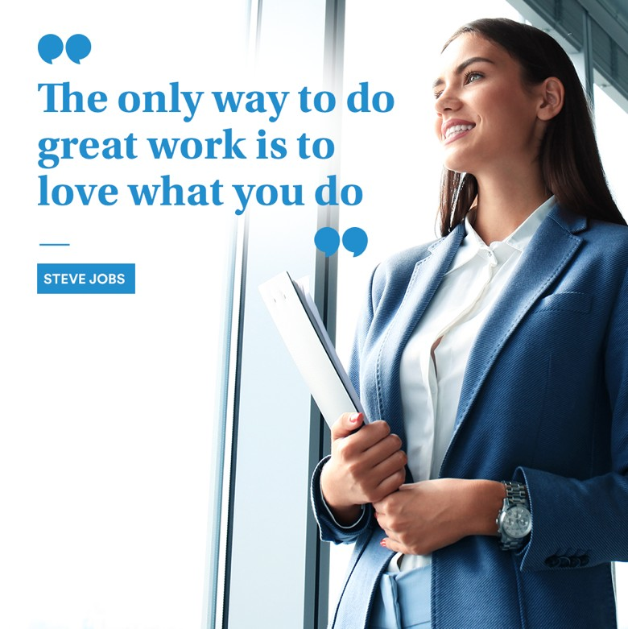
Post 5 – April
Caption:
When you are passionate about your work, you will be more dedicated, creative, and innovative in your approach. Your love for your job will drive you to put in the extra effort required to achieve your goals, and to continuously learn and grow in your field.
Text on Visual:
If becoming an insurance agent is your passion, DM so we can discuss further on how to be part of our industry.
"The only way to do great work is to love what you do." - Steve Jobs

Slide 7
Post 6 - April
Caption:
Wishing you all a very Happy Easter! May your day be filled with love, laughter, and all the good things that this holiday brings.
#HappyEaster #Easter2023 #springvibes #blessed

Slide 8
Post 7 - Video
Caption:
Becoming an insurance agent can be a rewarding career choice for those who are passionate about helping others, self- motivated, and who want to evolve in their career!
You’ll be helping families be protected and make them feel safer while building a base of loyal customers. With the right skills and dedication, you can develop a fulfilling career as an insurance agent.
Send a message for more details!

