Slide 1
MetLife Social Recruitment Calendar
March 2024

Slide 2
Post 1
Caption:
Seeking a career filled with earning potential, supportive leadership, and a culture of collaboration? Our team of thriving insurance agents is expanding, we’re on the lookout for passionate individuals ready to make an impact!
Ready to join the journey? Submit your application via [link XXX] to be considered for the selection process.
#MetLifeLebanon #WeAreHiring #MetLifeAgent #Insurance #Career #JobSeekers
LinkedIn

Slide 3
Post 2 - Video
Caption:
Developing soft skills is essential for success in today's workplace. Are you equipped with these 11 essential skills? Join our team by submitting your application via [link XXX] and let us guide you towards mastering these essential soft skills.
#MetLifeLebanon #MetLife #MetLifeAgent #Success #Career #Skills
LinkedIn

Slide 4
Post 3
Caption:
Calling all ambitious professionals! Are you ready to dive into the dynamic world of insurance and unlock your full potential?
Click the link below and take the first step towards your dream career in insurance!
(Insert link here)
#MetLifeLebanon #WeAreHiring #MetLifeAgent #Insurance #Career #JobSeekers
LinkedIn

Slide 5
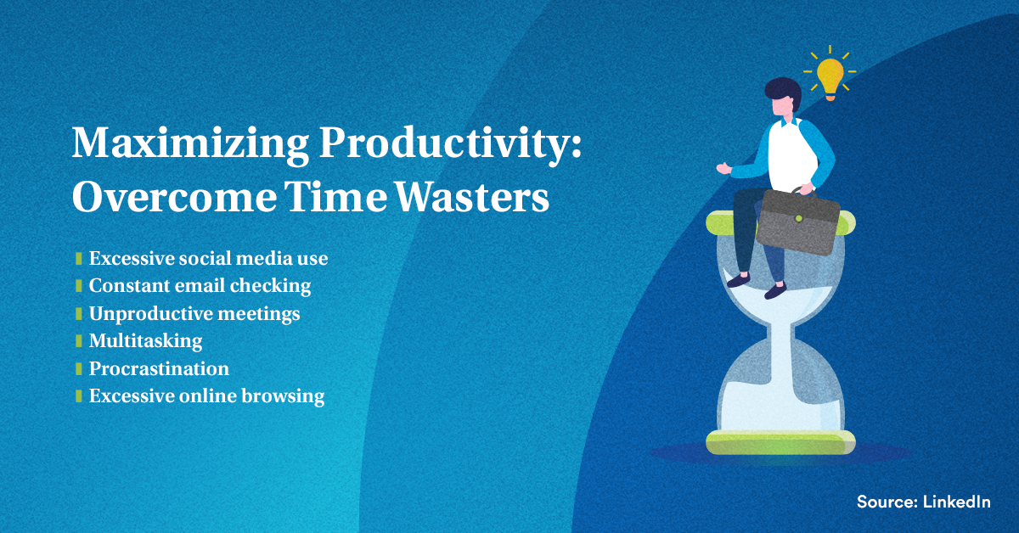
Post 4
Caption:
Maximizing productivity starts with identifying and overcoming common time wasters. From excessive social media scrolling to constant email checking, these distractions can hinder your efficiency. Take control of your time and focus on what truly matters for success.
#MetLifeLebanon #MetLifeAgent #insurance #InsuranceCareer #Productivity
LinkedIn

Slide 6
Post 5
Caption:
Elevate your career journey! Unlock continuous learning and training opportunities by joining our team with MetLife. Stay at the forefront of industry trends and supercharge your career with us.
Ready to dive in? Apply now via [link XXX] and explore this exciting opportunity.
#MetLifeLebanon #WeAreHiring #MetLifeAgent #Insurance #Career #JobSeekers
LinkedIn

Slide 7
Post 6
Caption:
Being an insurance agent is a thrilling blend of client engagement, risk assessment, market insight, and creative problem-solving. It’s not just a job; it’s a dynamic career path.
Does this sound like your kind of adventure? Reach out to discover more.
#MetLifeLebanon #MetLifeAgent #insurance #InsuranceCareer
LinkedIn

Slide 8
Post 7
Caption:
Secure your future with a career as an insurance agent. Join us and pave the way for long-term success in a field with a growing demand for skilled professionals.
Drop me a message to learn more about launching a successful career.
#MetLifeLebanon #MetLifeAgent #insurance #InsuranceCareer
LinkedIn

Slide 9
Post 8
LinkedIn Poll
Caption:
What motivates you most in a career?
Flexible schedule
Earning potential
Making a difference
Learning opportunities
LinkedIn

Slide 10
Thank You

