Slide 1
MetLife Calendar AL/UM
March, 2022

Slide 2
Post 1
Caption:
MetLife aspires to maintain its position as one of the best companies in the world with a strong financial rating and inclusive culture.
Leading global provider of insurance, annuity and employee benefits for 153 years.
Financially very strong and rated “AA-” by S&P
Proud history in Lebanon spanning more than 67 years with the #1 position in the Life insurance market
Strong on purpose, culture and values
Write to me and I will tell you how to start working in my team with MetLife.
Text on Visual:
What should you know about MetLife
Facebook, LinkedIn.

Slide 3
Post 2
Text on Visual:
Gain Compensation & Benefits when becoming an agent with MetLife!
Caption:
Your hard work with MetLife, will provide you with an opportunity to earn competitive remuneration and achieve financial independence.
Financial support to kick start your first 2 years
Generous First Year and Renewal commission
Top tier Medical, Life and Disability insurance & Pension Plan
Awards, bonus and recognition
Let us get in touch and talk about it.
Facebook, LinkedIn.

Slide 4
Post 3
Text on Visual:
“I never dreamed about success. I worked for it” Estee Lauder
Caption:
We all want to be successful, whether we want it for similar reasons or not. Either way, we cannot expect that dreams get us what we want. Are your ready to work hard for it? this is your opportunity. Send me a message so we can discuss further.
Facebook, LinkedIn.

Slide 5
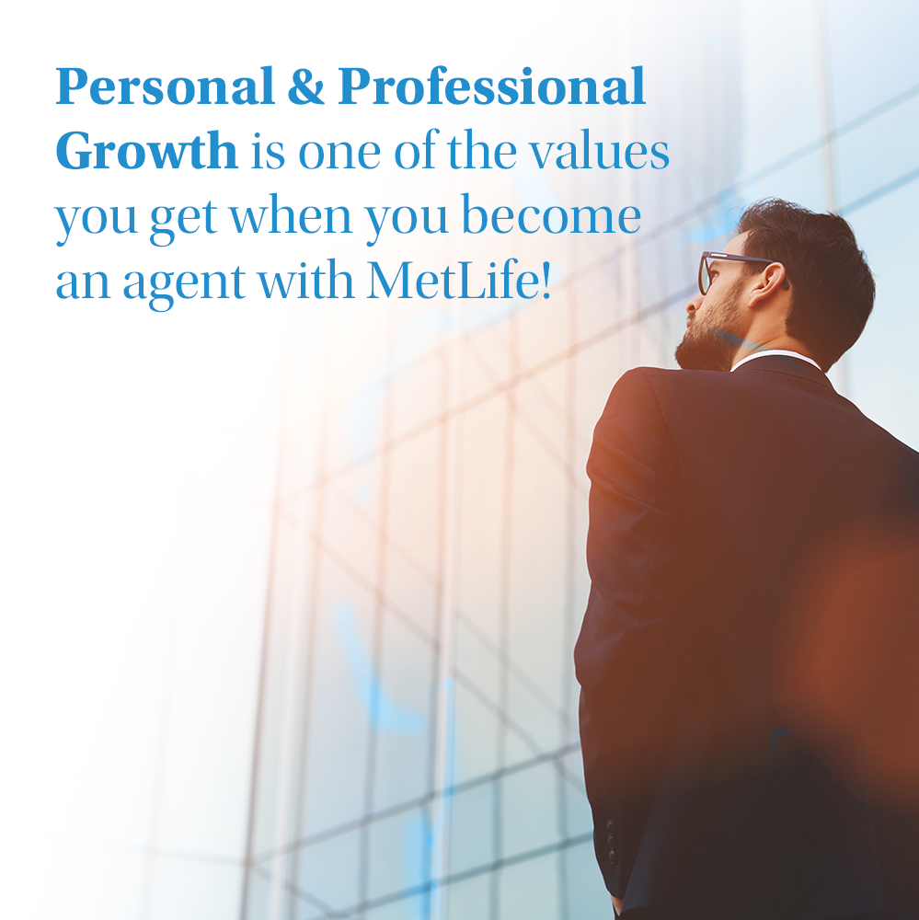
Post 4
Text on Visual:
Personal & Professional Growth is one of the values you get when you become an agent with MetLife!
Caption:
We believe in supporting your growth. From product trainings to leadership programs, we’ll guide you along and enable your all-round development to uncover your true potential.
DM so we can discuss further on how to be part of our industry.
Facebook, LinkedIn.

Slide 6
Post 5
Caption:
Athlete for work with MetLife? It works perfectly!
Are you an athlete, fitness instructor or personal trainer? I know how important a fighting spirit is to you, so I encourage you to work at MetLife’s agency.
Self-discipline, ambition and full focus on your goal - these are the features of a real athlete that will surely translate into your results. The work system that I would like to offer you allows you to develop a new profession.
I'm waiting for you impatiently! Contact me to know more. 📩
Text on Visual:
Are you an athlete, fitness instructor or personal trainer?
Let’s talk!
Facebook, LinkedIn.

Slide 7
Post 6
Text on Visual:
Get to handle your own schedule & control your own success!
Caption:
One of the things many insurance agents enjoy, particularly if they are coming from a different career, is the vast amount of flexibility they have as insurance professionals. Rather than having to punch a time clock twice/day and find busy work to fill up your time, you get to handle your own schedule.
Would you like to know more about working at MetLife’s agency, [Name of Agency]? Send me a message!
Facebook, LinkedIn.

