Slide 1
MetLife Calendar AL/UM
June 2022

Slide 2
Post 1
Text on Visual:
Unlike other types of sales, you are providing protection!
Caption:
Most people sometimes worry about the future. For example, getting ill or suffer from complications, losing their ability to work - for a shorter or longer period of time, etc... As an insurance agent, making sure their future remains secure becomes your number-one priority. They all need guidance in choosing how to protect their future and the future of their loved ones.
Would you like to take part in that? Send me a message so we can discuss
Facebook, LinkedIn.

Slide 3
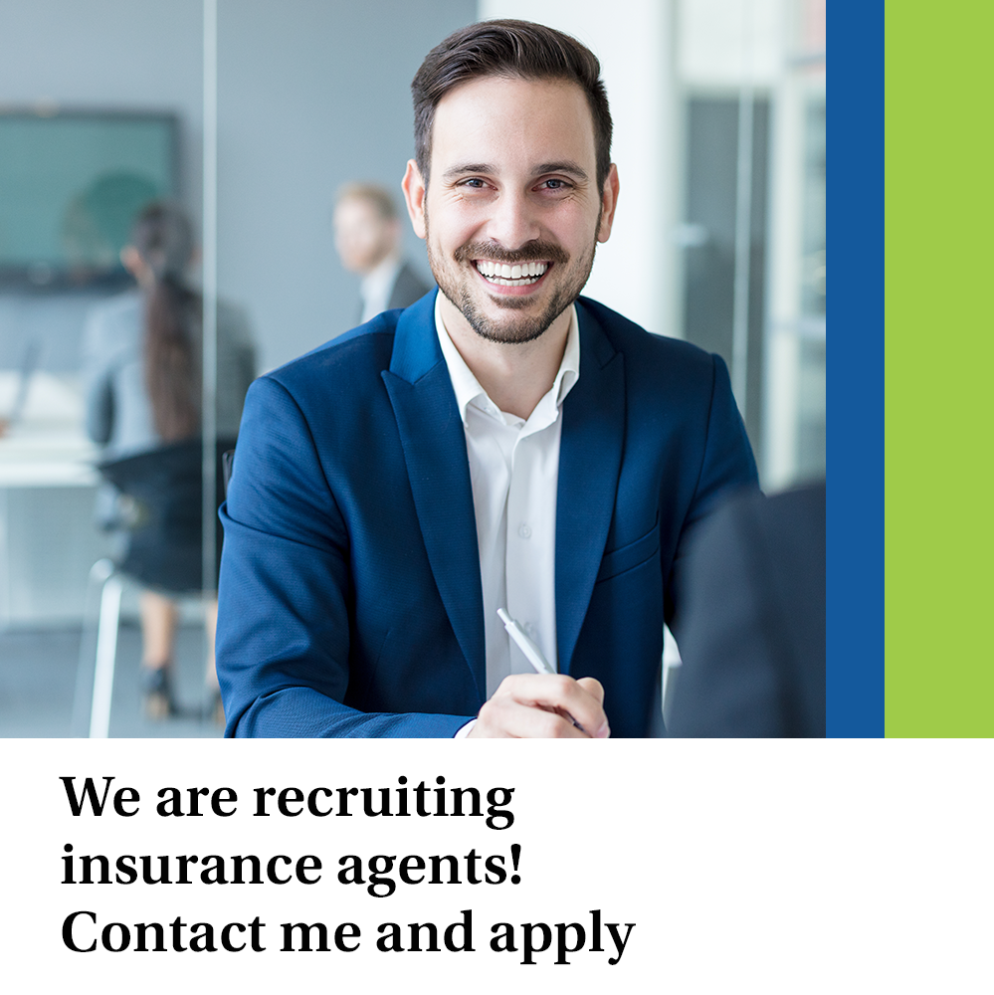
Post 2
Text on Visual:
We are recruiting insurance agents!
Contact me and apply
Caption:
Are you looking for a job?
Start your career as a MetLife insurance agent and gain valuable experience. I do not require specialist knowledge or knowledge of using complex tools - what counts for me is your willingness to learn and your willingness to work with people. 💪
At MetLife’s agencies, you will go through internal trainings to learn about our protection solutions and sales tools, which will make it much easier for you to implement your daily duties. Do you want to apply? Contact me and apply! 💬
Facebook, LinkedIn.

Slide 4
Post 3
Text on Visual:
Training and support start from day one and continue throughout an agent’s tenure!
Caption:
While it’s true that our agents are responsible for growing their network, MetLife provides each agent with the tools, support and training to maximize success. Training and support start from day one and continue throughout an agent’s tenure. As a MetLife insurance agent, you have an entire team by your side to aid you in continuing your success.
Would you like to know more about working at MetLife’s agency, [Name of Agency]? Send me a message!
Facebook, LinkedIn.

Slide 5
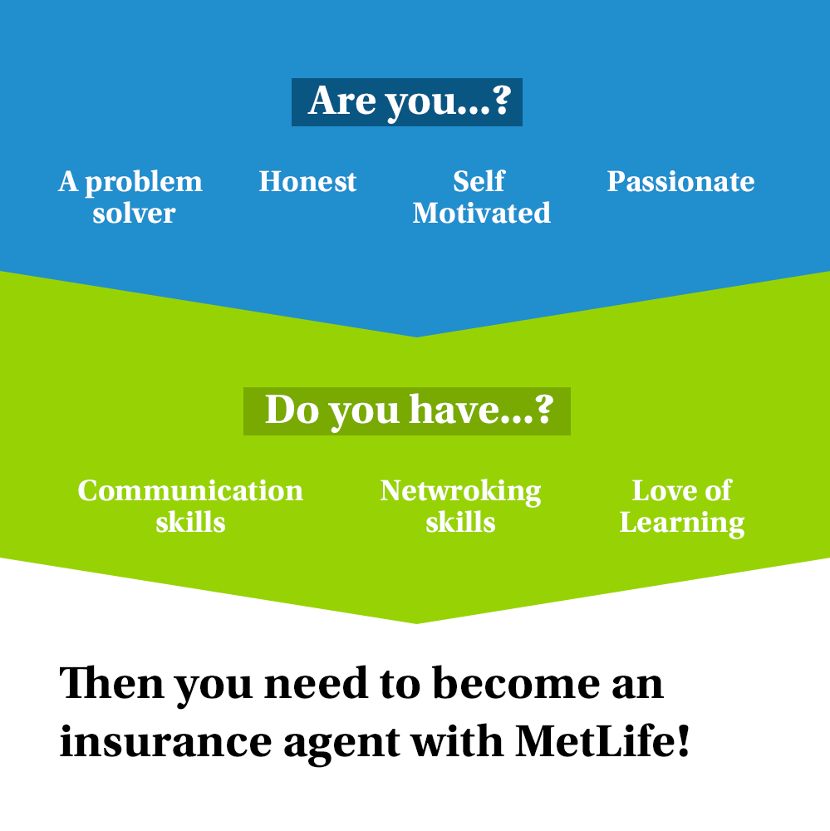
Post 4
Text on Visual:
Are you ……..?
A problem solver
Honest
Self motivated
Passionate
Do you have….?
Communication skills
Networking skills
Love of learning
Then you need to become an insurance agent with MetLife!.
Caption:
There are many advantages of going into the insurance industry. It is not a career for everyone though. It takes a certain type of person to thrive in this unstructured, fast-paced industry. Do you have what it takes?
DM so we can discuss further on how to be part of our team.
Facebook, LinkedIn.

Slide 6
Post 5
Caption:
Success will come to those who are thinking about it. Only if you keep thinking about it and engage yourself in a process of discovering new ways out, you will reach the position you aspire for!
Do you want to become a successful Insurance agent? Contact me to know more. 📩
Text on Visual:
“Success usually comes to those who are too busy to be looking for it.” – Henry David Thoreau
Facebook, LinkedIn.

Slide 7
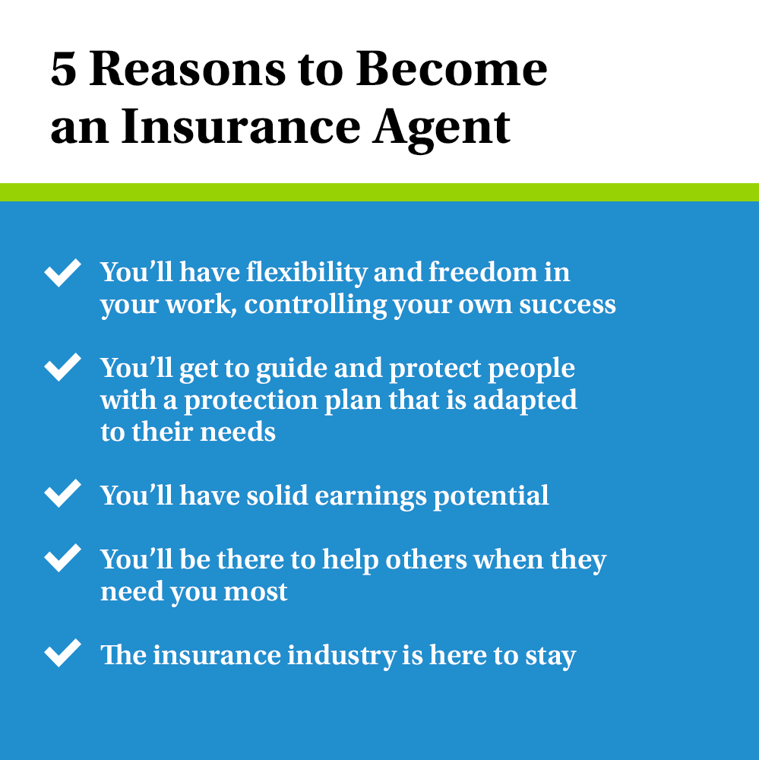
Post 6
Text on Visual:
5 Reasons to Become an Insurance Agent
1. You’ll have flexibility and freedom in your work, controlling your own success
You’ll get to guide and protect people with a protection plan that is adapted to their needs
3. You’ll have solid earnings potential
4. You’ll be there to help others when they need you most
5. The insurance industry is here to stay
Caption:
We love what we get to do every day. Here are five reasons you should become an insurance agent.
Let us connect and talk about it.
Facebook, LinkedIn.

Slide 8
Thank You

