Slide 1
MetLife Social Recruitment Calendar
January 2024

Slide 2
Post 1
Caption:
Do you enjoy connecting with people, value hard work, and find fulfillment in assisting others? A career in insurance might align perfectly with your strengths and interests.
Apply now :[link XXX ]to be considered for the selection process
#MetLifeLebanon #WeAreHiring #MetLifeAgent #Insurance #Career #JobSeekers
LinkedIn

Slide 3
Post 2
Caption:
Surviving the post-holiday return? These tips ensure a smooth transition: organize your space, reconnect with colleagues, and remember, it's okay to seek support.
#MetLifeLebanon #MetLife #MetLifeAgent #PostHolidays
LinkedIn

Slide 4
Post 3
Caption:
Every day as an insurance agent is about customizing protection, tailoring solutions to fit each unique need and situation, ensuring peace of mind one person at a time.
DM so we can discuss further on how to be part of our industry.
#MetLifeLebanon #WeAreHiring #MetLifeAgent #Insurance #Career #JobSeekers
LinkedIn

Slide 5
Post 4
Caption:
The way we work is rapidly changing due to technology and societal shifts. As we enter 2024, expect even faster adoption of AI and digital transformation, impacting everyone's work life, not just in tech.
#MetLifeLebanon #MetLifeAgent #2024Trends #WorkplaceTrends
LinkedIn

Slide 6
Post 5
Caption:
Embrace challenges as stepping stones toward an extraordinary future. Hardships refine us for the remarkable journey ahead. Keep pushing, keep believing, and watch your dreams unfold.
#MetLifeLebanon #MetLife #MetLifeAgent #Insurance #CareerPath
LinkedIn

Slide 7
Post 6
Caption:
Join us as an insurance agent and be the trusted advisor our clients need for a secure future.
Send a message to learn more about the opportunities available and how we can support you in building a successful career in the insurance industry.
#MetLifeLebanon #MetLifeAgent #insurance #InsuranceCareer
LinkedIn

Slide 8
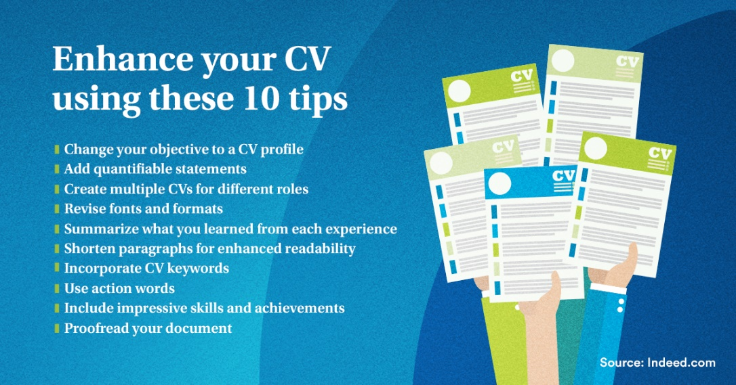
Post 7
Caption:
Ready to elevate your CV? Dive into these 10 expert tips. From highlighting key skills to tailoring your experiences, these strategies will help your resume shine and attract the attention you deserve in the competitive job market.
#MetLifeLebanon #MetLifeAgent #insurance #InsuranceCareer #Resume #JobApplication
LinkedIn

Slide 9
Post 8
LinkedIn Poll
Caption:
Job seekers! When considering a job, which benefits matter most to you?
Work-Life Balance
Career Development
Company Culture
Job Security
LinkedIn

Slide 10
Thank You

