Slide 1
MetLife Calendar AL/UM
January – February 2023

Slide 2
Post 1
Text on Visual:
Make 2023 a year of change
Caption:
We are looking for people with discipline and ambition to evolve; who want to outdo themselves, year after year, achieve their goals and increase income
Join our insurance agents today
DM me to tell you more about the world of MetLife insurance agents!
#2023 #newyear #career #sales #insurance
Facebook, LinkedIn.

Slide 3
Post 2 - (PAL)
Text on Visual:
Are you looking for a career change?
We’re hiring Sales Team Leaders
Caption:
We are recruiting Sales Team Leaders. For those interested to join, have an entrepreneurial mindset and fit the below criteria, please send us your resume to 123456789@metlifeagency.net
- 30-45 years old - University Graduates with Official Lebanese Baccalaureate - Minimum 5 years of experience in Sales - Minimum 2 years managerial experience - Highly motivated and Goal oriented
#sales #insurance #teamleader #entrepreneurial #recruitment #hiring
Facebook, LinkedIn.

Slide 4
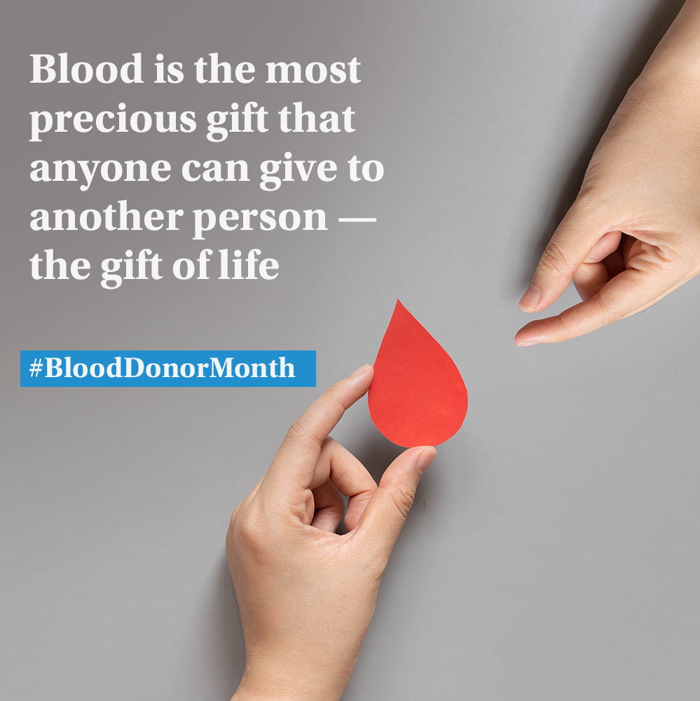
Post 3- okay
Text on Visual:
Blood is the most precious gift that anyone can give to another person — the gift of life
#BloodDonorMonth
Caption:
January is #BloodDonorMonth and we need to highlight the essential contribution that blood donors make to keep the world pulsating. That is by saving lives and improving other's health. #BloodDonor #DonateBlood #SaveLives #Health #Blood #Lebanon
Facebook, LinkedIn.

Slide 5
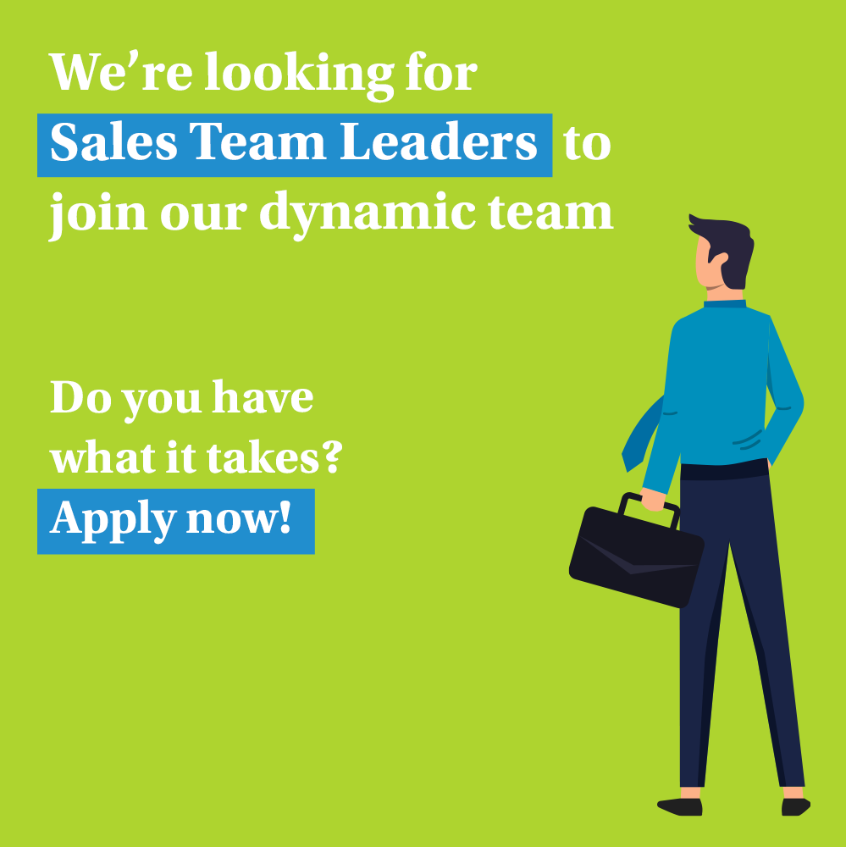
Post 4 (PAL)
Text on Visual:
We’re looking for Sales Team Leader to join our dynamic team.
Do you have what it takes?
Apply now!
Caption:
We’re now looking for Sales Team Leader to join our dynamic team at [Agency Name] with MetLife.
Key responsibilities:
Keep Informed of New Products and Services
Recruit, Train, and Coach the Sales Team
Set Sales Targets and Motivate Sales Team
Prepare Sales Reports
Requirements:
28-40 years old
University Graduates with Official Lebanese Baccalaureate
Minimum 5 years of experience in Sales
Minimum 2 years managerial experience
Highly motivated and Goal oriented
E-mail your CV to: XXXXX@metlifeagency.net to be considered for the selection process or message me.
#sales #insurance #teamleader #recruitment #hiring
Facebook, LinkedIn.

Slide 6
Post 5 - FEB
Caption:
Financial support, commissions, a portfolio of clients, productivity bonuses, persistence bonus, access to exclusive events and trainings, …
Have all this and more by being an insurance agent that collaborates with MetLife
DM so we can discuss further on how to be part of our industry.
#sales #insurance #recruitment #hiring
Text on Visual:
Achieve financial success with a career in insurance
Facebook, LinkedIn.

Slide 7
Post 6 ( World Cancer Day Feb 4)- okay
Text on Visual:
Awareness is our strongest weapon in the fight against cancer
#WorldCancerDay
Caption:
Knowledge about a problem is the first step in helping overcome it. Even for cancer, being aware of the risks, symptoms and various preventive measures can go a long way towards keeping us safe. #WorldCancerDay #Cancer #Health #CancerDay
Facebook, LinkedIn.

Slide 8
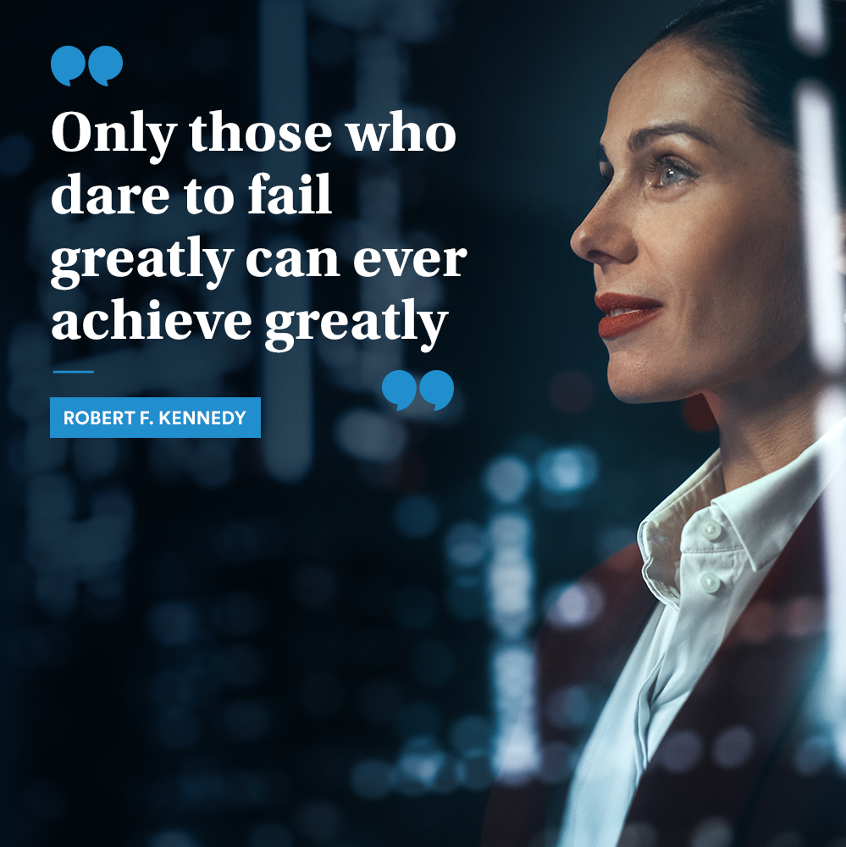
Post 7 – FEB- okay
Text on Visual:
“Only those who dare to fail greatly can ever achieve greatly”
Robert F. Kennedy
Caption:
The fear of risking failure keeps you from becoming the person you want to become and from accomplishing all that you want to accomplish.
You can be discouraged by failure or learn from it, so go ahead and make mistakes. Make all you can. Because remember that's where you will find success!
Share this post with someone who needs to hear this today!
Facebook, LinkedIn.

Slide 9
Thank You

