Slide 1
Fourth Calendar MetLife AL/UM

Slide 2
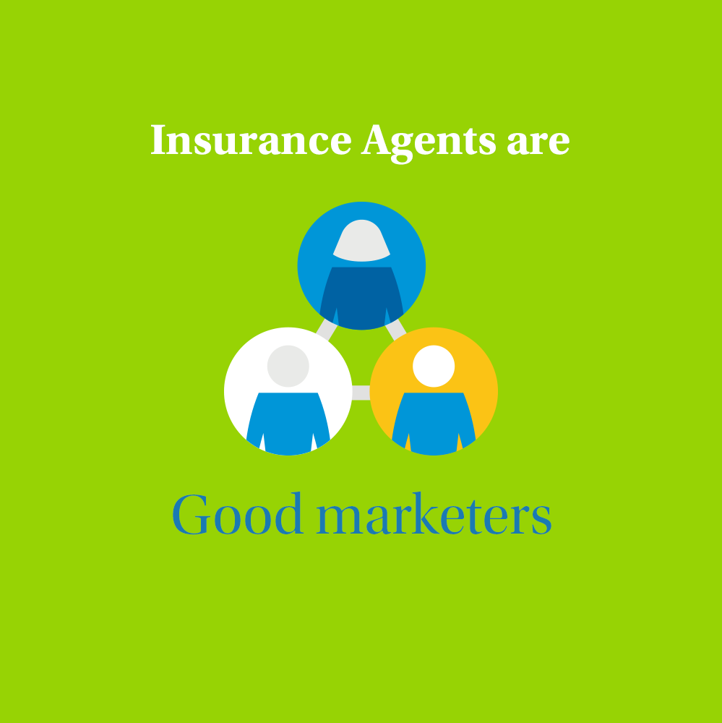
Post 1
Text on Visual:
Insurance Agents are good marketers.
Caption:
If you think Insurance Agents’ skills are limited to selling and negotiating, you’re in for a big surprise. Successful insurance agents implement marketing strategies to promote the insurance policies they’re offering. They work on various marketing activities that can support them in bringing new customers on board. Let us connect and talk about it.
Facebook, LinkedIn.

Slide 3
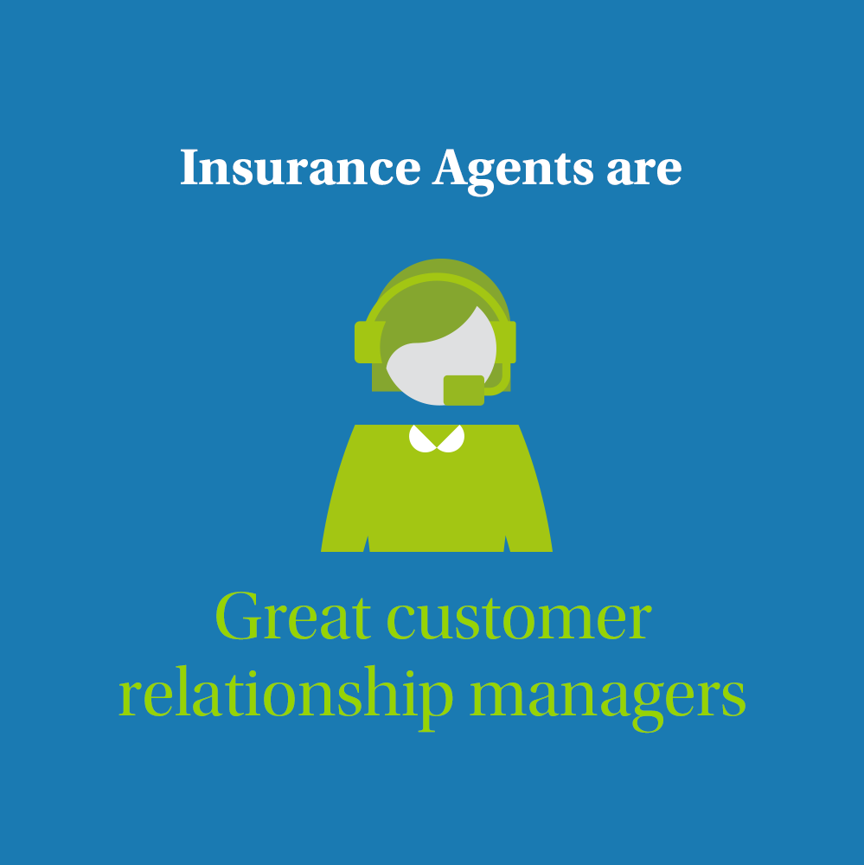
Post 2
Text on Visual:
Insurance Agents are great customer relationship managers.
Caption:
Selling a policy is merely half of the equation. As an insurance agent, you must maintain solid relationships with your clients. Your reputation as an insurance agent depends on you being there for your clients, when they need to file a claim or increase their coverage due to a major life event. Keep up with their news, greet them and don’t lose contact with them. Let us connect and talk about it.
Facebook, LinkedIn.

Slide 4
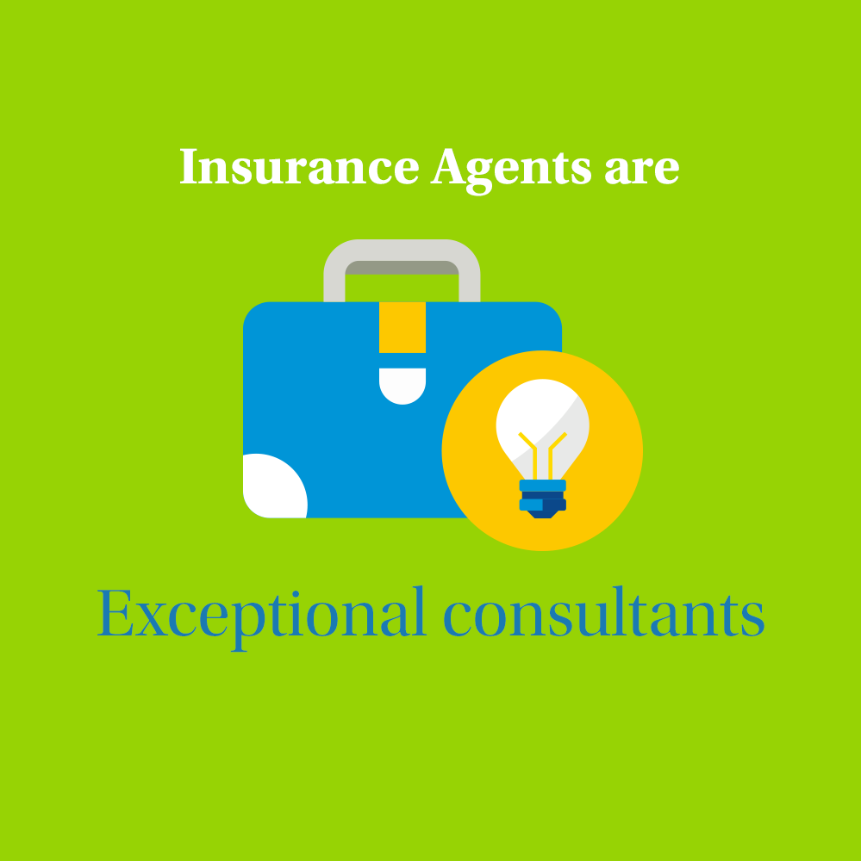
Post 3
Text on Visual:
Insurance Agents are exceptional consultants.
Caption:
Insurance agents are great match-makers, between people and policies. They must evaluate the needs of their clients and propose plans that will meet the criteria, as well as the client‘s financial status. They need to develop an understanding of their clients’ needs and financial capacity by studying present coverage and investments, all while building long-term goals. Let us connect and talk about it.
Facebook, LinkedIn.

Slide 5
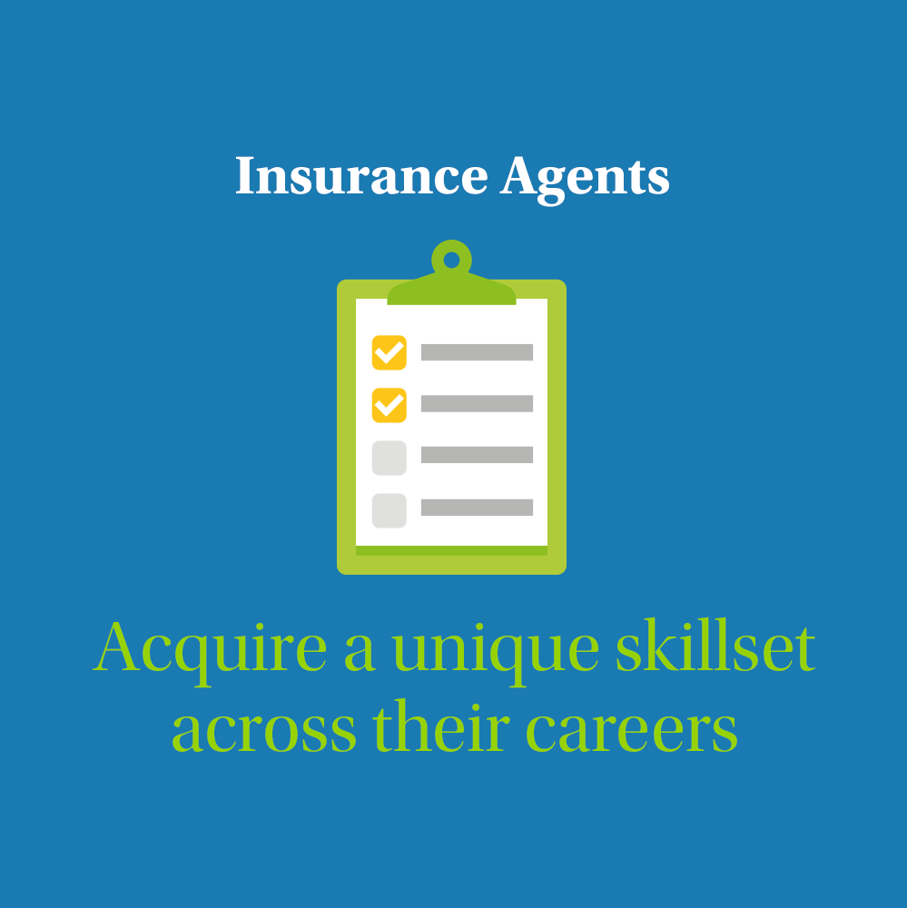
Post 4
Text on Visual:
Insurance Agents acquire a unique skillset across their careers.
Caption:
Being a good salesperson is a valuable skill when you work in insurance, but it’s not just a sales job. The position includes many fields and offers various learning curves, such as:
Communication
Technology
Problem-solving
Research
Analytics
Organization
The insurance industry is still evolving as customer needs do. Your understanding of social media, digital marketing, and cyber communication will be highly rated in today’s market. Let us connect and talk about it.
Facebook, LinkedIn.

Slide 6
Post 5
Text on Visual:
Invest in a career, not a job.
Caption:
Are you looking for a career or a job? There’s a big difference. One sets you up for life, another guarantees you a monthly paycheck. One keeps you focused on the big picture, the other keeps you wondering what’s tomorrow’s plan. Build a career, don’t fill a job position. As an insurance agent, each step you take, matters. Let us connect and talk about it.
Facebook, LinkedIn.

Slide 7
Post 6
Text on Visual:
A great work-life balance
Caption:
Each of us has his or her own priorities. But as much as our careers are important, so is our life outside of the office. One of the greatest benefits of working in insurance is your ability to create a work-life balance that supports you both financially and mentally. Insurance agents’ careers can be fulfilling, challenging, and lucrative. The position offers the flexibility that is you require to be where you’re needed. Let us connect and talk about it.
Facebook, LinkedIn.

Slide 8
Post 7
Text on Visual:
Are you a teacher? Let’s talk.
Caption:
Many people underestimate teachers and their skills. However, they have extremely developed interpersonal skills. If you are a teacher, you can certainly translate perfectly, choose the language of the recipient, you are patient and you approach everyone individually. With MetLife, we value these people! If you’re looking for a change after many years and you like working with people - write to me and I will tell you how to start working in my team.
Facebook, LinkedIn

Slide 9
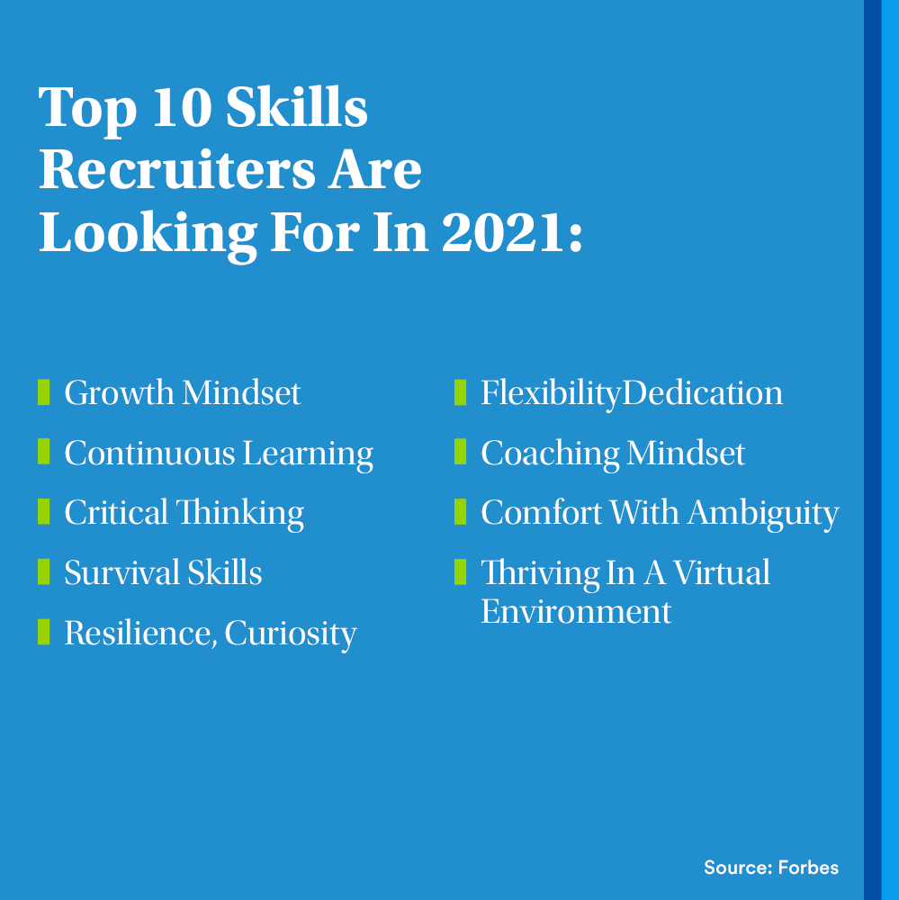
Post 8
Text on Visual:
Top 10 Skills Recruiters Are Looking For In 2021:
Growth Mindset
Continuous Learning
Critical Thinking
Survival Skills
Resilience, Curiosity
Flexibility
Dedication
Coaching Mindset
Comfort With Ambiguity
Thriving In A Virtual Environment
(Source: Forbes)
Caption:
Sales skills are one of the most important in a career as an insurance consultant but for me: drive, ambition and purpose skills are one of the many capabilities which will quickly help you climb the career ladder with MetLife.
We’re looking for people with different skills/traits to join our team. Write to me in a private message and I will provide you with more details.
Facebook, LinkedIn

Slide 10
Post 9
Text on Visual:
Join our team of Insurance Agents.
Caption:
We’re now looking for Life Insurance Agents to join our dynamic team at [Agency Name] with MetLife, who will be responsible for:
Introducing MetLife through visits and demonstrating the services it can provide
Providing intermediary services between the insurance company and clients and good customer service to maintain and retain clients
Meeting prospective clients to gather data about them and analyzing the client’s current portfolios and make recommendations based on their needs
Submitting a weekly activity report to the Unit Manager, along with the strategy plan for the coming weeks
Stay in touch with your customers to ensure a steady stream of repeat business
Having persistency, ambition, determination & positivity to achieve the personal SMART goals
Requirements:
Education Level: Bachelor Degree
Excellent communication skills
Display good analytical skills
Provide excellent customer service
Possess excellent interpersonal skills
We offer attractive remuneration packages and commission with career growth, learning and development for successful candidates.
Interested ? Apply by sending an email to XXX or message me on LinkedIn
Closing date for accepting applications is XXX
LinkedIn

Slide 11
Post 10
Text on Visual:
“All human interactions are opportunities either to learn or to teach.” - M. Scott Peck
Caption:
Invest your time wisely. Assess work environments based on their ability to add to your skillset. It’s all about the learning curve. Yet, don’t give up on your own way of doing things while learning new ways. Keep your unique approach intact and inspire others with it.
Facebook, LinkedIn.

