Slide 1
First Calendar MetLife AL/UM

Slide 2
Post
This is the visual you should upload after it is designed, so this is the background of the visual. We write on it, brand it, and then publish it.
It can be a video, several photos, or one photo.
Caption:
This is the caption of the post. It should be attractive, smart for audience and includes a call to action Add hashtags on Instagram and LinkedIn
Channels to be posted on

Slide 3
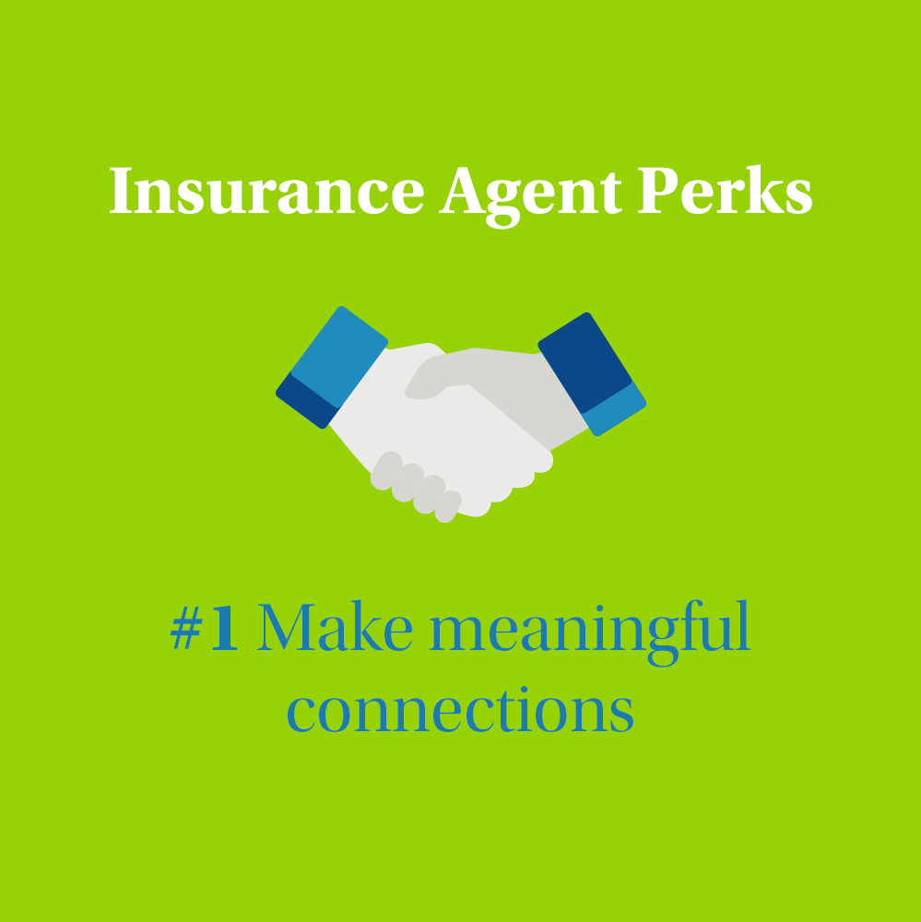
Post 1
Text on Visual:
Insurance Agent Perks
#1 Make meaningful connections
Caption:
As an insurance agent, you will meet a lot of people which will trust you to advise them towards what’s best for them. Some relationships outgrow their professional nature, and bloom into an honest, genuine friendship. I am looking for people who want to help others and enjoy working with people. If you appreciate human interaction, it might be the perfect opportunity for you. Send me a message and I will tell you more about the position at hand.
Facebook, LinkedIn.

Slide 4
Post 2
Text on Visual:
Insurance Agent Perks
#2 A clear & certain career path
Caption:
Unlike other lines of business, an insurance career guarantees growth and development. From the day you start your training with us, your career path will be laid out for you, with clear milestones. Effort does not go unnoticed, passion is celebrated and credit is given when its due. If you’re someone who places importance on career development, let’s talk. I am recruiting top talents who are looking for a chance to shine.
Facebook, LinkedIn.

Slide 5
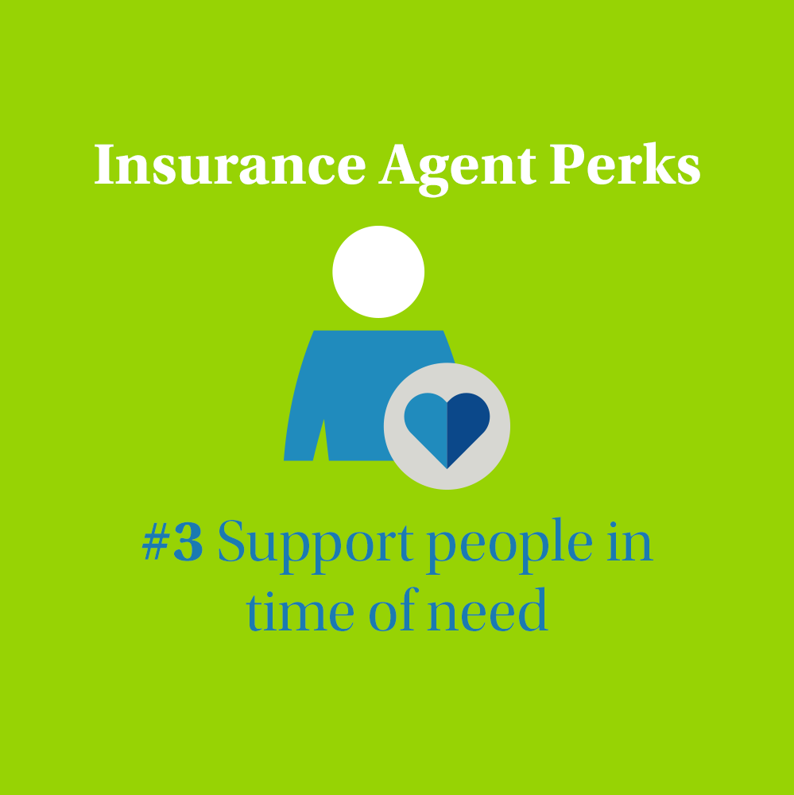
Post 3
Text on Visual:
Insurance Agent Perks
#3 Support people in time of need
Caption:
Each job has its own emotional return, and as hard as it might be, insurance’s emotional return is being the much needed, timely support for people in their time of need. Life insurance policies remind us of what’s important in life, family. If you value the real human impact that your work can have, let’s connect. I will tell you all about the many life changing experiences I’ve had along the way.
Facebook, LinkedIn.

Slide 6
Post 4
Text on Visual:
Insurance Agent Perks
#4 Work remotely with a flexible schedule
Caption:
If you’re someone who is active, dynamic and hates to sit at an office all day, this might be for you. I am recruiting top talents for my agency so contact me if you’re interested or send this to anyone you think would appreciate a flexible schedule.
Facebook, LinkedIn.

Slide 7
Post 5
Text on Visual:
Recruitment to my team is ongoing. Let’s talk!
Caption:
TBD
Hello, do you have great contact skills with people? Are self-confidence and entrepreneurship your strengths? At MetLife, we are looking for open-minded and empathetic people who know the realities of life. I am waiting for you! Do you want to learn more about the work of an insurance agent? Let’s connect.
Facebook, LinkedIn.

Slide 8
Post 6
Caption:
We’re all looking for more safety, it’s human nature. I am here to advise you to consider the best solution that insures more protection to every aspect of your life that you wish to have protected. The decision up to you and your needs.
Contact me and I will help you recognize your needs and choose the appropriate insurance.
Facebook, LinkedIn

Slide 9
Post 7
Caption:
We’re now hiring Life Insurance Agents to join our dynamic team at [Agency Name] with MetLife, who will be responsible for:
1. Creating a sales funnel, seeking out new clients and developing clientele by networking to find new customers and generate lists of prospects.
2. Scheduling calls and making a minimum of five personal sale meetings daily to keep a high profile in the market place.
3. Introducing MetLife through sales visits and demonstrating the services it can provide.
4. Be prepared to provide the prospect with the right consultancy that satisfy his/her needs.
5. Submitting a weekly activity report to the Unit Manager, along with the strategy plan for the coming weeks.
6. Implementing the sales solicitation technique and cultivating positive relationships with prospects.
7. Stay in touch with your customers to ensure a steady stream of repeat business.
8. Improving sales skills and standing out from the crowd
9. Assist and help the clients in resolving any insurance claims.
10. Having persistency, ambition, determination & positivity to achieve the personal SMART goals
This permanent position is well suited to an individual that is looking to advance their career in sales techniques, communication skills and personal development.
This exciting position offers opportunity to progress into a higher role.
Requirements:
- Education Level: Bachelor Degree
- Eager to learn
- Excellent interpersonal skills
- Experience working in a relevant field
Interested Candidates should apply by sending an email to XXX or message me on LinkedIn
Closing date for accepting applications is…
Facebook, LinkedIn.

Slide 10
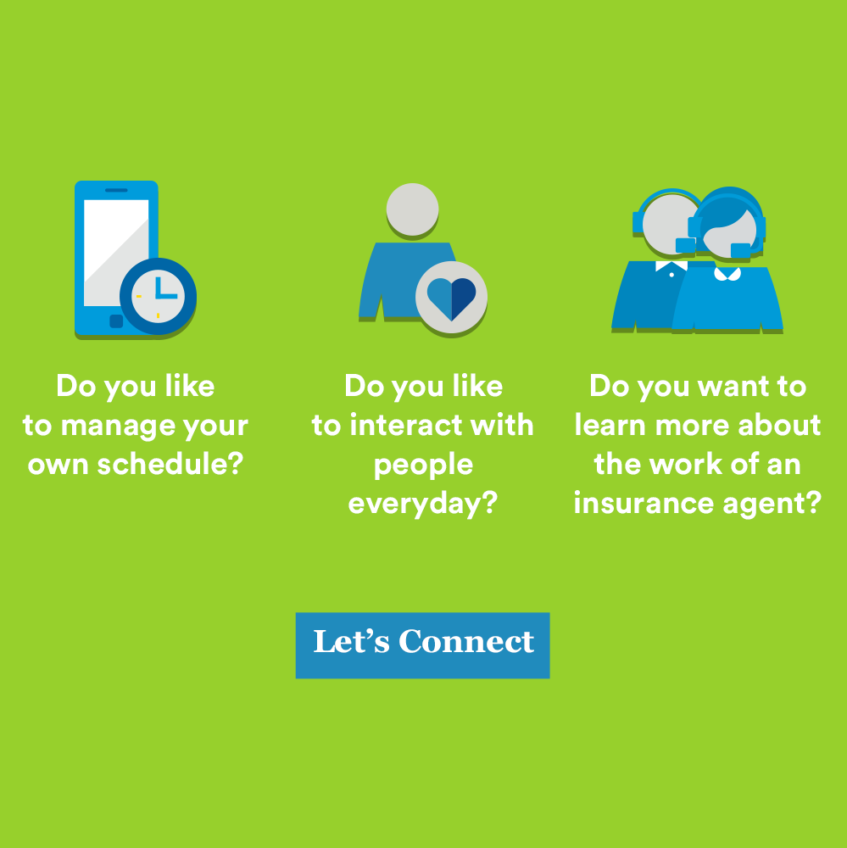
Post 8
Caption:
The situation for entrepreneurs is now uncertain - isn't this the right time to take matters into your own hands? If you meet these 3 criteria, then I am waiting for you:
✔ You manage your working time yourself
✔ You like to interact with people everyday
✔ You are confident; I need a person who can be relied upon by those who find themselves in a difficult situation.
Let’s connect, I have a very interesting opportunity for you.
Facebook, LinkedIn.

Slide 11
Post 9
Caption:
When I started working with MetLife, I didn't think my career with MetLife would develop like this. I started as an insurance agent, then as a Unit manager, and finally became an Agency Leader [If UM: I started as an insurance agent, and then as a Unit manager ]. Years of experience in this profession, as well as the observation of my colleagues from work, convinced me of one thing - the most important thing in this career is motivation and an open mind. Knowledge comes with time. The most successful people in our industry are people who can listen to others and are not looking for an office job between 9:00 and 17:00. Are you curious about the work of an insurance agent? Would you like to give it a shot? Let’s connect and I will answer all your questions.
Facebook, LinkedIn.

Slide 12
Post 10
Video
Caption:
This is not a sales pitch. Life, whether we like it or not, comes with its hassles. Think ahead of time and you will find yourself ahead, capable of managing the pressure that is yet to unfold. Go through the list and make a strategic financial decision the soonest rather than a late panic decision. DM me the word “ Life” if you decide to take a step towards protecting yourself from the unexpected
Facebook, LinkedIn.

Slide 13
Post 11
Add visual of your choice (if relevant)
Caption:
Choose a quote that portrays your positive mindset during these hard times. Post it and include below hashtags:
#Lebanon #Insurance #Motivation #Leadership
LinkedIn.

Slide 14
Thank You

