Slide 1
Fifth Calendar MetLife AL/UM

Slide 2
Post 1
Text on Visual:
Ask your questions!
Caption:
I would like to hear back from you if you have been following me and consuming my content. Do you have any questions about a career in life insurance? Message me with your questions!
Facebook, LinkedIn.

Slide 3
Post 2
Text on Visual:
“The purpose of life is not to be happy. It is to be useful, to be honorable, to be compassionate, to have it make some difference that you have lived and lived well.”
― Ralph Waldo Emerson
Caption:
A career in life insurance gives us a purpose. Couldn’t have said it better myself. Message me and let’s make a difference together!
Facebook, LinkedIn.

Slide 4
Post 3
Text on Visual:
Minimal Barriers to become an Agent We will guide you through your career journey.
Caption:
Insurance agents should go through different internal trainings and learnings followed by assessment exams before joining my team. However, previous experience in sales or insurance industry are not a requirement, as MetLife believes in supporting your growth; from technical training to leadership programs. We’ll guide you along and enable your all-round development to uncover your true potential.
Facebook, LinkedIn.

Slide 5
Post 4
Text on Visual:
Choose a career, not a job
Caption:
I’ve said it before and I will say it again, life insurance agents invest their time in a career not a job position. If you notice that you’re good at maintaining the relationships in your life and have an ease to communicate with people, message me and let’s discuss your opportunities in the insurance industry.
Facebook, LinkedIn.

Slide 6
Post 5
Text on Visual:
Open call to school professors.
Caption:
This is an open call to all school professors! The insurance industry can prove to be a perfect fit for you given your advanced interpersonal skills. Great insurance agents are great with people, they’re patient and they do their best to understand their counterpart. Message me and let’s discuss the opportunity that I can offer you.
Facebook, LinkedIn

Slide 7
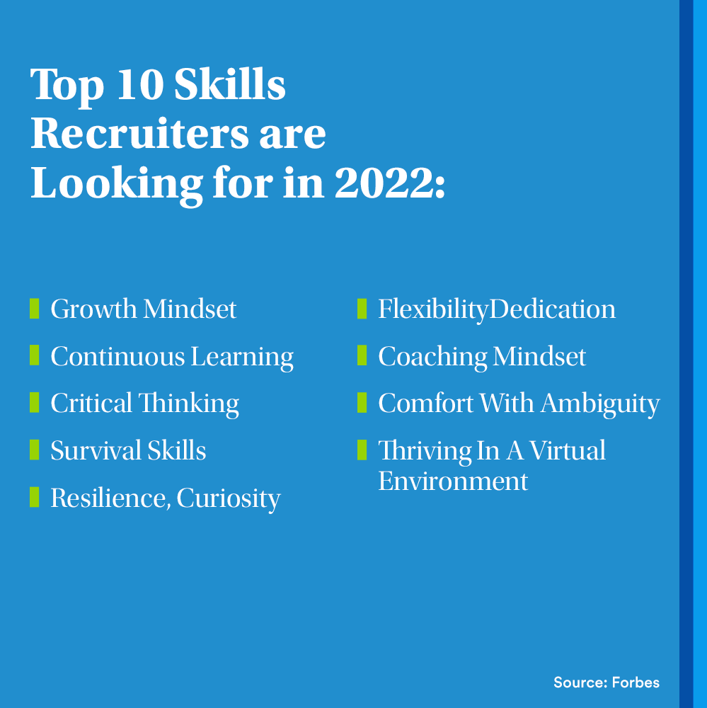
Post 6
Text on Visual:
Top 10 Skills Recruiters Are Looking For In 2021:
Growth Mindset
Continuous Learning
Critical Thinking
Survival Skills
Resilience, Curiosity
Flexibility
Dedication
Coaching Mindset
Comfort With Ambiguity
Thriving In A Virtual Environment
(Source: Forbes)
Caption:
Reposting this! Go through the list, and if you check more than four, we can work on the rest together! A career in life insurance is a lifetime journey, especially when it comes to the set of skills you will pick up while building up your experience. Message me and let’s discuss the opportunity I may have for you.
Facebook, LinkedIn

