Slide 1
MetLife Social Recruitment Calendar
February 2024

Slide 2
Post 1
Caption:
No finance background or experience needed, just passion, drive, and a desire to help others. We'll train you for success!
Submit your application via [link XXX] to be considered for the selection process.
#MetLifeLebanon #WeAreHiring #MetLifeAgent #Insurance #Career #JobSeekers
LinkedIn

Slide 3
Post 2
Caption:
Begin your journey towards success in 2024 by embracing 3 vital principles:
Intentionality: Set clear goals aligned with your vision, prioritize ruthlessly, and make every decision count.
Focus on what you can control: Don't waste energy on external factors, prioritize areas where you can make a difference, and identify key actions for maximum impact.
Embrace your strengths: Reflect on past successes, leverage your unique skills, and continuously refine your assets for professional growth.
Mention someone who needs to hear this.
#MetLifeLebanon #MetLife #MetLifeAgent #Success #Career
LinkedIn

Slide 4
Post 3
Caption:
Your work goes beyond the sale. You'll be helping people build financial security, protect their loved ones, and prepare for the future. That's a legacy worth building.
DM so we can discuss further on how to be part of our industry.
#MetLifeLebanon #WeAreHiring #MetLifeAgent #Insurance #Career #JobSeekers
LinkedIn

Slide 5
Post 4
Caption:
Embark on a career at MetLife where work feels like joy, not just a job. Become an agent and discover the perks of a fulfilling career. Mark Twain knew the secret—find joy in what you do!
Click the link below and take the first step towards your dream career in insurance!
(Insert link here)
#MetLifeLebanon #MetLife #MetLifeAgent #Insurance #CareerPath
LinkedIn

Slide 6
Post 5
Caption:
Ready to build something meaningful? Apply now and start:
Making a difference from day one.
Crafting your own success story.
Becoming an essential part of our team.
Apply now via [link XXX] and explore this exciting opportunity .
#MetLifeLebanon #WeAreHiring #MetLifeAgent #Insurance #Career #JobSeekers
LinkedIn

Slide 7
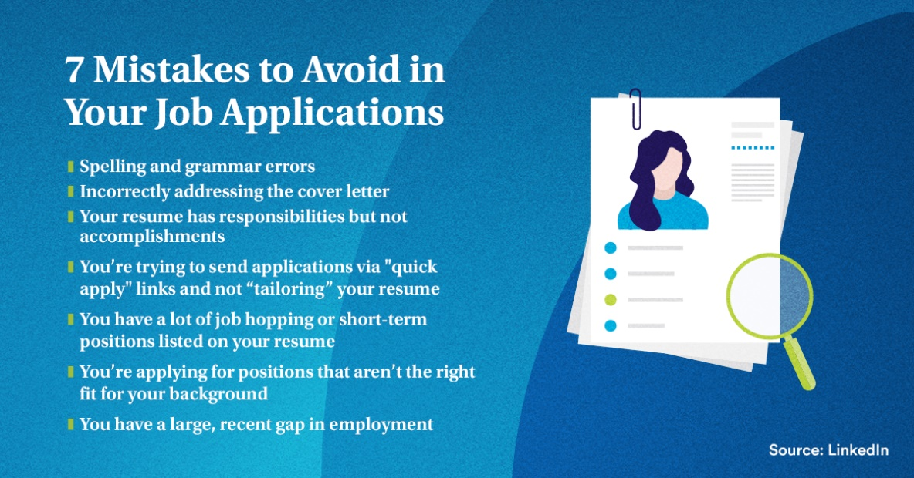
Post 6
Caption:
Level up your job hunt! Ditch these 7 application mistakes and make your candidacy explode. No typos, tailored resumes, skills not gaps - that's the recipe for career mastery.
#MetLifeLebanon #MetLifeAgent #insurance #InsuranceCareer #Resume #JobApplication
LinkedIn

Slide 8
Post 7
Caption:
As an agent, your potential for growth is as limitless as your drive. The future is yours to define.
Ready to dive into the exciting world of insurance! DM to learn about opportunities and how we can help you launch a successful career.
#MetLifeLebanon #MetLifeAgent #insurance #InsuranceCareer
LinkedIn

Slide 9
Post 8
LinkedIn Poll
Caption:
What would make you switch careers?
Lack of growth or challenge
Poor work-life balance
Toxic work environment
Better financial compensation
LinkedIn

Slide 10
Thank You

