Slide 1
March Calendar MetLife AL/UM
2022

Slide 2
Post 1
Text on Visual:
Work for the people
Do you have the needed skills?
Caption:
Many people underestimate insurance agents and their skills. If you can certainly translate perfectly, choose the language of the recipient, you are patient, you approach everyone individually and have the willingness to change people’s lives for the better; we value these people at MetLife! Interested? Write to me directly
Facebook, LinkedIn.

Slide 3
Post 2
Text on Visual:
“No one is useless in this world who lightens the burdens of another.”
- Charles Dickens
Caption:
It’s not all rainbows and butterflies, but it only takes one human moment for you to understand the value of our work.
Facebook, LinkedIn.

Slide 4
Post 3
Text on Visual:
Join our team of Insurance Agents with MetLife.
Caption:
We’re now looking for Life Insurance Agents to join our dynamic team at [Agency Name] with MetLife, who will be responsible for:
Introducing MetLife through visits and demonstrating the services it can provide
Providing intermediary services between the insurance company and clients and good customer service to maintain and retain clients
Meeting prospective clients to gather data about them and analyzing the client’s current portfolios and make recommendations based on their needs
Submitting a weekly activity report to the Unit Manager, along with the strategy plan for the coming weeks
Stay in touch with your customers to ensure a steady stream of repeat business
Having persistency, ambition, determination & positivity to achieve the personal SMART goals
Requirements:
Education Level: Bachelor Degree
Excellent communication skills
Display good analytical skills
Provide excellent customer service
Possess excellent interpersonal skills
We offer attractive remuneration packages and commission with career growth, learning and development for successful candidates.
Interested ? Apply by sending an email to XXX or message me on LinkedIn
Closing date for accepting applications is XXX
LinkedIn

Slide 5
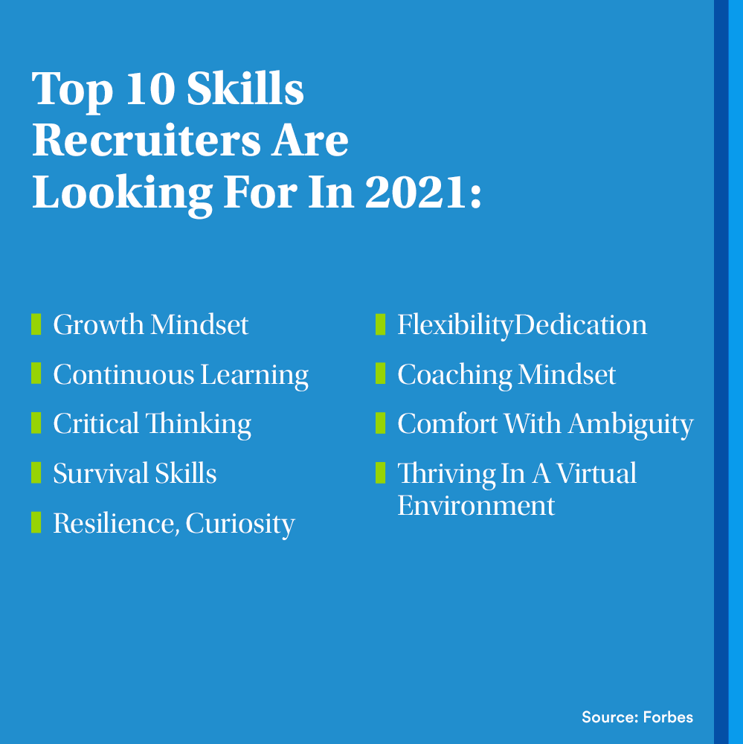
Post 4
Text on Visual:
Top 10 Skills Recruiters Are Looking For In 2021:
Growth Mindset
Continuous Learning
Critical Thinking
Survival Skills
Resilience, Curiosity
Flexibility
Dedication
Coaching Mindset
Comfort With Ambiguity
Thriving In A Virtual Environment
(Source: Forbes)
Caption:
Reposting this! Go through the list, and if you check more than four, we can work on the rest together! A career in life insurance is a lifetime journey, especially when it comes to the set of skills you will pick up while building up your experience. Message me and let’s discuss the opportunity I may have for you.
Facebook, LinkedIn

Slide 6
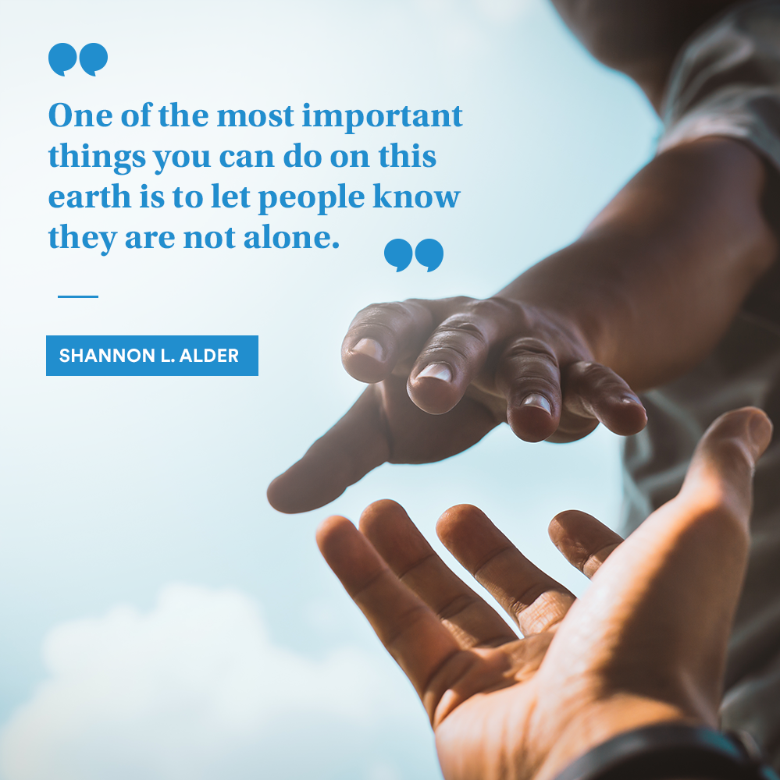
Post 5
Text on Visual:
“One of the most important things you can do on this earth is to let people know they are not alone.”
― Shannon L. Alder
Caption:
This quote made me reflect on our responsibility as life insurance experts. It’s exactly what each of your clients should feel when they interact with you. Our position allows us to be there for people when they need us most, so let’s make sure they know that we’re going to be well prepared to support them.
Facebook, LinkedIn.

