Slide 1
MetLife Calendar AL/UM
December 2022

Slide 2
Post 1
Text on Visual:
Embark on a lifetime of learning and professional development
Caption:
If you become an agent with MetLife, you'll make a commitment to the Company, but the Company will also make a commitment to you. With MetLife, you embark on a lifetime of learning and professional development through comprehensive training in insurance and protection services.
Write to me and I will tell you how to start working in my team with MetLife.
Facebook, LinkedIn.

Slide 3
Post 2
Text on Visual:
Are you looking for a job?
We’re hiring Insurance agents
Caption:
We are recruiting Insurance agents!
For those interested to join our dynamic team at [Agency Name] with MetLife, have an entrepreneurial mindset and fit the below criteria, please send us your resume to 123456789@metlifeagency.net
Education Level: Bachelor Degree
Excellent communication skills
Display good analytical skills
Provide excellent customer service
Possess excellent interpersonal skills
Highly motivated and Goal oriented
DM me to tell you more about the world of MetLife insurance agents!
Facebook, LinkedIn.

Slide 4
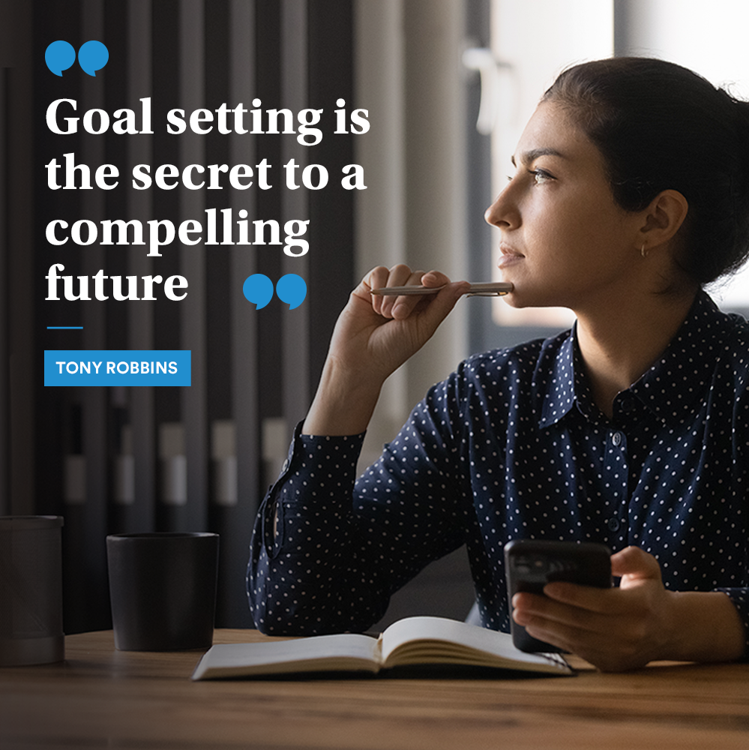
Post 3
Text on Visual:
“Goal setting is the secret to a compelling future.” — Tony Robbins
Caption:
Have you set your goals for 2023?
Share your 2023 goals with us in the comments section
Facebook, LinkedIn.

Slide 5
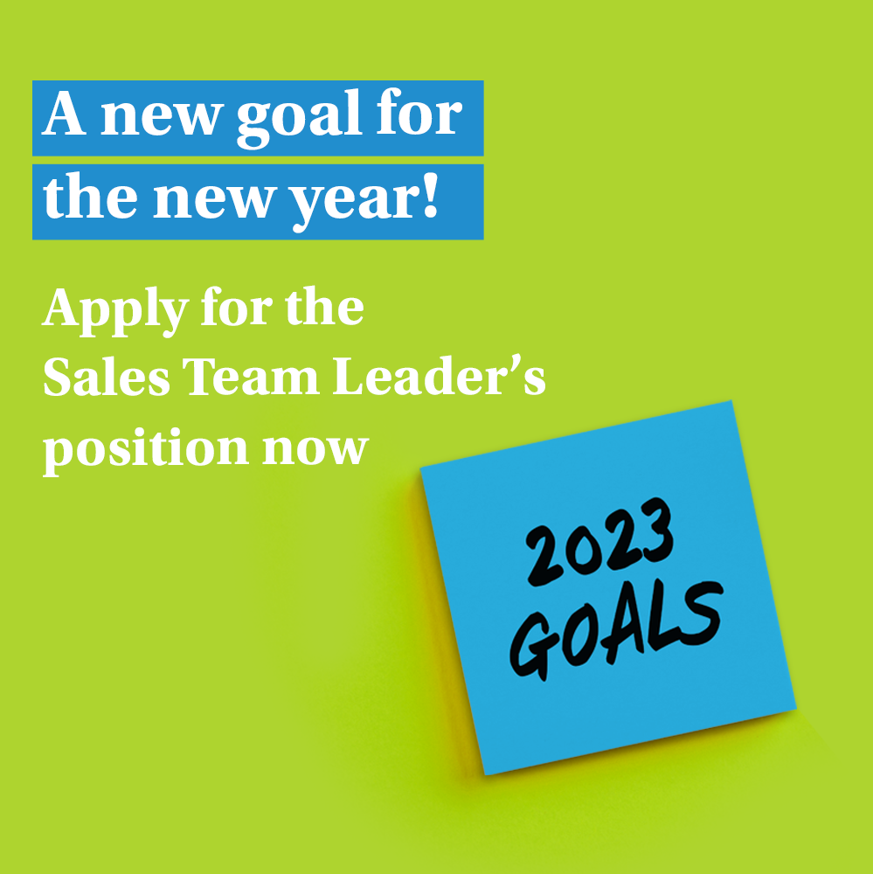
Post 4 (PAL)
Text on Visual:
A new goal for the new year!
Apply for the Sales Team Leader’s position now
Caption:
We’re now looking for Sales Team Leader to join our dynamic team at [Agency Name] with MetLife.
Key responsibilities:
Keep Informed of New Products and Services
Recruit, Train, and Coach the Sales Team
Set Sales Targets and Motivate Sales Team
Prepare Sales Reports
Requirements:
28-40 years old
University Graduates with Official Lebanese Baccalaureate
Minimum 5 years of experience in Sales
Minimum 2 years managerial experience
Highly motivated and Goal oriented
E-mail your CV to: XXXXX@metlifeagency.net to be considered for the selection process or message me on LinkedIn
Closing date for accepting applications is XXX
Facebook, LinkedIn.

Slide 6
Post 5
Caption:
May your heart and home be filled with all the joys the festive season brings. Merry Christmas!
#MerryChristmas #HolidaySeason #Christmas
Text on Visual:
Best wishes for a joyous Holiday filled with love, happiness and prosperity!
Facebook, LinkedIn.

Slide 7
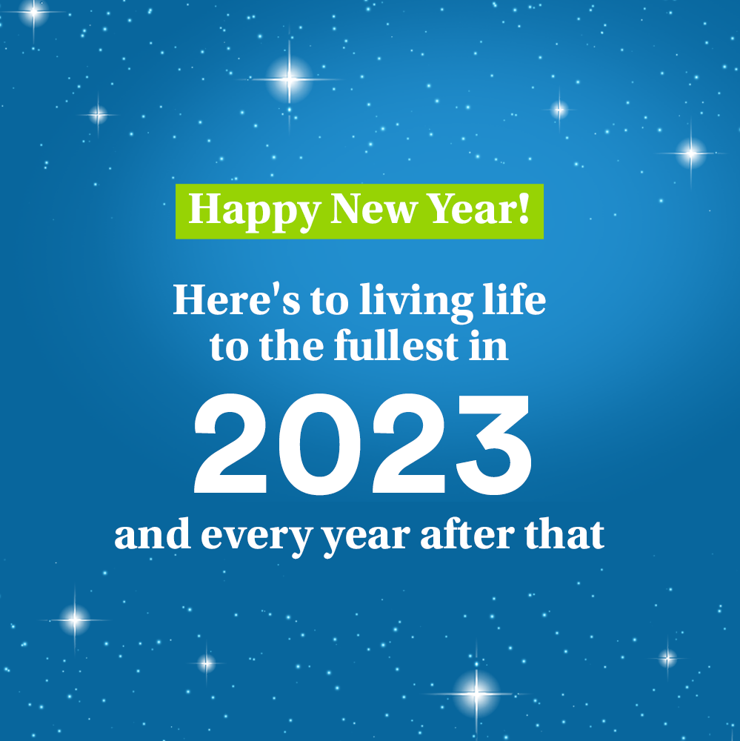
Post 6
Text on Visual:
Happy New Year! Here's to living life to the fullest in 2023... and every year after that
Caption:
May the New Year bring you and your loved ones, happiness, peace, and prosperity. Wishing you a joyous 2023!
#HappyNewYear #NewYear2023 #HolidaySeason
Facebook, LinkedIn.

Slide 8
Thank You

