Slide 1
MetLife Calendar AL/UM
August, 2022
© Born Interactive, Proprietary and Confidential

Slide 2
Post 1
Caption:
Do you feel like your mission in life is to help others? As a MetLife Insurance Agent can dedicate their life to improving others!
What are you waiting for? DM me to tell you more about the world of MetLife insurance agents!

Slide 3
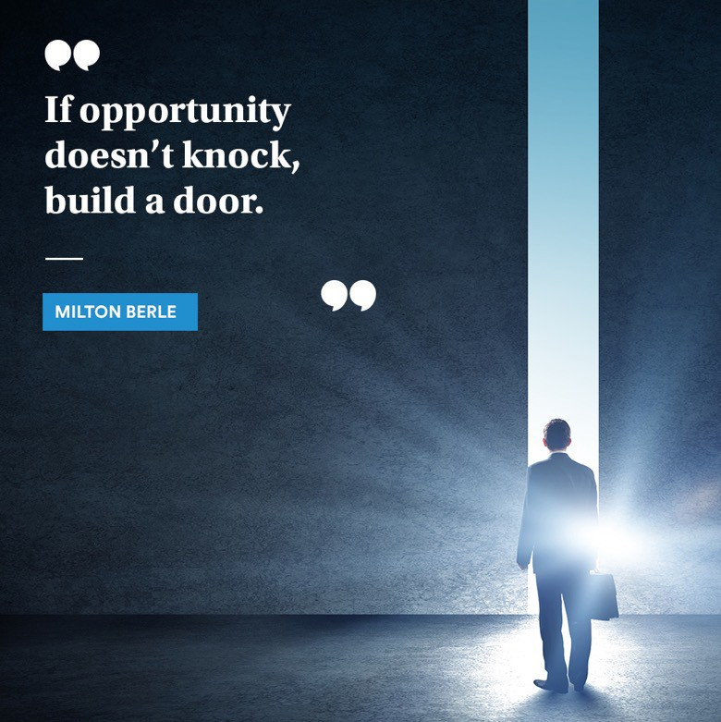
Post 2
Caption:
Lots of opportunities come knocking if we are receptive. The trick is to recognize them. Then you have to decide whether or not to open the door.
Create your own opportunity now, join MetLife, and become an insurance agent.
For more information, contact me.

Slide 4
Post 3
Caption:
Growing in the profession of choice is essential. Learn how, at MetLife, we value our Insurance Agents and give them the opportunities they deserve.
DM me to find out more!

Slide 5
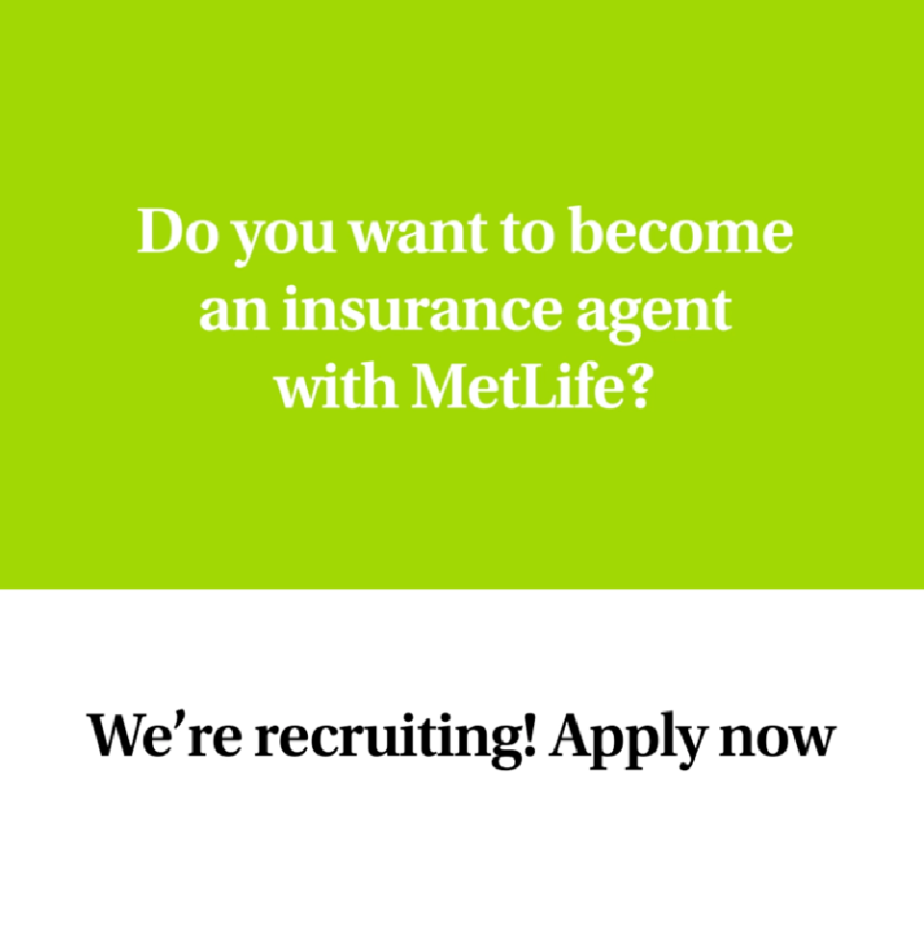
Post 4 (a video)
Caption:
We’re recruiting Insurance agents!
We’re looking for all the skills/traits mentioned. We are also looking for drive, ambition and purpose! Are you ready to become an agent with MetLife?
We offer attractive remuneration packages and commission with career growth, learning and development for successful candidates.
Interested ? Apply by sending an email to 123456789@metlifeagency.net or message me.

Slide 6
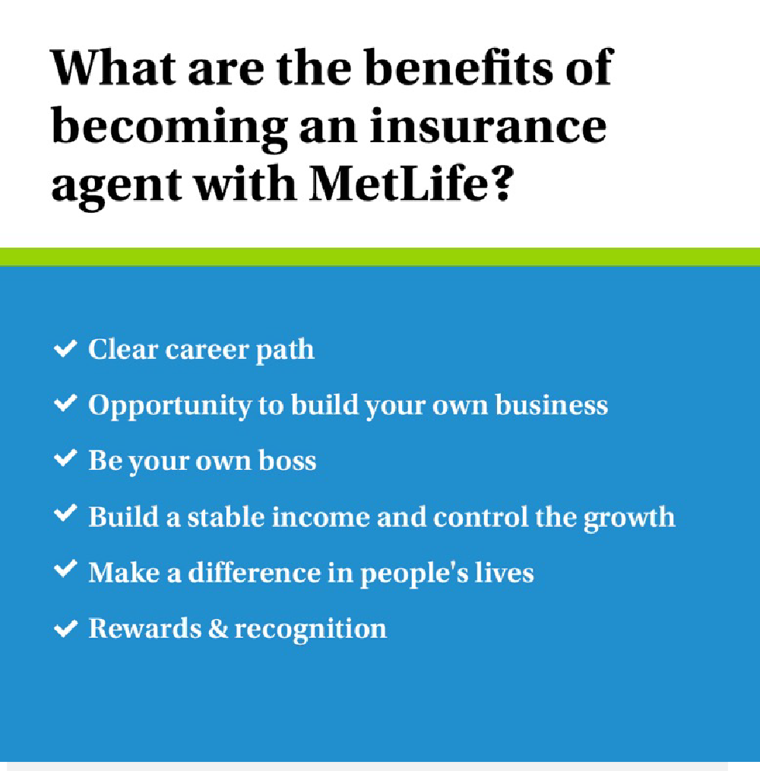
Post 5
Caption:
The insurance industry has a lot of possibilities. Insurance agents serve as the ultimate link between the insurance business and the individual investor. As an agent for MetLife, you may reap several financial, social, and personal rewards.
Do you want to be a part of that? Send us a message so we can talk about it.

Slide 7
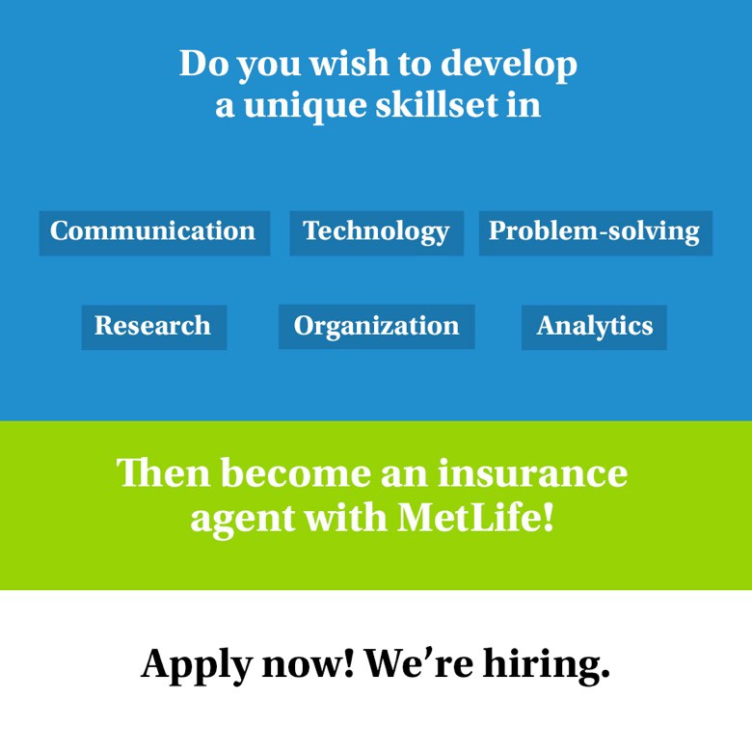
Post 6
Caption:
The position of an insurance agent includes many fields and offers various learning curves. The good news is that we’re hiring insurance agents!
Join our dynamic team at [Agency Name] with MetLife, please send us your resume to 123456789@metlifeagency.net

Slide 8
Thank You
© Born Interactive, Proprietary and Confidential

