Slide 1
MetLife Calendar AL/UM
April, 2022

Slide 2
Post 1 - Okay
Text on Visual:
Give back to your community when you become an agent with MetLife!
Caption:
Job seekers today are looking for something that doesn’t only provide a paycheck, but also a purpose - a chance to give back.
An insurance career can help satisfy this desire for meaningful work and community involvement. At its roots, the insurance industry is about protecting members of a community.
Would you like to take part in that? Send me a message so we can discuss
Facebook, LinkedIn.

Slide 3
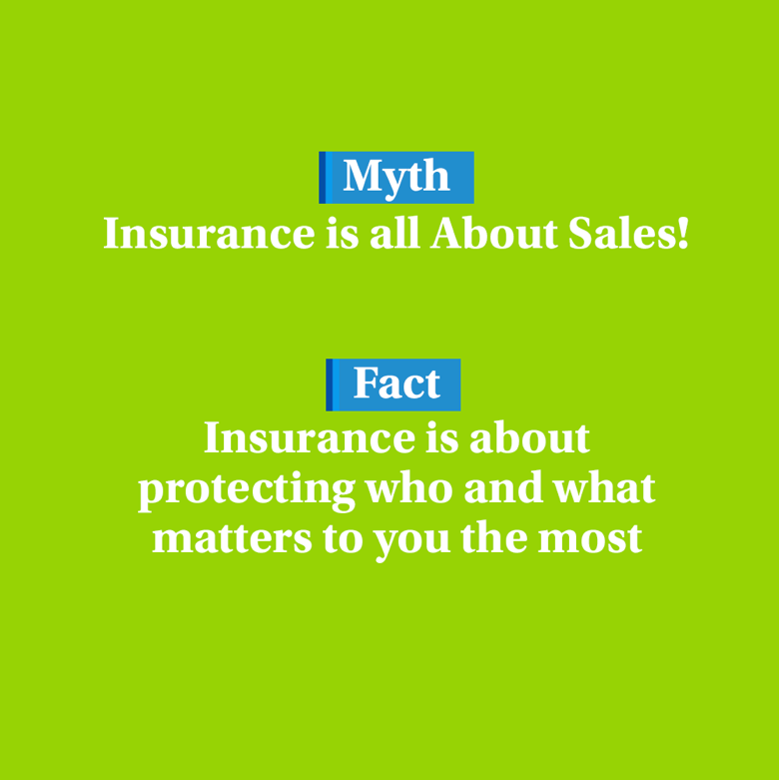
Post 2 - okay
Text on Visual:
Myth: Insurance is all About Sales!
Fact: Insurance is about protecting who and what matters to you the most
Caption:
Becoming an insurance agent is not another sales job; it’s an opportunity designed to help people protect who and what matters to them the most. It is a fulfilling and rewarding job because you will be helping individuals and families within your community protect their livelihoods and futures.
Let us get in touch and talk about it.
Facebook, LinkedIn.

Slide 4
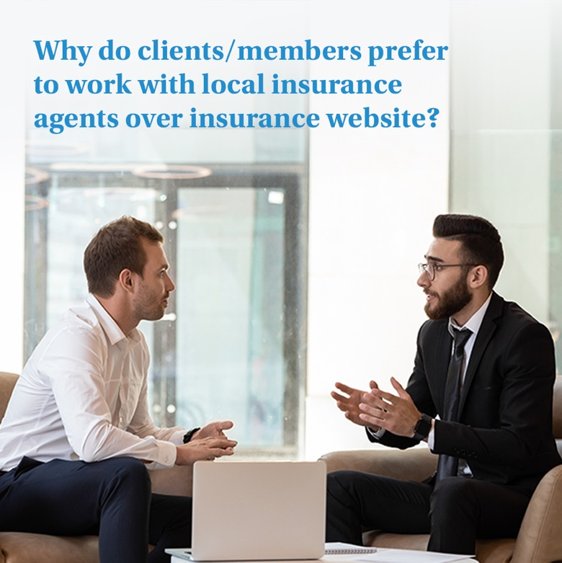
Post 3- okay
Text on Visual:
Why do clients/members prefer to work with local insurance agents over insurance website?
Caption:
Some people may believe it’s easier to buy insurance and compare quotes online, but not everyone. The reason so many of our clients/members prefer to work with us over insurance websites is because we have the ability to customize insurance packages and offer a level of service that simply isn’t possible online.
Would you like to know more about working at MetLife’s agency, [Name of Agency]? Send me a message!
Facebook, LinkedIn.

Slide 5
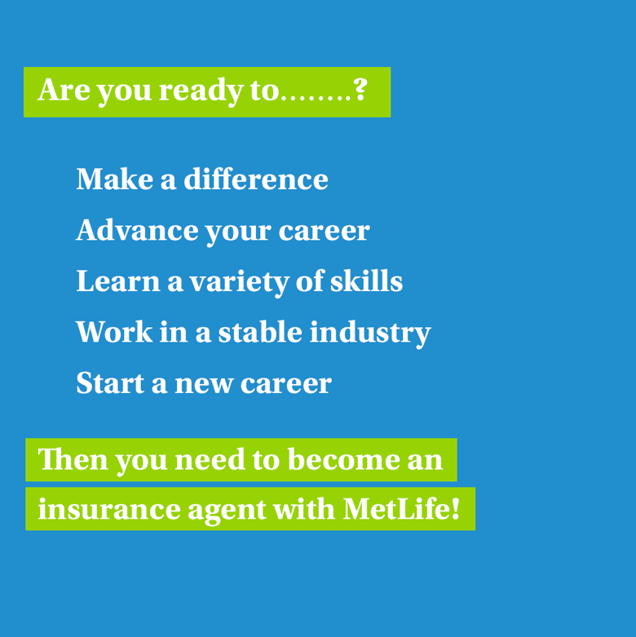
Post 4
Text on Visual:
Are you ready to……..?
Make a difference
Advance your career
Learn a variety of skills
Work in a stable industry
Start a new career
Then you need to become an insurance agent with MetLife!.
Caption:
Why work in insurance? Insurance is an essential, diverse industry that affects almost everyone. From businesses that need group life and medical plans to individuals who simply want Life Insurance or accident and health insurance, there are few people who don’t have insurance coverage of one type or another.
DM so we can discuss further on how to be part of our industry.
Facebook, LinkedIn.

Slide 6
Post 5 - okay
Caption:
Are you someone who is interested in running your own business? A leader and an individual who wants to make a difference in the lives of people in their community? If you are and you are ready for a transition from your past job to a new one as a MetLife insurance agent, we’d love to talk to you.
Text on Visual:
It’s never too late to start a new profession in insurance!
Facebook, LinkedIn.

Slide 7
Post 6
Text on Visual:
Meet new people and help them achieve their financial goals!
Caption:
If the monotony of doing the same work over and over is unappealing, a career in insurance sales is definitely a good option for you. We usually love the variety of work insurance sales provides. There are some tasks that need to be done on a regular basis, but for the most part, we are constantly meeting new people and helping them achieve their financial goals.
Contact me to know more. 📩
Facebook, LinkedIn.

